Slide 1
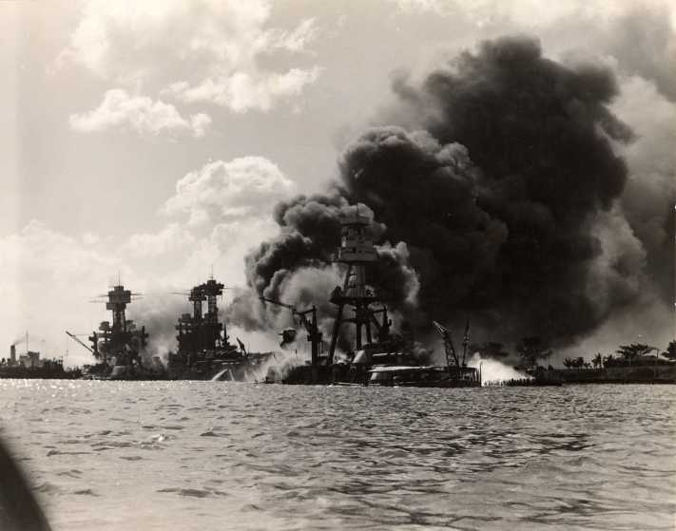
REMEMBER PEARL HARBOR! “A DATE WHICH SHALL LIVE IN INFAMY” 12/7/41
OBJ: To understand how America rallied for war by looking at government direction of the economy.

Slide 2
“TO AMERICAN PRODUCTION WITHOUT WHICH THE WAR WOULD HAVE BEEN LOST” STALIN A CALL TO ARMS – AMERICA READIES FOR WAR
JOINT CHIEFS & OSS CREATED
1940 1ST PEACETIME DRAFT-PARTIALLY PREPARED FOR WAR
WAR PRODUCTION BOARD: WAR MANPOWER COMMISSION, NATIONAL WORKERS LABOR BOARD & OFFICE OF PRICE ADMINISTRATION (OPA)
MIRACLE OF WAR PRODUCTION: SYNTHETIC RUBBER
“WIZARD WAR” SCIENTIFIC & TECHNOLOGICAL ADVANCES: 1ST COMPUTERS, MASH UNITS, BLOOD PLASMA, INSTANT FOOD, RADAR/SONAR, ANTIBIOTICS, VACCINES ETC.
MANHATTAN PROJECT LATE 1941 FROM CAMBRIDGE TO ALAMOGORDO

Slide 3
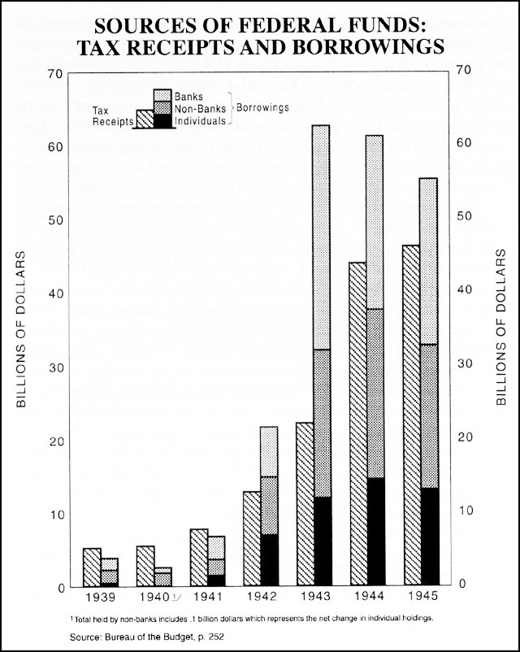
ECONOMIC GROWTH
LATE ‘42 WARTIME PRODUCTION 1/3 OF ECONOMY = OUTPUT OF GERMANY, ITALY & JAPAN COMBINED
BUSINESS COOPERATION & IN RETURN *TAX WRITE OFFS, *SUSPENSION OF ANTI-TRUST PROSECUTIONS,
2/3 GOV’T SPENDING TO 100 LGEST CO’S
COSTS : INCREASED BUDGET, SPEND 10X MORE THAN WWI
DEF. SPENDING 9-46% OF GNP
ALLIANCE BETWEEN GOVERNMENT & DEFENSE (MILITARY INDUSTRIAL COMPLEX)
SIGNIFICANT SHIFT IN DIST. OF INCOME
CURBED INFLATION, RATIONS IN PLACE, VICTORY GARDENS “USE IT UP WEAR IT OUT, MAKE IT DO OR DO WITHOUT”,
WAR BONDS, TAXES & PAYROLL TAXES ‘43 INCREASED REVENUE

Slide 4
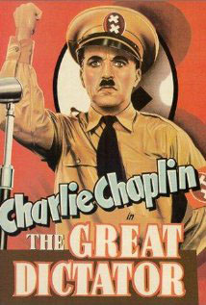
PROPAGANDA & PUBLIC OPINION: FANNING THE FLAMES OF PATRIOTISM
OFFICE OF CENSORSHIP
OFFICE OF WAR SHAPE INFO
PUBLIC OPINION: WITHHOLD & DIVULGE INFO. WHEN ‘NECESSARY’
HOLLYWOOD
MAINTAIN UNITY & SUPPORT
MAIL SUBJECT TO REVIEW
WHEN COMPLACENCY DESCENDED BRUTAL IMAGES RELEASED

Slide 5
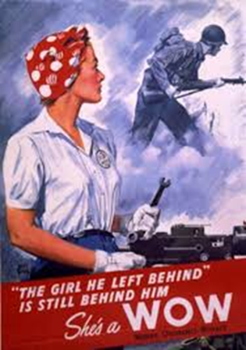
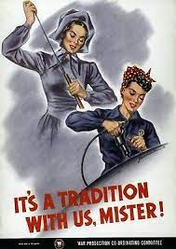
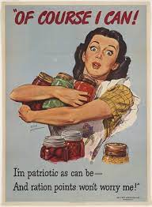
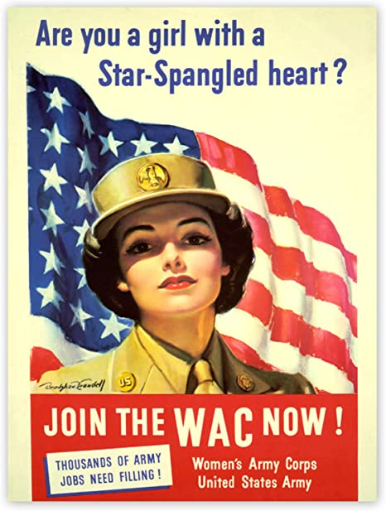

Slide 6
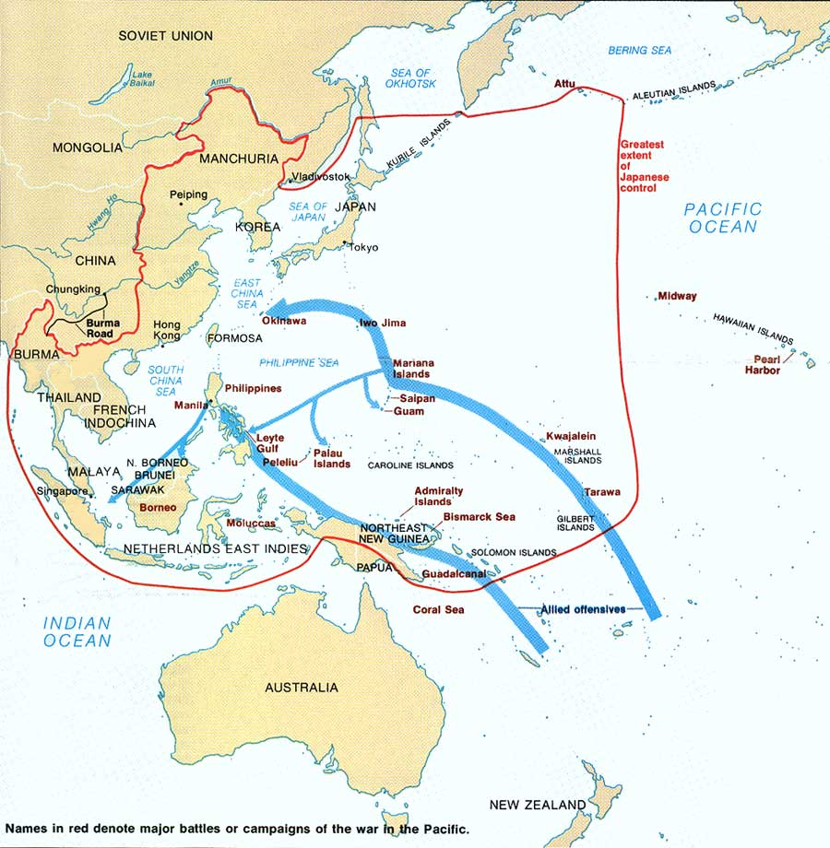
PACIFIC
THEATER

Slide 7
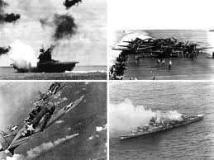
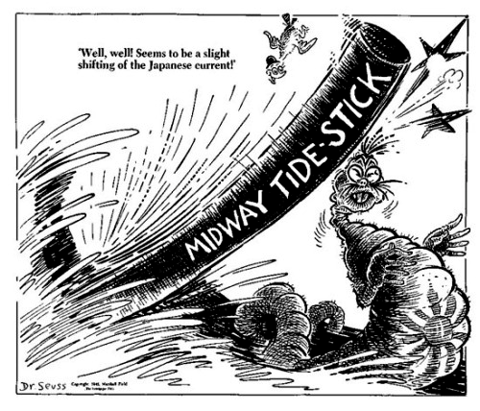
NIMITZ & MacARTHUR 2 PRONGED APPROACH
CORAL SEA MAY ‘42: 1ST BATTLE FOUGHT BY AIRCRAFT, SAVE AUSTRALIA
MIDWAY JUNE ‘42: 1ST DEFEAT OF MODERN JAPANESE NAVY
GUADALCANAL AUGUST ‘42: USE OF DDT, 5 SULLIVANS ON USS JUNEAU

Slide 8
EUROPEAN THEATER 1942-44
*GERMANY DOMINATED
*INVADED RUSSIA
*STALINGRAD 8/42-1/43
*DEMANDED 2ND FRONT (COD WAR)
*HITLER THE THREAT – EUROPE 1ST AGREED UPON AT CASABLANCA JANUARY 1943 CHURCHILL & FDR
*NORTH AFRICA 11/42-MAY 43
ROMMEL, MONTGOMERY & IKE & GERMANS OUT BY MAY 1943
*COLOGNE ‘42, HAMBURG ‘43, DRESDEN ’45
WARTIME MEETINGS:
*CAIRO 11/43: GB, US, CHINA
OUTLINE STRATEGY FOR JAPAN
*TEHRAN 12/43: STALIN, FDR & CHURCHILL – SET DATE FOR D-DAY

Slide 9
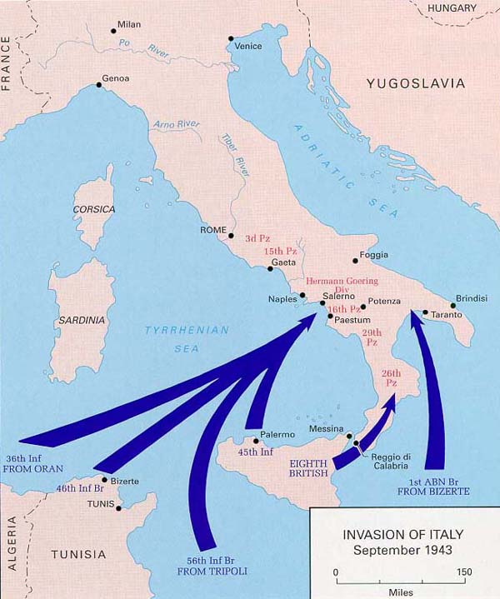
THE SOFT UNDERBELLY & CONTROL OF EUROPE 1943-1945
BATTLE FOR THE ATLANTIC: SOPHISTICATED RADAR & SONAR
RUSSIANS FEND OFF GERMANS: BATTLE NEAR KURSK & SOVIETS PUSHED WEST
ALLIES AGREED ON JUNE 4, 1944 TO OPEN 2ND FRONT
D- DAY: 200K ALLIED TROOPS ON SHORES OF NORMANDY
BATTLE OF THE BULGE (ARDENNES FOREST) DECEMBER ‘44 – 1/1945 GERMANS ULTIMATELY DEPLETED

Slide 10
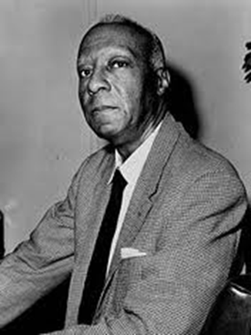
FIGHTING THE WAR AT HOME – NO ORDINARY TIME
AMERICAN SOCIETY CHANGED FOREVER
WOMEN AT HOME “ROSIE & ROSITA THE RIVETER”
WORKFORCE 75% MARRIED
33% W/ KIDS UNDER 13
A.P. RANDOLPH
CORE 1942 – DESEGREGATE PUBLIC FACILITIES IN THE NORTH
“THUNDERING MARCH” & FEDERAL EMPLOYMENT PRACTICES COMMISSION (FEPC)
RACE RIOTS 1943: LA, AL, TX, MI, NY,
NO FIRESIDE CHAT ON RACE

Slide 11
WOMEN ABROAD: 400,000 JOINED FORCES: WAVES, WACS, & WASPS
1ST GRADUATING CLASS –WAVES – 80,000 TOTAL
AFRICAN AMERICAN – WACS 65,000

Slide 12
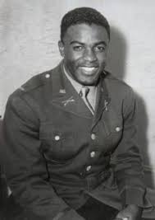
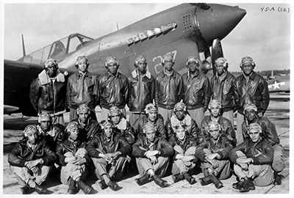
AFRICAN AMERICANS IN THE MIILITARY
“I USED TO SING THE GOSPEL, NOW I ONLY SING THE BLUES” B.B. KING
ARMED SERVICES SEGREGATED
DE FACTO JIM CROW ON BASE
NON-COMBATANTS INITIALLY

Slide 13
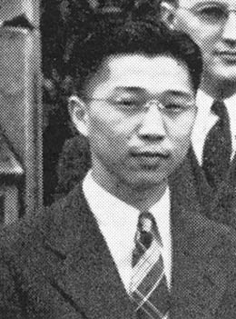
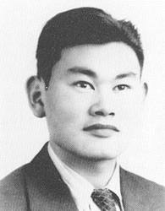
RAMPANT RACISM ELSEWHERE
350,000 MEXICAN AMERICANS SERVED
PROMISES MADE & PROMISES BROKEN
BRACEROS PROGRAM
OTHER MEXICAN AMERICANS MOVE OUT OF AGRICULTURE INTO INDUSTRY
ZOOT SUIT RIOTS 1943
HOMOSEXUALS LEGALLY BANNED FROM SERVICE BUT MANY SERVED
VETERAN’S BENEVOLENT ASSOCIATION
JAPANESE INTERNMENT E.O. 9066 2/19/42
CULMINATION OF 40+ YEARS OF XENO-PHOBIA, $2 BILL IN LOSSES
HIRABAYASHI V US ‘43 & KOREMATSU V US ’44
UPHOLD 9066 CURFEW, EXCLUSION & INTERN.
1988 R. REAGAN “PERSONAL JUSTICE DENIED”
1998 W.J. CLINTON GAVE KOREMATSU MEDAL OF FREEDOM

Slide 14
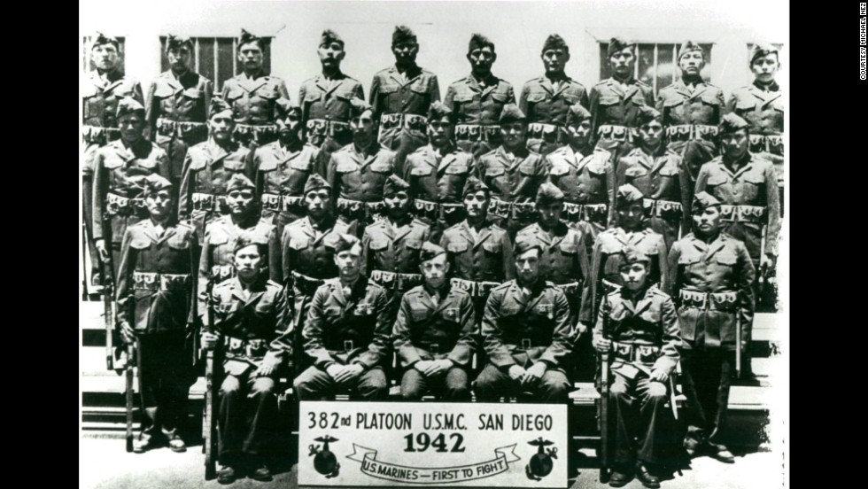
NATIVE AMERICANS & JAPANESE SOLDIERS
NATIVE AMERICANS – IRA HAYES & BATTLE OF IWO JIMA
29 ORIGINAL NAVAJO CODE TALKERS
1943 PROHIBITION AGAINST ENLISTMENT LIFTED
20,000+ FOUGHT FOR US
100TH INFANTRY “PURPLE HEART BATTALION”
OVER 6,000 SERVED IN MILITARY INTELLIGENCE
300 INTERNEES REFUSED TO BE DRAFTED, CONVICTED, PRISON & PARDONED 1947
ARMED FORCES DESEGREGATED

Slide 15
TRIUMPH & TRAGEDY – HOW DOES DIPLOMACY & MILITARY MIGHT HELP END WWII

Slide 16
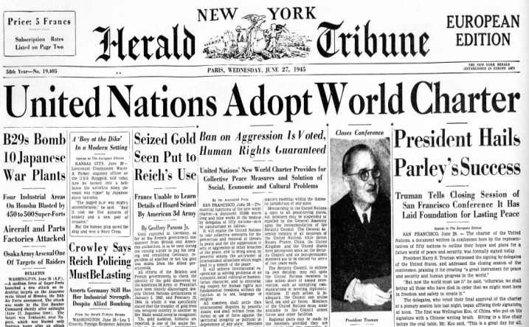
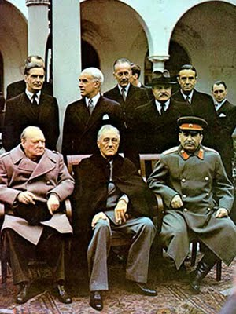
THE LAST MEETING OF THE BIG 3
FDR SICK
THE NEW MISSOURI COMPROMISE: HST
DEWEY: REPUBLICAN
NARROWEST POPULAR VOTE MARGIN SINCE 1916
US NEEDS RUSSIANS
YALTA ‘45 & DEMANDS
*KOREA & MANCHURIA
*SPHERE OF INFLUENCE IN EE & FREE ELECTIONS
*DIVISION OF GERMANY
*DATE FOR INTER-NATIONAL CONFERENCE IN S.F. 4/45
*WILL JOIN AGAINST JAPAN

Slide 17
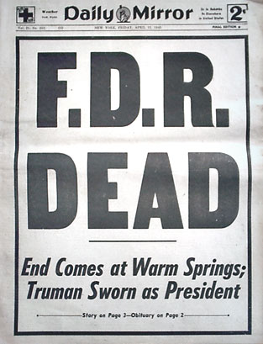
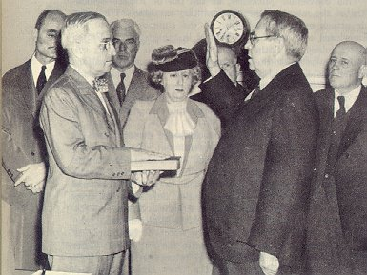
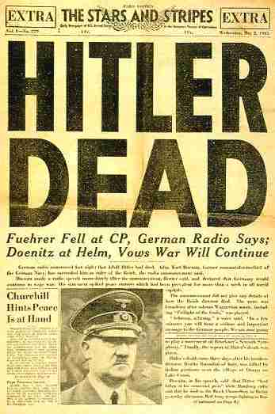
VICTORY OVER EUROPE MAY 7, 1945
GB & US MEET RUSSIANS AT ELBE
FDR DIED
HARRY S. TRUMAN PRESIDENT
CRAM SESSION ON MANHATTAN PROJECT
BIG SHOES TO FILL, LACKS SELF-CONFIDENCE, PRESSURE TO ‘GET THE JOB DONE’
APRIL 30 HITLER DEAD– SURRENDER 1 WEEK LATER
HST TOUGH STANCE ON FREE ELECTIONS WHICH HARDENED STALIN & NO FOLLOW THROUGH ON YALTA

Slide 18
“FOR MOST OF IT (WHAT I SAW & HEARD) I HAVE NO WORDS” E. R. MURROW

Slide 19
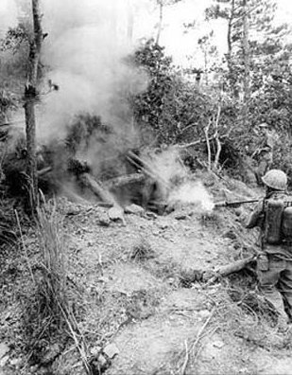
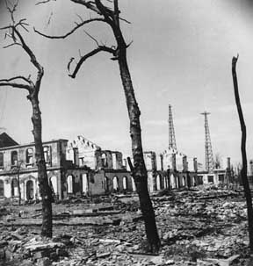
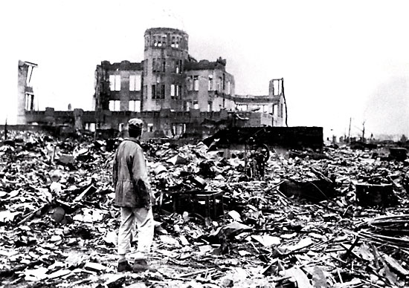
“A HELL OF UNSPEAKABLE TORMENTS”
“A WAR WITHOUT MERCY” GI’S WAR
IWO JIMA “THE MEAT GRINDER” IRA HAYES
BOMBING TOKYO – 16 SQ. MILES
OKINAWA 6/45 35 % CASUALTY RATE
A-BOMB TESTED JULY 1945
HIROSHIMA & NAGASAKI AUGUST ‘45
UNCONDITIONAL SURRENDER
TO DROP OR NOT TO DROP?

Slide 20
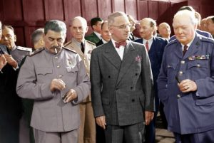
POTSDAM
CLARIFY AND IMPLEMENT YALTA
DIVISION OF GERMANY
NEW DEMOCRATIC GOVERNMENT IN GERMANY
PURGE ALL ASPECTS OF AUTHORITARIAN RULE FROM GOVERNMENT
BORDERS WITH RUSSIA QUESTIONABLE

