Slide 1
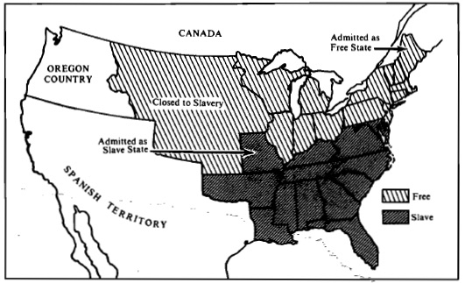
1. The map above show the US immediately following the
A. passage of the Northwest Ordinance
B. negotiation of the Adams-Onis Treaty
C. Passage of the Missouri Compromise
D. Settlement of the Mexican American War

Slide 2
2. The U.S. House of Representatives responded to abolitionist agitation in the 1830’s by
A. approving appropriations to help finance colonization efforts
B. prohibiting the slave trade in the District of Columbia
C. limiting the publication of abolitionist writings to certain publishers
D. banning discussion of antislavery petitions
3. Andrew Jackson supported all of the following EXCEPT
A. Indian removal B. the right of nullification
C. removal of federal deposits from the Bank of the U.S.
D. annexation of new territory E. use of presidential veto power

Slide 3
“The creation of a home market is not only necessary to procure for our agriculture a just reward of its labors, but it is indispensable to obtain a supply of our necessary wants. . . . Suppose no actual abandonment of farming, but, what is most likely, a gradual and imperceptible employment of population in the business of manufacturing, instead of being compelled to resort to agriculture. . . . Is any part of our common country likely to be injured by a transfer of the theatre of [manufacturing] for our own consumption from Europe to America?
“. . . Suppose it were even true that Great Britain had abolished all restrictions upon trade, and allowed the freest introduction of the [products] of foreign labor, would that prove it unwise for us to adopt the protecting system? The object of protection is the establishment and perfection of the [manufacturing] arts. In England it, has accomplished its purpose, fulfilled its end. . . . The adoption of the restrictive system, on the part of the United States, by excluding the [products] of foreign labor, would extend the [purchasing] of American [products], unable, in the infancy and unprotected state of the arts, to sustain a competition with foreign fabrics. Let our arts breathe under the shade of protection; let them be perfected as they are in England, and [then] we shall be ready . . . to put aside protection, and enter upon the freest exchanges.”
Henry Clay, speaker of the House of Representatives, speech in Congress, 1824
4, The excerpt could best be used by historians studying which of the following in the early 1800’s?
A. the political debates over economic development
B the lives of women working in new factories
C. the effects of new technologies on commerce
D. the value of British-manufactured imports

Slide 4
5. Which of the following was an interpretation of the speech by opponents of the goals Clay expressed in the excerpt? A. Clay was seeking to discourage factory production to protect traditional artisans B. Clay’s proposal would require the expansion of slavery to supply factory workers C. Clay’s manufacturing plan would benefit 1 section of the country more than others D. Clay was seeking to encourage an increase in imports of British manufactured goods 6. Which of the following describes an interpretation of Clay’s economic principles at the time as expressed in the excerpt? A. the sections of the U.S. should retain separate regional economies B. the farmers of the US should switch to manufacturing jobs C. the US should increase domestic manufacturing to promote prosperity D. THE US should never engage in foreign commerce
“The creation of a home market is not only necessary to procure for our agriculture a just reward of its labors, but it is indispensable to obtain a supply of our necessary wants. . . . Suppose no actual abandonment of farming, but, what is most likely, a gradual and imperceptible employment of population in the business of manufacturing, instead of being compelled to resort to agriculture. . . . Is any part of our common country likely to be injured by a transfer of the theatre of [manufacturing] for our own consumption from Europe to America? “. . . Suppose it were even true that Great Britain had abolished all restrictions upon trade, and allowed the freest introduction of the [products] of foreign labor, would that prove it unwise for us to adopt the protecting system? The object of protection is the establishment and perfection of the [manufacturing] arts. In England it, has accomplished its purpose, fulfilled its end. . . . The adoption of the restrictive system, on the part of the United States, by excluding the [products] of foreign labor, would extend the [purchasing] of American [products], unable, in the infancy and unprotected state of the arts, to sustain a competition with foreign fabrics. Let our arts breathe under the shade of protection; let them be perfected as they are in England, and [then] we shall be ready . . . to put aside protection, and enter upon the freest exchanges.” Henry Clay, speaker of the House of Representatives, speech in Congress, 1824

Slide 5
7. Daniel Webster’s address to the Senate in 1830 in reply to Senator Hayne is best remembered for its A. attack on the Tariff of Abominations B. defense of the principle of national union C. assertion of the idea of States’ rights D. Apology for New England’s disloyalty in the War of 1812 E. praise for President A. Jackson
8. The Embargo Act of 1807 had which of the following effects on the U.S.?
A. it severely damaged American manufacturing
B it enriched many cotton plantation owners
C. it disrupted American shipping
D it was ruinous to subsistence farmers
E. it had little economic impact

Slide 6
“Let us, then, fellow-citizens, unite with one heart and one mind. Let us restore to social intercourse that harmony and affection without which liberty and even life itself are but dreary things. And let us reflect that, having banished from our land that religious intolerance under which mankind so long bled and suffered, we have yet gained little if we countenance a political intolerance as despotic, as wicked, and capable of as bitter and bloody persecutions. . . . We have called by different names brethren of the same principle. We are all Republicans, we are all Federalists. If there be any among us who would wish to dissolve this Union or to change its republican form, let them stand undisturbed as monuments of the safety with which error of opinion may be tolerated where reason is left free to combat it.” Thomas Jefferson, first inaugural address, 1801
9. The excerpt best reflects which of the following?
A. conflicts over how the Constitution should be implemented & interpreted
B. fear that the US would be overtaken by a foreign power
C. disagreement over the consequences of the French Revolution for the US
D. Secessionist pressures coming from slaveholders in the South

Slide 7
10. The most unpopular & least successful of President Jefferson’s policies was his A. advocacy of territorial expansion B. handling of Barbary Coast pirates C. reduction of the size of the military D. adherence to neutrality in dealing with England & France
11. The Kentucky & Virginia resolutions, the Hartford Convention, and the South Carolina Exposition & Protest were similar in that all involved a defense of
A. freedom of the seas B. freedom of speech
C. institution of slavery D. states’ rights E. presidential power

Slide 8
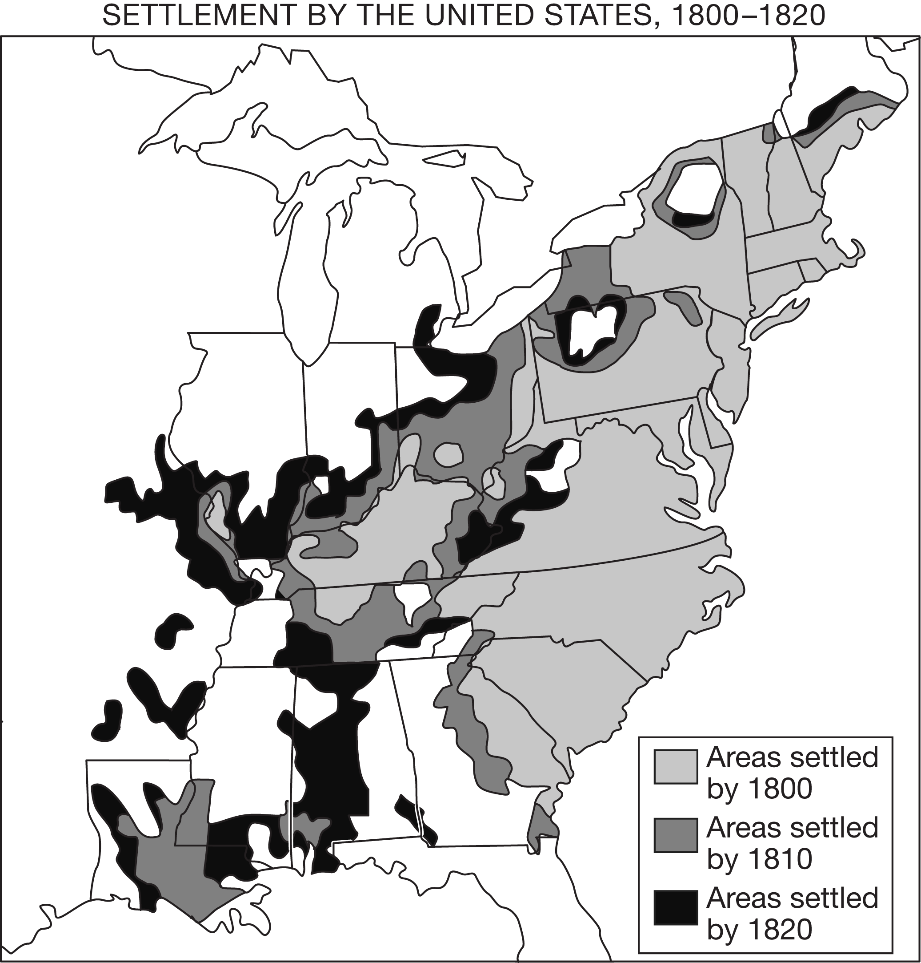
13. Which of the following most likely accounts for the limits of US Settlement in portions of North Carolina & Georgia on the map?
A. tobacco & sugarcane crops failed to thrive in those areas
B. American Indians maintained sovereign control over those areas
C. the NW Ordinance prohibited slavery in those regions
D. the lands were set aside for American Indian reservations
14. The patterns of settlement shown in the map culminated in which of the following national crises by 1820
A. Outrage over the Federalist Party’s disloyalty in proposing New England’s secession
B. Widespread opposition to the demands of the women’s rights advocates at Seneca Falls
C. The emergence of sectional tensions over the admission of Missouri
D. disbelief at the violence resulting from popular sovereignty in Kansas
12. Which of the following most directly contributed to the spread of settlement depicted on the map?
The development of transcontinental railroads
efforts to secure boundaries with Great Britain
Federal grants for purchases of western land
sustained population growth after the American Revolution

Slide 9
15. The Supreme Court established which of the following by its ruling in Marbury v. Madison? A. states have the authority to nullify acts of Congress B. the Bank of the U.S. is constitutional under the implied powers clause C. States may not interfere with interstate commerce D. the Supreme Court has the authority to determine the constitutionality of congressional acts
16. Which of the following is true of Marshall’s decision in McCulloch V Maryland?
A. it reversed his position on judicial review
B. it increased federal authority by invoking the doctrine of implied powers
C. it declared the Yazoo land claims fraudulent
D. it granted individual states the right to regulate interstate commerce.
17. Which of the following transportation developments opened the West to settlement & trade between 1790-1830?
A. turnpikes & canals B. Railroads & steamships
C. Turnpikes & railroads D. canals & railroads

Slide 10
18. THE AMERICAN COLONIZATION SOCIETY ESTABLISHED IN THE EARLY 19TH CENTURY WITH THE GOAL OF
A. ENCOURAGING IMMIGRATION FROM IRELAND & GERMANY
B. ENCOURAGING CHINESE CONTRACT LABORERS TO EMIGRATE TO THE US
C. SETTLING WHITE AMERICANS ON WESTERN LANDS
D. TRANSPORTING AFRICAN AMERICANS BACK TO AFRICA

Slide 11
“We have conquered many of the neighboring tribes of Indians, but we have never thought of holding them in subjection—never of incorporating them into our Union....To incorporate Mexico, would be the very first instance of the kind of incorporating an Indian race; for more than half of the Mexicans are Indians, and the other is composed chiefly of mixed tribes.... Ours, sir, is the Government of a white race.... [I]t is professed and talked about to erect these Mexicans into a Territorial Government, and place them on an equality with the people of the United States. I protest utterly against such a project.” Senator John C. Calhoun, “Conquest of Mexico” speech, 1848
19. The excerpt most directly reflects which of the following developments in the US during the 1st half of the 19th Century?
A. the end of the Spanish-American War B. Westward expansion
C. the booming internal slave trade D. increased manufacturing
20. Based on the excerpt, Calhoun would also be most likely to support which of the following?
A. pro-slavery arguments B. policies favoring immigration
C. expanded US federal authority D. US sale of disputed territory

Slide 12
21. The most controversial & divisive component of the Compromise of 1850 was the
A. measure’s endorsement of popular sovereignty
B. admittance of Missouri as a slave state
C. passage of a tougher national fugitive slave act
D. admittance of Texas as a slave state
22. “Build, therefore, your own world. As fast as you conform your life to the pure idea in your mind, that will unfold its great proportions. A correspondent revolution in things will attend the influx of the spirit.”
The 1836 passage above exemplifies which of the following intellectual trends?
A. evangelicalism B. Transcendentalism C. abolitionism
D. Mormonism D. Pragmatist philosophy

Slide 13
23. The Second Great Awakening did which of the following?
A. it resulted in a sharp decline in church membership
B. it increased Protestant toleration for Catholics
C. it produced increased respect for civil authority
D. it encouraged conversion to evangelical Christianity.
24. The following are TRUE about the textile mills of New England in the early 19th Century EXCEPT
A. a large percentage of their workforce was made up of women
B. the depended on water for power
C. they used a system called the putting-out system
D. there was little labor unrest in the mills until the 1830’s & 40’s
25. A key motivating factor for many reformers of the 1840’s was
A. Evangelical Christianity B. Marxism C. Abolition D. American System

