Slide 1
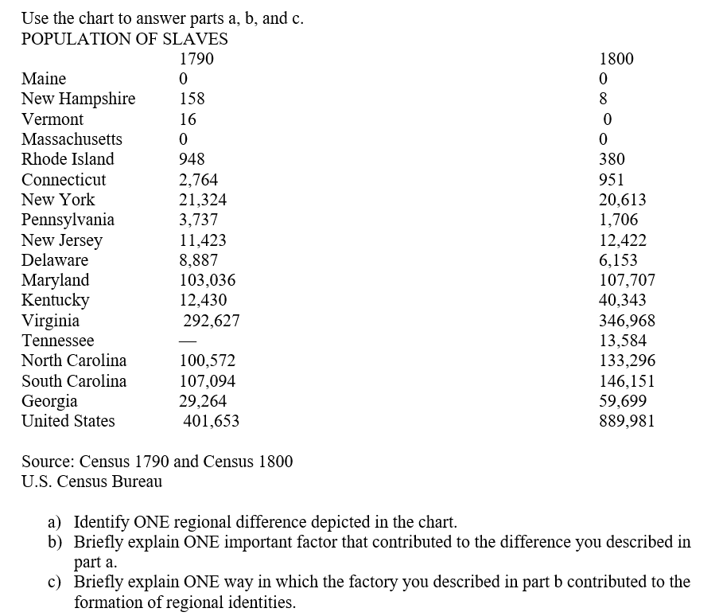

Slide 2
Scoring Notes
Identify ONE regional difference depicted in the chart.
Examples could include but are not limited to the following:
Southern States:
*The slave population in the southern states increased between 1790 and 1800. (Southern states include Maryland, Virginia, North Carolina, South Carolina, Georgia, Kentucky, and Tennessee.)
*The number of slaves in these states as a whole grew from 645,023 in 1790 to 847,748 in 1800 or by approximately 24 percent, which equates to an increase of one new slave for every four existing slaves.
New England: The slave population in New England decreased between 1790 and 1800. (New England states include Maine, New Hampshire, Vermont, Massachusetts, Rhode Island, and Connecticut.)
* The number of slaves in this region decreased from 3,886 in 1790 to 1,339 in 1800 or by approximately 66 percent, which equates to a decrease of two slaves for every three slaves.
Middle States: The slave population in the Middle States decreased between 1790 and 1800. (Middle states include New York, New Jersey, Pennsylvania, and Delaware. )
*The number of slaves in this region decreased from 45,371 in 1790 to 40,894 in 1800 or by approximately 10 percent, which equates to a decrease of one slave for every 10 existing slaves.)

Slide 3
b) *An increased demand for slave labor in Southern states after the invention of cotton gin
*The importation of slaves into the Southern states
*Natural increase in the slave population, especially in Southern states where children born to slave mothers were also the slaves of the mother’s master
*A rapid shift toward industrialization in New England
*The passage of gradual emancipation laws in Northern states
*The growing prominence of social reformers and organizations in New England and the middle states appealed to moral sensibilities of justice and freedom
*A rise in manumissions as middle states relaxed the regulations associated with the process for freeing slaves
*A shift away from labor-intensive farming in the middle states

Slide 4
c) Briefly explain ONE way in which the factor you described in part b contributed to the formation of regional identities.
Examples could include but are not limited to the following:
*Southern states developed a regional identity that included: reliance on cotton, continued use of slave labor, advocacy for individual property rights, and support of states’ rights.
*New England and middle states developed regional identities that included: emphasis on industrialization, passage of gradual abolition laws, and a shift away from labor-intensive farming

Slide 5
Answer a, b & c.
Explain how ONE specific technological innovation affected the development of agriculture in the first half of the nineteenth century.
b) Explain how ONE specific technological innovation (different from what you chose in a) affected the development of manufacturing in the first half of the nineteenth century.
c) Explain ONE specific effect of the technological innovation you selected in parts a OR b on one of the following regions in the United States during the first half of the nineteenth century.
North South or West

Slide 6
Scoring Notes
Improvements in farm tools, such as drills, mowers, rakes, and plows, reduced the costs associated with tilling the land
*Cotton gins, threshers, & automatic reapers cut labor costs by as much as half & dramatically reduced the time spent harvesting crops
*Steamboats, improved riverboats, canals, railroads, turnpikes, private roads & other innovations associated with transportation reduced the costs & time of shipping agricultural products and opened up Eastern markets to frontier farmers.
b) *steamboats, improved riverboats, canals, railroads, turnpikes, private roads and other innovations associated with transportation reduced the costs & time of shipping raw materials & manufactured goods, opened up new markets on the frontier, and generated a growing demand for manufactured products.
*Interchangeable parts revolutionized manufacturing of farm tools, weapons, train cars, etc.
*Improvements in waterwheels & the use of water to power factory machines prompted a surge in the number of factories

Slide 7
C) NORTH
*The region’s economy prospered from interconnected roads & canals
*Advanced machinery supported large-scale manufacturing
*New urban & commercial centers developed
*Employment opportunities increased in factories
European immigrants flood into Norther cities looking for employment opportunities.
SOUTH
*Farm tools brought new efficiencies to plantation farming
*A deep reliance on cotton as a staple crop became the norm
Increasing reliance on slavery with spread of cotton into the Southwest
*The region’s agriculture-based economy grows
*Increasing sectionalism as slavery becomes more entrenched

Slide 8
WEST
*Railroads opened the region
*Immigrant populations relocated to the frontier.
*New sources of raw materials became available
Increasing sectionalism as the Midwest becomes more intimately tied to the Northeast

Slide 9
AS TO THE HISTORY OF THE REVOLUTION, MY IDEAS MAY BE PECULIAR, PERHAPS SINGULAR. WHAT DO WE MEAN BY REVOLUTION? THE WAR? THAT WAS NO PART OF THE REVOLUTION; IT WAS ONLY AN EFFECT & CONSEQUENCE OF IT. THE REVOLUTION WAS IN THE MINDS OF THE PEOPLE, AND THIS WAS EFFECTED FROM 1760-1775, IN THE COURSE OF THE YEARS, BEFORE A DROP OF BLOOD WAS SHED AT LEXINGTON. Former Pres. J. Adams to former Pres. T. Jefferson 8/1815
THERE IS NOTHING MORE COMMON THAN TO CONFOUND THE TERMS OF THE AMERICAN REVOLUTION WITH THOSE OF THE AMERICAN WAR. THE AMERICAN WAR IS OVER; BUT THIS IS FAR FROM BEING THE CASE WITH THE AMERICAN REVOLUTION. ON THE CONTRARY, NOTHING BUT THE FIRST ACT OF THE GREAT DRAMA IS CLOSED. IT REMAINS YET TO ESTABLISH AND PERFECT OUR NEW FORMS OF GOVERNMENT; AND TO PREPARE THE PRINCIPLES MORALS & MANNERS OF OUR CITIZENS FOR THESE FORMS OF GOVERNMENT, AFTER THEY ARE ESTABLISHED AND BROUGHT TO PERFECTION. BENJAMIN RUSH, SIGNER OF THE DECLARATION OF INDEPENDENCE & DELEGATE TO THE CONTINENTAL CONGRESS, 1/1787
A) Briefly describe 1 significant difference between Adams’ understanding & Rush’s understanding of the American Revolution
B) Briefly explain how 1 specific historical event or development from the period between 1760-1800 could be used to support Adams’ interpretation.
C) Briefly explain how 1 specific historical event or development from the period between 1760-1800 could be used to support Rush’s interpretation.

Slide 10
A) Adams thought that the revolutionary spirit that led to fighting was the revolution; out of a growing resistance to British regulation, the emergence of an American identity completed the revolution.
Rush argued that the revolution was changing political systems and seeing if this new form of government could work, te revolution came after the fighting ended.

Slide 11
B)
Developments: growing separateness from Britain (American Mind, end of Salutary Neglect)
Stamp Act, Stamp Act Congress & public demonstrations, like Sons of Liberty
Boycotts of British goods
Boston Tea Party & intolerable Acts
Common Sense by T. Paine
Declaration of Independence – list of grievances 1760-1775
Virtual v Actual Representation

Slide 12
C.
Developments: rebublican form of government, American identity, nationalism
Declaration of Independence – statement of principles, morals as basis of gov’t
Articles of Confederation
Slavery as unresolved within the time period – NW Ordinance
Constitutional Convention & US Constitution
Bill of Rights
Election of Washington, Jay Treaty, Cabinet formation
Election 1800, 1st party system, peaceful transfer of power

Slide 13
Answer (a), (b), (c).
Identify ONE factor that increased tensions between Great Britain and its North American colonies in the period 1763-1776, and briefly explain how this factor helped lead to the American Revolution
Identify a SECOND distinct factor that increased tensions between Great Britain and its North American colonies in the same period, AND briefly explain how this factor helped lead to the American Revolution
Identify a THIRD distinct factor that increased tensions bet between Great Britain and its North American colonies in the same period, AND briefly explain how this factor helped lead to the American Revolution

Slide 14
SCORING GUIDE
*Britain’s debt from the French & Indian war led it to try to consolidate control over its colonies & raise revenue through direct taxation such as the Stamp Act, Townshend Acts, Tea Act & Intolerable Acts, generating tensions between Great Britain & its North American colonies.
* Colonists resented the end of Salutary Neglect, the curtailment of self-government, and inability to set taxation policy, “no taxation without representation”
*Colonial organizations, Sons of Liberty & publications, Common Sense, created structure for revolutionary activity
*Colonial confrontations, Boston Massacre & Boston Tea Party, exacerbated tensions
*Military participation in the French and Indian War not only provided military experience but also established Americans’ sense of themselves as an independent people
*Westward population movement provoked British restrictions (Proclamation of 1763) as well as discontent with those restrictions
*The Enlightenment inspired rethinking of concepts such as rights of individuals, the rights of British subjects, and republican self-government
*Intercolonial connections strengthened earlier in the 18th century, print culture, proliferation of newspapers & pamphlets, Great Awakening, served the independence movement between 1763-1776.

