Slide 1
DOCUMENT SOURCING REVIEW
DBQ M/T 1/17 on Populists

Slide 2
RUBRIC POINTS – UP TO 2 – WE HAVE STRESSED THE “ALTHOUGH CLAUSE” FOR THESE POINTS

Slide 3
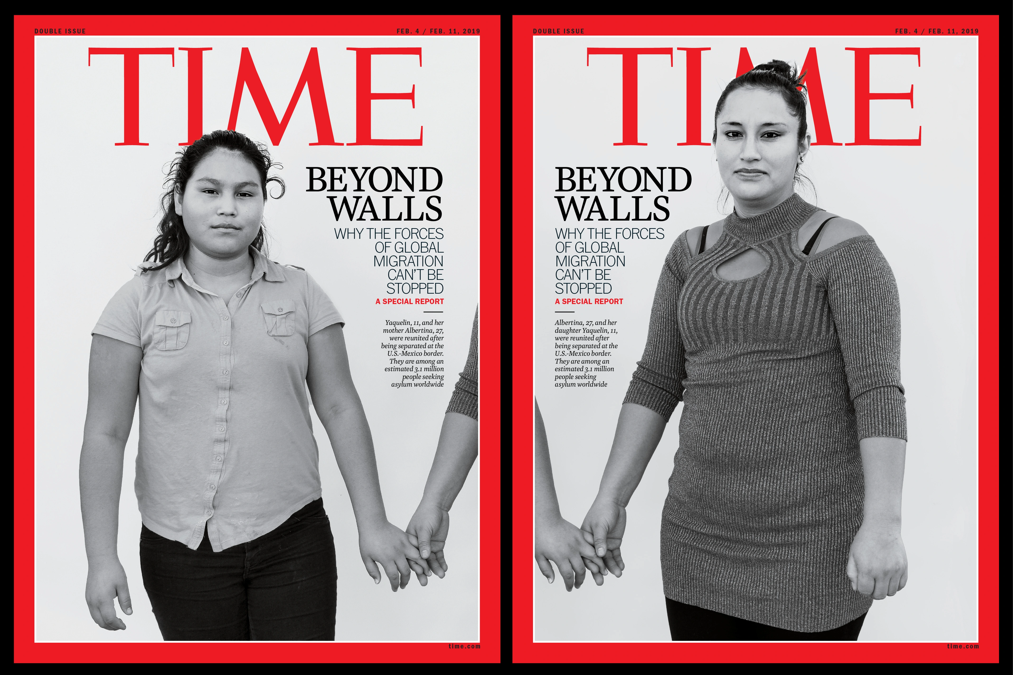
Cover TIME Magazine, February 4 & 11, 2019 moderately align with liberal, progressive, or left-wing thought and/or policy agendas. A Lean Left bias is a moderately liberal rating on the political spectrum

Slide 4
ANALYZE DOCUMENT
First things first
Title/Label/Comments – implication?
Liberal leaning – implications?
Date – Implications
Historical Context
Audience
Purpose – why this picture, why this date
Point of View – trustworthy information on issue?

Slide 5
H – historical situation
A – Audience
P – Purpose
P – point of view
whY – is this significant
You have sourced the doc
Now – for more content specific docs ☺

Slide 6
Source: “The Farmer Is the Man”, a popular rallying song during the great farmers’ revolt of the 1890s.
When the farmer comes to town With his wagon broken down, Oh, the farmer is the man who feeds them all. If you’ll only look and see I think you will agree That the farmer is the man who feeds them all. The farmer is the man, The farmer is the man, Lives on credit till the fall; Then they take him by the hand And they lead him from the land, The middleman’s the one who gets it all. When the banker says he’s broke, And the merchant’s up in smoke, They forget that it’s the farmer feeds them all. It would put them to the test If the farmer took a rest, Then they’d know that it’s the farmer feeds them all.

Slide 7
“It isn’t the man who does the work that makes the money. It’s the man who gets other men to do it.” Andrew Carnegie capitalism, plutocracy, wage slavers, monopoly newspaper union of st. louis

Slide 8
