Slide 1
E. FEDERALIST PAPERS Madison, Jay, Hamilton
FEDERALISTS (AH): NEED STRONGER CENTRAL GOVERNMENT
ANTI-FEDERALISTS (ADAMS): STATES SUBORDINATE TO NATIONAL GOVERNMENT UNACCEPTABLE
FEDERALIST #10 – STRONG & UNIFIED GOV’T MORE EFFICIENT THAN INDIVIDUAL STATES AT CONTROLLING FACTIONS
MASSACHUSETTS: CONTENTIOUS RATIFICATION 2/1788– 4 STATES FOLLOW
NH 9TH STATE 6/21/88 BUT NOT YET FOR NEW YORK & VIRGINIA
VA 6/26/88 & FINALLY NY RATIFY JULY 26 (30 TO 27)

Slide 2
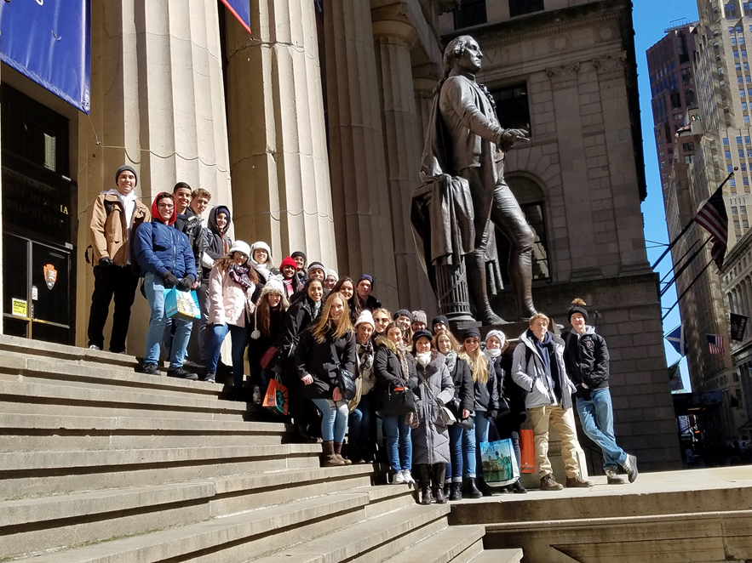
A NEW GOVERNMENT IN ACTION HOW DID THE CONSTITUTIONAL GOVERNMNET IN AMERICA TAKE SHAPE?

Slide 3
WASHINGTON’S PRESIDENCY FIRST TERM: 1789-1794
ELECTORAL COLLEGE- 2/9/89 ELECTOR CASTS 2 VOTES
PRESIDENT MOST VOTES
VICE PRESIDENT 2ND MOST VOTES
OATH OF OFFICE: NY FEDERAL HALL 4/30/89
CABINET: JEFFERSON-STATE, HAMILTON-TREASURY, KNOX-WAR (EXPANSION W/ HONOR), RANDOLPH –ATTY GEN

Slide 4
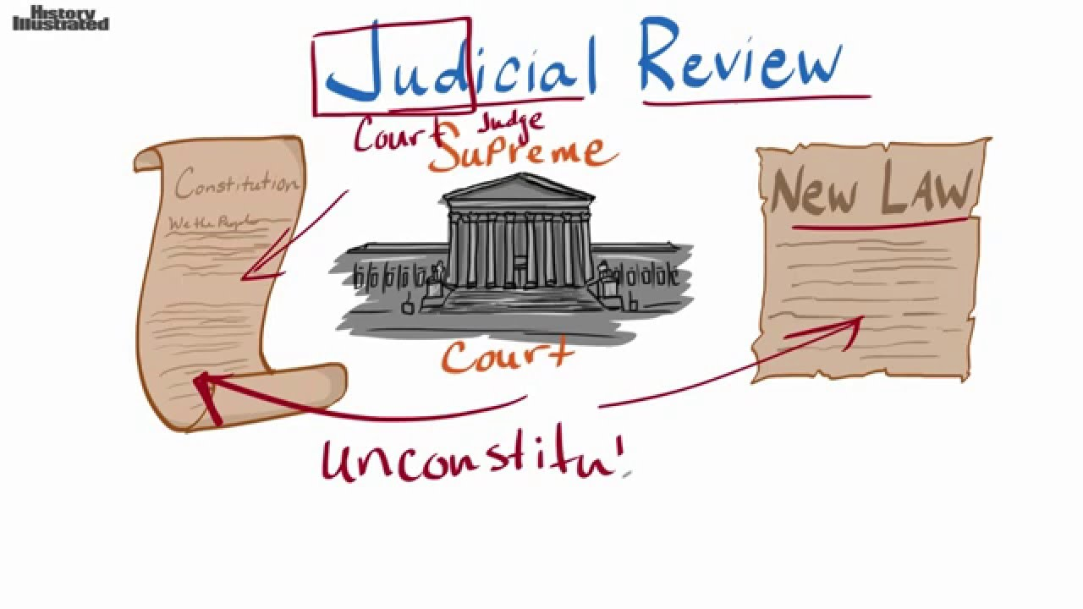
NATIONAL JUSTICE & BILL OF RIGHTS (Fed#51)
ARTICLE III, SECTION 1: JUDICIARY
NO GUIDANCE
JUDICIARY ACT 1789: ESTABLISHED US FEDERAL JUDICIAL SYSTEM
SUPREME COURT: FINAL JURISDICTION
JUDICIAL REVIEW
U.S. CONSTITUTION SUPREME LAW OF THE LAND
MADISON: AUTHOR: RATIFIED 1791
1-8 GUARANTEE OF PERSONAL LIBERTIES, INDIVIDUAL RIGHTS
9 -RIGHTS NOT LISTED ARE NOT DENIED
10 -POWERS NOT GIVEN TO FED RESERVED FOR STATES
NO SERIOUS CHECK ON FRAMER’S NATIONALIST OBJECTIVES
CHISOLM V. GEORGIA 1793: CONGRESS OVERRULED SC & GET 11TH AMENDMENT: PROHIBITS FED COURTS FROM HEARING CERTAIN SUITS AGAINST STATES

Slide 5
THE ROLE & INFLUENCE OF HAMILTON & FORMULATION OF FEDERAL POLICY 1789-94
FUNDING & ASSUMPTION:
STRENGTHEN COUNTRY’S CREDIT
DEFER DEBT PAYMENTS
ASSUME ALL STATE DEBTS-POWER IN FED’S HANDS
OPPOSITION GREAT:
EXCISE TAX ON WHISKEY
TARIFFS ON IMPORTS
WHO ‘REALLY’ HOLDS THE BONDS & THEREFORE GETS PAID?
NATIONAL BANK:
RAISE $ THROUGH STOCK
LOOSE VS. STRICT CONSTRUCTION
‘NECESSARY & PROPER’ CLAUSE: IMPLIED POWERS
MANUFACTURING CLASS BENEFITED

Slide 6
THE RISE OF POLITICAL PARTIES BATTLE BETWEEN JEFFERSON & HAMILTON
FEDERALISTS
REPUBLICANS
HAMILTON
LOOSE CONSTRUCTION
CAPITAL IS WAY TO SUCCESS & NATIONAL ORDER IN THE UNITED STATES
SUPPORT GREAT BRITIAN
JEFFERSON
STRICT CONSTRUCTION
LAND IS WAY TO SUCCESS & NATIONAL ORDER IN UNITED STATES
SUPPORT FRANCE

Slide 7
2ND ELECTION OF GEORGE WASHINGTON

Slide 8
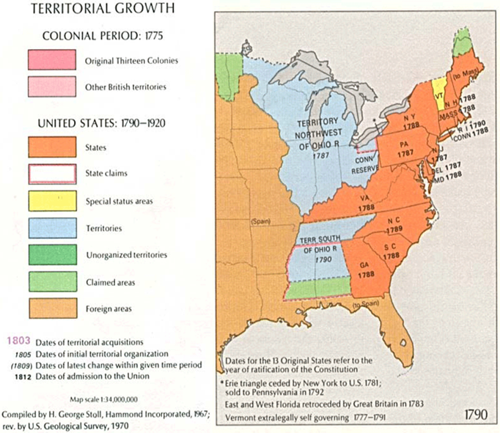
I. 2nd ADMINISTRATION CHALLENGES AT HOME
A. WHISKEY REBELLION SUMMER 1794
EXCISE TAX: FUNDING & ASSUMPTION
ENFORCED IN WESTERN PA
VIOLENCE
GW SENT 13,000 MILITIA
DON’T MESS WITH AUTHORITY OF G. WASHINGTON
B. OHIO COUNTRY
BATTLE OF FALLEN TIMBERS – LAST OF THE REVOLUTION 1794
LITTLE TURTLE & MIAMI TRIBE
“MAD” ANTHONY WAYNE – VICTORY
TREATY OF GRENVILLE 1795
DEFINITIVE WESTERN BOUNDARY WITH NATIVE AMERICANS

Slide 9
II.CHALLENGES ABROAD A. THE FRENCH REVOLUTION 1789 & WAR IN EUROPE 1793
APRIL 1793 PROCLAMATION OF NEUTRALITY - AH VS TJ
VIOLATION OF AMERICAN SHIPPING RIGHTS
IMPRESSMENT OF AMERICAN’S & SHIPS ATTACKED 1793-94
FRANCO-AM ALLIANCE OVER
JAY TREATY 1795
BR TROOPS TO BE REMOVED
NORMALIZED RELATIONS
LED TO PINCKNEY TREATY 1795 (Treaty of San Lorenzo)
FREE NAVIGATION OF MISS. RIVER & RIGHT OF DEPOSIT NEW ORLEANS
SETTLERS POUR INTO WEST

Slide 10
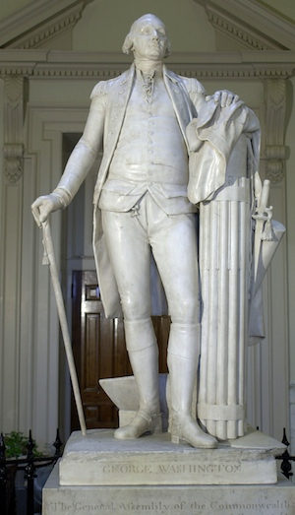
III. WASHINGTON’S FAREWELL ADDRESS 9/ 1796
Houdon – Classical Style
DISENCHANTED WITH RIVALRY BETWEEN FEDERALISTS & REPUB-LICANS
AVOID POLITICAL PARTIES
NO FOREIGN ENTAGLEMENTS TEMPORARY ALLIANCES FOR EXTRAORDINARY PURPOSES ONLY- POLICY OF ISOLATION

Slide 11
IV. ELECTION OF 1796
FEDERALIST JOHN ADAMS
REPUBLICAN T. JEFFERSON
PINCKNEY AS POSSIBLE VP
ELECTION RESULTS: FEDERALIST PRESIDENT & REPUBLICAN VP
ADAMS 71
JEFFERSON 68
PINCKNEY 59

