Slide 1
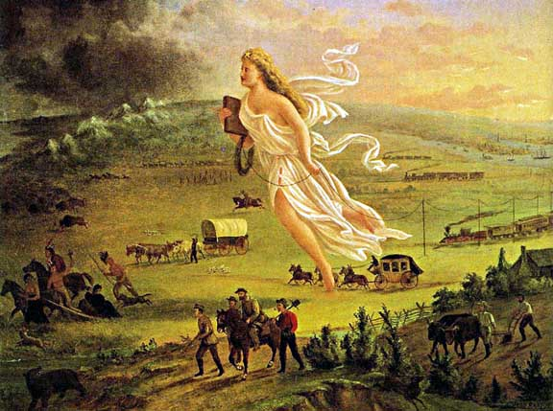
A GREAT MIGRATION / A GREAT DEGRADATION
Obj: To determine the role of the U.S. Government in western settlement by looking at Indian Policy and Congressional Legislation
John Gast American Progress 1872

Slide 2
READJUSTMENTS AFTER RECONSTRUCTION
WAVING THE BLOODY SHIRT
WM. SUMNER/H. SPENCER: SOCIAL DARWINISM
MATERIALISM
FUNDAMENTAL ÷ SECTIONAL SO BALANCE OF POWER NEAR PERFECT
MAJOR ISSUES GO UNADDRESSED
BLACKS :CIVIL RIGHTS CASES 1883, PLESSY V FERGUSON 1896, ATLANTA COMPROMISE 1895 B.T.WASHINGTON
TARIFF: PROTECTIONIST? OR LOWER?
CURRENCY : EXPAND OR CONTRACT
CIVIL SERVICE: GRANT SCANDALS & PENDELTON ACT 1883

Slide 3
SCANDALS
Uncle Sam directs those implicated in the Crédit Mobilier of America scandal to commit Hari-Kari.
1872
1874
Whiskey Ring cartoon by Thomas Nast

Slide 4
THE GREAT AMERICAN DESERT 1825-1865
1ST ½ 19TH CENTURY WEST OF MISSISSIPPI, UNINHABITABLE
BUFFALO, SOD, INDIANS
EVE OF CIVIL WAR INDIANS ½ THE POP & ¼ MILL ROAMED THE GREAT PLAINS
CONTACT WITH WHITES ALREADY MADE – HORSE MOST TRANSFORMING ADAPTATION FOR INDIANS
PLAINS INDIANS NOMADIC, FOLLOWED BUFFALO, & WARLIKE, INTERTRIBAL WARFARE

Slide 5
INDIAN POLICY
EXPANSION WITH HONOR 1784
INDIAN REMOVAL 1830
CHEROKEE NATION V GEORGIA 1831
WORCESTER V GEORGIA 1832
BLACKHAWK WAR 1832
INDIAN INTERCOURSE ACT 1834
TRAIL OF TEARS 1838-39
2ND SEMINOLE WAR 1835-42
RESERVATION SYSTEM ABANDONED 1851
CONCENTRATION: DEFINITE BOUNDARIES, INDIVIDUAL TRIBAL TREATIES – POST ’51
TREATY SYSTEM ABANDONED 1871
GRANT’S PEACE POLICY 1868
SMALL SCATTERED RESERVATIONS
ABOLISH TREATY MAKING 1871

Slide 6
INDIAN WARS 1870-1890’S
CIVIL WAR 1861-65: DAKOTA WAR, MN 1862 & SAND CREEK, CO 11/1864
GREAT SIOUX WARS 1854-1890
NAVAJO LONG WALK 1864-66
BATTLE OF LITTLE BIG HORN 6/1876
FED GOV’T CONTROL BLACK HILLS, SD
NEZ PERCE 1877
APACHE 1886
CARLISLE INDIAN SCHOOL, PA 1879 “KILL THE INDIAN, SAVE THE MAN”
“A CENTURY OF DISHONOR” HELEN HUNT JACKSON 1881
GHOST DANCE/WOUNDED KNEE 1890
DAWES SEVERALTY ACT 1887 END OF TRIBAL LIFE
INDIANS AS INDIVIDUALS, PVT PPTY OWNERS, ASSIMILATION

Slide 7
19th century Manifest Destiny was just another name for Imperialism. Evaluate with regards to Anglo-American & Native American relations.

Slide 8
MOVING WEST
MORE LAND OPEN TO AGRICULTURE THAN LAST 250 YRS. COMBINED
HOMESTEAD ACT 1862: 160 ACRES, $10, STAY 5 YEARS & IMPROVE LAND OR
$1.25/ACRE & STAY 6 MONTHS;
GOV’T GAVE AWAY 48 MILL, SOLD 100 MILL, 128 MILL IN LAND GRANT;
START UP COSTS $1,200, 3X ANNUAL AVERAGE
TIMBER CULTURE ACT 1873: RECEIVE EXTRA 160 ACRES & PLANT TREES ON 25%
DESERT LAND ACT 1877: 640 ACRES @ $1.25 & IRRIGATE PART W/I 3 YEARS
TIMBER & STONE ACT 1878: $2.50/ACRE, LUMBER CO’S CLEAN UP!
2/3 ALL HOMESTEADERS FAILED BY 1890

Slide 9
FARMING THE FRONTIER GOV’T ROLE IN WESTERN DEVELOPMENT & LAISSEZ FAIRE POLICY BETWEEN 1870-1890 HUGE INCREASE IN PRODUCTION
LIBERAL LAND POLICIES
MORRILL LAND GRANT ACT 1862- IMPROVED KNOWLEDGE & EDUCATION OF FARMING, HUSBANDRY, LAND MANAGEMENT
CLEVER & SUCCESSFUL SOLUTIONS CREATED TO FARM MIDWEST
TECHNOLOGY – DEERE & MCCORMICK
BONANZA FARMING TOOK OVER FROM INDIVIDUALS – BECAME INDUSTRY
INCREASED POPULATION: MORE FOOD, LOANS, CASH CROPS, PANIC 1873 –
MOTHER NATURE 1885-1887

Slide 10
BOOM & BUST FOR FARMERS PANICS 1873 & 1893 – INSTABILITY OF ECONOMY
UNITED STATES POPULATION AND MONEY IN CIRCULATION, 1865-1895
Population (in thousands) Money in Circulation (in thousands)
1865 35,701 $1,180,197
1870 39,905 899,876
1875 45,073 925,702
1880 50,262 1,185,550
1885 56,658 1,537,434
1890 63,056 1,685,123
1895 69,580 1,819,360

Slide 11
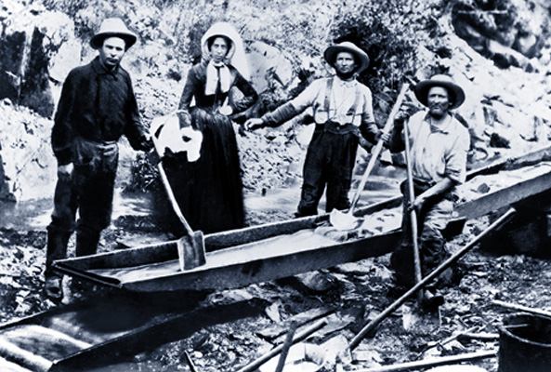
MINING: 1ST MAJOR INDUSTRY TO ATTRACT PEOPLE WEST
CALIFORNIA GOLD RUSH 1848
SIERRA NEVADAS 1852
COMSTOCK LODE 1853
1900 $1BILLION WORTH OF GOLD IN CALIFORNIA ALONE
MONTANA – IMMIGRANT MECCA
INDIVIDUAL MINERS SELL OUT
ANACONDA MINING: MONEY & MEANS
ENVIRONMENTAL DEVASTATION NOT ANYONE’S MAJOR CONCERN

Slide 12
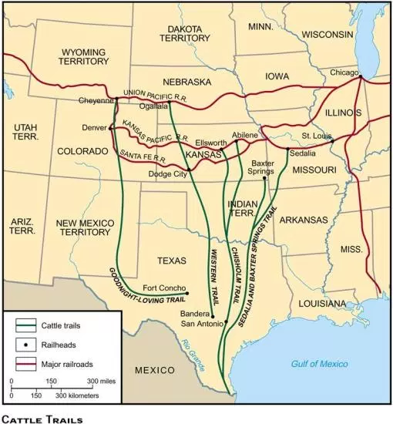
BOOM & BUST IN THE CATTLE INDUSTRY
EASTERN DEMAND, POPULATION & RR CONTRIBUTE TO BOOM
OPEN RANGE, PEAK YEARS 1880-1885, COWBOY’S ¼ BLACK & ¼ MEXICAN – SKILLS CAME NORTH
J. MCCOY & LONG DRIVE 1869
TEXAS LONGHORN: BUY AT $5/HEAD & SELL AT $40/HEAD IN KS
OTHER INDUSTRIES THRIVE: RR, MEATPACKING, REFRIGERATION
1880 6MILL HEAD VIA RR
BATTLE B/W RANCHERS & FARMERS; BARBED WIRE
OVERSUPPLY, OVERGRAZING, OVERCROWDING
TEXAS FEVER: UP TO 90% DIE IN SOME AREAS 1888-93
MOTHER NATURE 1885-1887 “THE BIG DIE UP”

Slide 13
TRANSPORTATION ADVANCES: PACIFIC RAILWAY ACT 1862
*EXPLOITATION: GOV. SUBSIDIES
*LIFE TRANSFORMED
*1910 9 LINES: RAPID RAIL CON-STRUCTION → FEDERAL & STATE INCENTIVES
* ECO GROWTH & FOREIGN MKTS
*INDEMNITY ZONE CLAUSE
*BUFFALO DECIMATED
*TRANSCONTINENTAL RR: UNION PACIFIC & CENTRAL PACIFIC
*12,000 CHINESE, NUMEROUS IRISH, VETERANS, BLACKS & MEXICANS
*5/10/69 PROMONTORY PT, UT
*PANIC 1893 – BANKRUPTCY CLAIMED MOST RR

Slide 14
GIVE ME LAND, LOTS OF LAND UNDER STARRY SKIES ABOVE, DON’T FENCE ME IN!
What role did the U.S. Government play in western development from 1860-1890?
Which actions of the government supported the laissez-faire philosophy, and which did not?

