Slide 1
INDUSTRY CHANGED THE FACE OF AMERICA 1830-1850
Obj: To understand how technological & transportation improvements influenced the national economy by examining the role of the Supreme Court

Slide 2
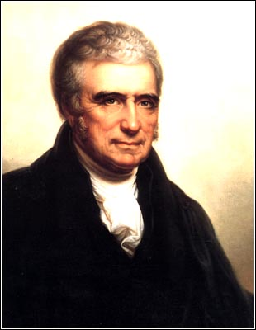
ECONOMIC NATIONALISM UNIFIES THE NATIONAL ECONOMY THE MARSHALL COURT IN ACTION
INTERPRET & ENFORCE CONSTITUTION IN ORDER TO ENCOURAGE ECONOMIC DEVELOPMENT AGAINST THE EFFORTS OF STATES TO INTERFERE IN RIGHTS OF INDIVIDUALS OR COMBINATION OF INDIVIDUALS
USE OF CONTRACT CLAUSE TO KEEP STATES IN PLACE
CONTRACT CLAUSE PROHIBITS STATES FROM PASSING LAWS ‘IMPAIRING THE OBLIGATION OF CONTRACTS’
LOOSE CONSTRUCTION
PROMOTE GENERAL WELFARE OF THE NATION BY ENCOURAGING ECONOMIC GROWTH AND PROSPERITY
FLETCHER V. PECK 1810: DOES SC HAVE RIGHT TO DECLARE STATE LAW UNCONSTITUTIONAL?
CASE OVER LAND SALES IN GA

Slide 3
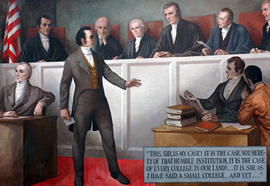
DARTMOUTH V WOODWARD 1819 CONTRACT CLAUSE
STATE LEGISLATURE “MAKE DARTMOUTH A PUBLIC COLLEGE”
DANIEL WEBSTER ARGUED FOR COLLEGE – CHARTER PREDATED STATE & IRREVOCABLE
JM: ANY CHARTER GRANTED BY A STATE TO A PRIVATE CORP. WAS FULLY PROTECTED BY THE CONTRACT CLAUSE
CORPS CHARTERED BY STATES COULD HOLD ON TO PRIVILEGES GRANTED IN ORIGINAL CHARTERS INCREASING POWER AND INDEP OF BUS. CORPS
FOSTERED GROWTH OF CORP. W/ LTD PUBLIC RESPONSIBILITES

Slide 4
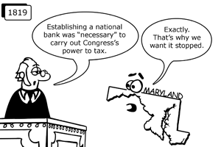
MCULLOCH V. MARYLAND 1819 THE BANK, AGAIN
MOST IMPORTANT DECISION
MD LEVIED TAX ON STATE BRANCH OF US BANK
US BANK REFUSED TO PAY TAX
1) DID CONGRESS HAVE RIGHT TO ESTABLISH A BANK? YES – IMPLIED POWERS
2) DID A STATE HAVE THE POWER TO TAX OR REGULATE AN AGENCY OR INSTITUTION ESTABLISHED BY THE FED. GOV’T? NO – POWER TO TAX WAS POWER TO DESTROY – SUPREMACY OF FED. GOV’T OVER STATES
LOOSE CONSTRUCTION TO ENCOURAGE ECO GROWTH
IMPLIED POWERS DOCTRINE

Slide 5
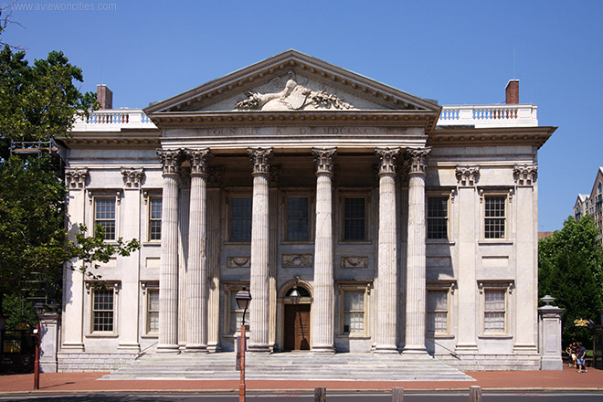
PANIC 1819-1821 1ST PEACETIME FINANCIAL CRISIS IN U.S
EARLY TO MID 19TH C. PRINTED NO PAPER MONEY & LACK OF COINS
FAILED TO MEET GROWING ECO NEEDS FOR CIRCULATING CURRENCY
FAILURE TO RE-CHARTER BANK 1811
PRIVATE & STATE BANKS FILLED GAP
WAR 1812 & POSTWAR BOOM LED TO INCREASE IN STATE BANKS, MORE NOTES, THREAT OF INFLATION
2ND BANK OF US CHARTERED 1816 TO CONTAIN STATE BANKSP- FAILED – EASY CREDIT & UNSCRUPULOUS LENDING PRACTICES
DROP IN COTTON PRICES DUE TO EURO GROWTH
LAND SPECULATION OUT WEST KEY FACTOR
FORECLOSURES ENSUED
IS NEW SYSTEM OF CREDIT & BANKING DESIRABLE?

Slide 6
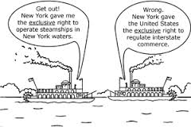
GIBBONS v. OGDEN 1824 TRANSPORTATION ISSUE
FULTON & LIVINGSTON LICENSED BY NY STATE TO OPERATE FERRY SERVICE NY-NJ (OGDEN OPERATING SERVICE)
COMPETITORS LICENSED BY US CONGRESS (GIBBONS)
DECISION: STATE LICENSE UNCONSTITUTIONAL. FED GOV’T REGULATES INTERSTATE COMMERCE
COMMERCE DEFINITION NOW INCLUDES NAVIGATION – FREED PRIVATE INTERESTS FROM STATE INTERFERENCE
EXPAND POWER OF FED. GOV’T AT EXPENSE OF THE STATE& ENCOURAGED GROWTH OF NATIONAL ECONOMY

Slide 7
SHORT REVIEW
FEDERALIST VIEW OF NATIONAL ECONOMY; IF THE NATION SUCCEEDS STATES REAP BENEFITS
DOMESTIC POLICY UNDER REPUBLICANS: INTERNAL IMPROVEMENTS, BANK RECHARTERED, TARIFFS, MISSOURI COMPROMISE 1820
FOREIGN POLICY: RUSH-BAGOT 1817, ADAMS-ONIS 1819 AND MONROE DOCTRINE 1823 (WRITTEN BY JQA) EUROPE TO KEEP HANDS OFF NEWLY INDEPENDENT NATIONS IN LATIN AMERICA. AMERICAN CONTINENT NO LONGER OPEN FOR COLONIZATION. US TO KEEP NOSE OUT OF INTERNAL EUROPEAN STATE AFFAIRS
ECONOMICS: MCCULLOCH, FLETCHER, DARTMOUTH, GIBBONS
NATION LITERALLY BROUGHT TOGETHER THROUGH TRANSPORTATION NETWORK- ERIE CANAL & OTHERS: PA, CHESAPEAKE & OHIO, MICHIGAN & ILLIONIS 1848 LINK CHICAGO & MISSISSIPPI RIVERS 1852 CANALS 2X TONNAGE OF RR – 1860 RR MAIN CARRIERS IN ALL PRODUCTS
RAILROADS ON THEIR WAY
WEST FEEDS NATION, SOUTH FEEDS FACTORIES, FACTORIES MAKE GOODS

