Slide 1
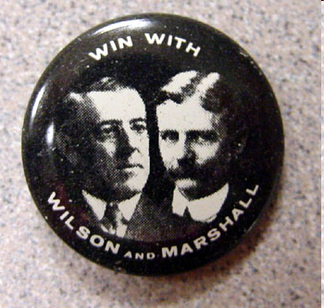
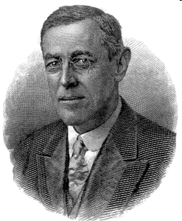
WOODROW WILSON & NEW FREEDOM IN ACTION 1912-1916
Objective: To understand Wilson’s progressivism by looking at legislation passed during his first term

Slide 2
I. ELECTION OF 1912
BULLMOOSE CANDIDACY: TR & NEW NATIONALISM- STRENGTHEN GOV’T, USE GOV’T AS AGENT OF REFORM
REPUBLICANS: TAFT
DEMOCRATS: WILSON - NEW FREEDOM- RESTORE COMPETITION/ FREE MARKET & SMALLER FED GOV
SOCIALISTS: DEBS (4TH TIME)
DEMS TOOK BOTH HOUSES
ISSUES FOR WW: DESTROY MONOPOLIES TO ALLOW FOR COMPETITION, ENTREPRE-NUERSHIP, SMALL BUSINESS
USE GOVERNMNET TO ADDRESS PROBLEMS OF NEW CORPORATE ORDER

Slide 3
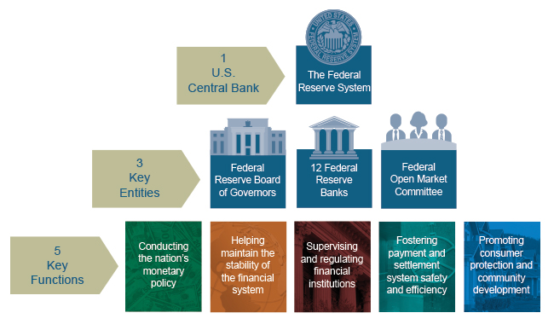
II. LEGISLATIVE WINDFALL
UNDERWOOD TARIFF 1913 – 1ST RE-DUCTION SINCE 1860: 15% & INCOME TAX PART OF TARIFF
GRADUATED INCOME TAX 16TH AMEND.
DIRECT ELECTION OF SENATORS: 17TH
FEDERAL RESERVE ACT 1913: SOUND & FLEXIBLE CURRENCY, GREATEST LEG. ACHIEVEMENT: PREVENT PANIC, PROMOTE ECO. GROWTH
FEDERAL TRADE COMMISSION 1914- WATCHDOG AGENCY, OUT OF CHARACTER (MORE LIKE TR)
CLAYTON ANTITRUST ACT 1914
NEW FREEDOM COMPLETED

Slide 4
III. AFRICAN AMERICANS
THE SOULS OF BLACK FOLK 1903
JULY 1905 NIAGRA MOVEMENT
W.E.B. DUBOIS & WM MONROE TROTTER: OPPOSITION TO B.T. WASHINGTON THESIS
“DECLARATION OF PRINCIPLES”
MET UNTIL 1908, RACE RIOT SPRINGFIELD
N.A.A.C.P. – INTEGRATED ORG TO FIGHT RACISM

Slide 5
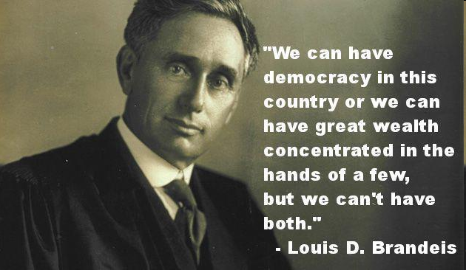
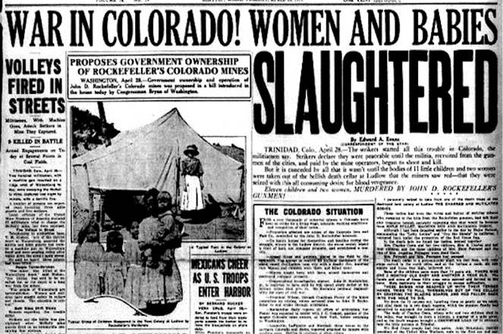
IV. PROGRESSIVES DISAPPOINTED
EXCLUSIONARY & LOST SUPPORT
LOUIS BRANDEIS – 1ST JEWISH SC JUSTICE 1916
FEDERAL FARM LOAN ACT 1916 GIVE FARMERS CREDIT
FEDERAL AID ROAD ACT 1916 1ST FEDERAL HIGHWAY FUNDING LAW
KEATING OWEN ACT 1916: FED. REG-ULATION OF COMMERCE IN GOODS MFG. BY KIDS UNDER 14
ADAMSON ACT 1916: 8 HOUR DAY FOR RR WORKERS
FEDERAL WORKMEN’S COMPENSATION ACT 1916
NO AMENDMENT FOR WOMEN
HAMMER V. DAGENHART 1918 KEATING OWEN UNCONSTITUTIONAL
OVERTURNED 1941 US V. DARBY LUMBER CO.
LUDLOW MASSACRE 1914: LABOR RAGED

Slide 6
V. WILSON & FOREIGN POLICY
A. MEXICO
MISSIONARY DIPLOMACY
AVOIDED JINGOISM OF TR
1914 HUERTA RESIGNED
VILLA & CARRANZA VIE FOR POWER
CARRANZA ‘WON’ & RECOGNIZED BY U.S.
VILLA RETALIATED, KILLED 23 U.S. CITIZENS IN MX & US
U.S. PUSUED VILLA, MORE DEATH, CARRANZA ORDERED TROOPS AGAINST U.S. & FORCED U.S. TO WITHDRAW

