Slide 1
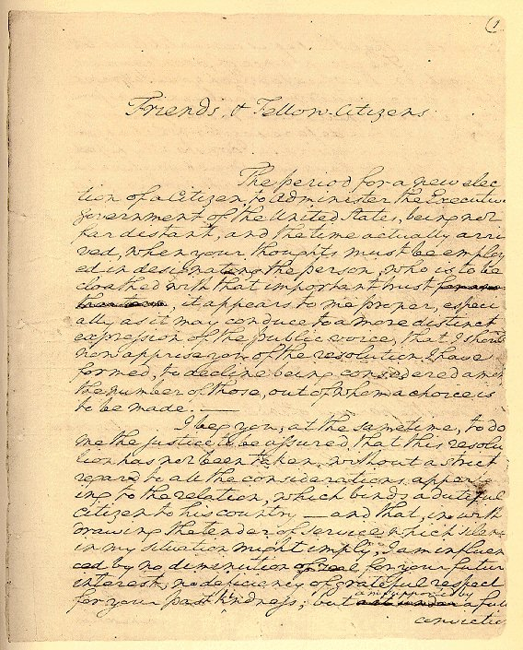
CHALLENGES AT HOME AND ABROAD Obj: To determine domestic & foreign policy success during Washington’s 2nd administration

Slide 2
I. AT HOME A. WHISKEY REBELLION SUMMER 1794
EXCISE TAX: FUNDING & ASSUMPTION
ENFORCED MORE IN WEST-ERN PA
VIOLENCE AGAINST REVENUE AGENTS
GW SENT 13,000 MILITIA
DON’T MESS WITH AUTH-ORITY OF G. WASHINGTON

Slide 3
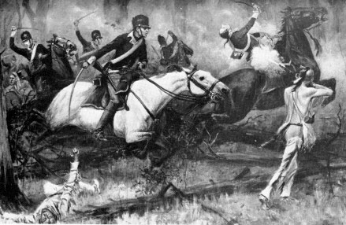
B. OHIO COUNTRY
BATTLE OF FALLEN TIMBERS 1790-94
“LAST BATTLE OF THE REVOLUTION”
LITTLE TURTLE & MIAMI TRIBE SUCCESSFUL AGAINST U.S.
DECISIVE VICTORY AUGUST 1794 GENERAL “MAD ANTHONY” WAYNE
TREATY OF GREENVILLE 1795 – DEFINITE BOUNDARY BETWEEN US & INDIAN LANDS.
“EXPANSION WITH HONOR”

Slide 4
II. ABROAD A. THE FRENCH REVOLUTION 1789 & WAR IN EUROPE 1793
APRIL 1793 PROCLAMATION OF NEUTRALITY
GENET AFFAIR
GW ASKED FOR RECALL
MORE IMPORTANTLY: VIOLATION OF AMERICAN SHIPPING RIGHTS
IMPRESSMENT
FRANCO-AMERICAN ALLIANCE OVER
GB & FR ATTACKING AMERICAN SHIPS –1793-94
SOLUTION NEEDED

Slide 5
B. JAY TREATY 1795
JAY SENT TO ENGLAND TO END ATTACKS
ENGLAND WANTED TREATY: FEARFUL OF A FRANCO-AMERICAN ALLIANCE
ONLY MAJOR CONCESSION: BRITISH EVACUATE WESTERN POSTS, COMPENSATE SHIPOWNERS, OPEN UP ASIAN COLONIES FOR TRADE
AMERICAN NEUTRAL RIGHTS ON THE WATER NOT RESPECTED
VALUABLE NONETHELESS BECAUSE RELATIONS W/ GB REGULARIZED
ENABLED US TO SOLVE PROBLEMS WITH SPAIN

Slide 6
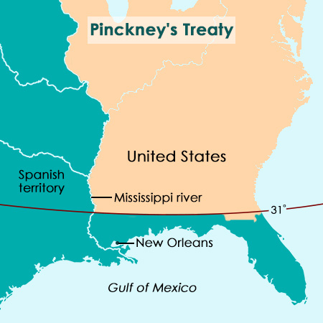
C. PINCKNEY TREATY 1795 TREATY OF SAN LORENZO
SPAIN’S EXIT FROM EUROPEAN WAR
FEARFUL OF FRANCO-AMERICAN ATTACK
IMPROVE RELATIONS WITH U.S.
FREE NAVIGATION OF THE MISSISSIPPI RIVER AND RIGHT OF DEPOSIT AT NEW ORLEANS
RATIFIED 4 MONTHS AFTER JAY; 10/1795
SETTLERS POURED INTO WEST

Slide 7
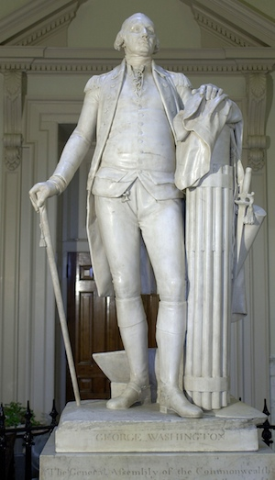
III. WASHINGTON’S FAREWELL ADDRESS 9/ 1796
Houdon – Classical Style
DISENCHANTED WITH RIVALRY BETWEEN FEDERALISTS & REPUB-LICANS
AVOID POLITICAL PARTIES
NO FOREIGN ENTAGLEMENTS TEMPORARY ALLIANCES FOR EXTRAORDINARY PURPOSES ONLY- POLICY OF ISOLATION

Slide 8
IV. ELECTION OF 1796
FEDERALIST JOHN ADAMS
REPUBLICAN T. JEFFERSON
PINCKNEY AS POSSIBLE VP
ELECTION RESULTS: FEDERALIST PRESIDENT & REPUBLICAN VP
ADAMS 71
JEFFERSON 68
PINCKNEY 59

Slide 9
A. CONTINUED TROUBLE FRANCE & AMERICAN SHIPPING
NEGOTIATE SETTLEMENT WITH FRANCE
“XYZ AFFAIR” – FIASCO
1798 ADAMS RELEASED REPORT
CONGRESS CREATED NAVY DEPT., TRIPLE SIZE OF ARMY, AMERICAN PRIVATEERS ATTACKED FR. SHIPS
REPUBLICANS COMMITTED TO FRIENDSHIP W/ FRANCE
EUROPEAN REFUGEES FLOODED AMERICA
WAR NOT AN OPTION

Slide 10
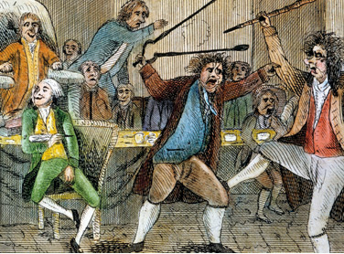
B. ALIEN & SEDITION ACTS 1798 FIRST FIGHT IN CONGRESS
FEDERALISTS TOOK XYZ AFFAIR A STEP FURTHER
NATURALIZATION ACT – 14 YRS FOR CITIZENSHIP
PRESIDENTIAL POWER TO EXPEL ALIENS – NEVER INVOKED
SEDITION ACT: CRIME TO INCITE RIOT OR IMPEDE LAWS & ILLEGAL TO SPEAK, WRITE AGAINST GOV’T
GOV’T “MASTERS NOT SERVANTS OF THE PEOPLE”
WAY TO SILENCE REPUBLICANS W/ 1800 AROUND THE CORNER

Slide 11
C. THE REPUBLICAN RESPONSE THE VIRGINIA & KENTUCKY RESOLVES
TJ: ALIEN & SEDITION ACTS VIOLATED 1ST AMENDMENT & IMPEDED STATES’ RIGHTS
STATES HAD RIGHTS TO DECLARE LAW OF CONGRESS UNCONSTITUTIONAL
FRANCE NEVER WANTED WAR & XYZ AFFAIR NOT A BIG DEAL SO COMMISSIONERS TO BE RECEIVED POST HASTE
TENSION B/W ADAMS & FEDERALISTS
NAPOLEON IN CHARGE BUT WAR AVOIDED – CONVENTION 1800

Slide 12
With a neighbor discuss the following – list 3 issues in notes & be prepared to share
WHAT ISSUES MADE THE POLITICS OF THE 1790’S DIVISIVE?

