Slide 1
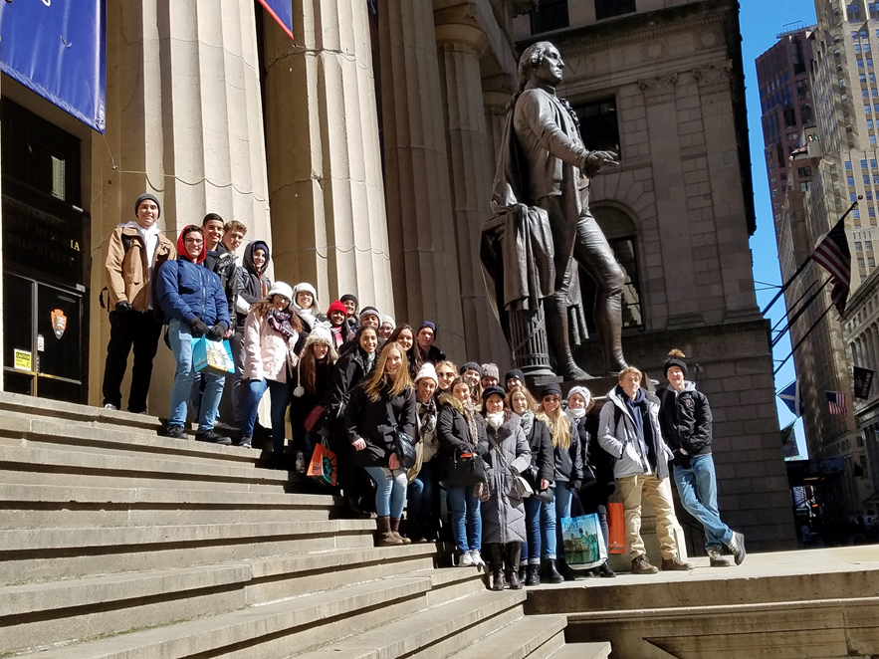
A NEW GOVERNMENT IN ACTION HOW DID THE CONSTITUTIONAL GOVERNMNET IN AMERICA TAKE SHAPE?

Slide 2
WASHINGTON’S PRESIDENCY FIRST TERM: 1789-1794
ELECTORAL COLLEGE- 2/9/89 ELECTOR CASTS 2 VOTES
PRESIDENT MOST VOTES- EVERY ELECTOR IN EVERY STATE CAST A VOTE FOR WASHINGTON
VICE PRESIDENT 2ND MOST VOTES JOHN ADAMS
OATH OF OFFICE: NY FEDERAL HALL 4/30/89

Slide 3
WASHINGTON’S CABINET
JEFFERSON: STATE
KNOX: WAR – EXPANSION W/ HONOR WAS POLICY W/ NATIVE AMERICANS
HAMILTON: TREASURY
RANDOLPH: ATTORNEY GENERAL

Slide 4
NATIONAL JUSTICE & BILL OF RIGHTS (Fed#51)
ARTICLE III, SECTION 1
NO CONSTITUTIONAL GUIDANCE FOR NATIONAL COURT SYSTEM
JUDICIARY ACT 1789: ESTABLISHED US FEDERAL JUDICIAL SYSTEM
FEDERAL DISTRICT COURT IN EACH STATE
SUPREME COURT: FINAL JURISDICTION
JUDICIAL REVIEW
U.S. CONSTITUTION SUPREME LAW OF THE LAND – FED #51
MADISON: AUTHOR: RATIFIED 1791
1-8 GUARANTEE OF PERSONAL LIBERTIES, INDIVIDUAL RIGHTS
9 -RIGHTS NOT LISTED ARE NOT DENIED
10 -POWERS NOT GIVEN TO FED RESERVED FOR STATES
NO SERIOUS CHECK ON FRAMER’S NATIONALIST OBJECTIVES
CHISOLM V. GEORGIA 1793: CONGRESS OVERRULED SC & GET 11TH AMENDMENT: PROHIBITS FED COURTS FROM HEARING CERTAIN SUITS AGAINST STATES

Slide 5
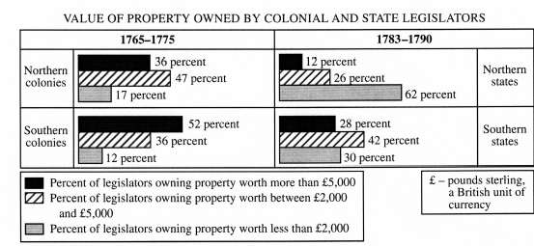
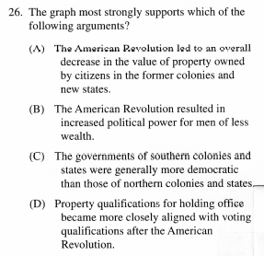
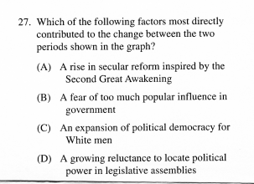
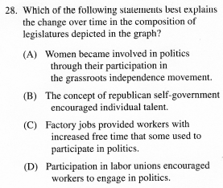

Slide 6
THE ROLE & INFLUENCE OF HAMILTON & FORMULATION OF FEDERAL POLICY 1789-94
FUNDING & ASSUMPTION:
STRENGTHEN COUNTRY’S CREDIT
DEFER DEBT PAYMENTS
ENTICE WEALTHY TO INVEST IN FEDERAL GOVERNMENT
ASSUME ALL STATE DEBTS
CONCENTRATE POWER IN NAT’L GOV’T
OPPOSITION GREAT:
EXCISE TAX ON WHISKEY
TARIFFS ON IMPORTS
WHO ‘REALLY’ HOLDS THE BONDS & THEREFORE GETS PAID?
NATIONAL BANK:
RAISE $ THROUGH STOCK
LOOSE VS. STRICT CONSTRUCTION
‘NECESSARY & PROPER’ CLAUSE
IMPLIED POWERS
MANUFACTURING CLASS BENEFITED

Slide 7
THE RISE OF POLITICAL PARTIES BATTLE BETWEEN JEFFERSON & HAMILTON
FEDERALISTS
REPUBLICANS
HAMILTON
LOOSE CONSTRUCTION
CAPITAL IS WAY TO SUCCESS & NATIONAL ORDER IN THE UNITED STATES
SUPPORT GREAT BRITIAN
JEFFERSON
STRICT CONSTRUCTION
LAND IS WAY TO SUCCESS & NATIONAL ORDER IN UNITED STATES
SUPPORT FRANCE

Slide 8
2ND ELECTION OF GEORGE WASHINGTON

