Slide 1
WELCOME TO APUSH
Dr. Hosmer, Mr. Ancharski & Ms. Stuart
https://uhsapush2015.weebly.com/ - bookmark it!
Unit Overview – on website, use it to check for understanding
Advocate, investigate, communicate

Slide 2
HISTORY IS AN INTERPRETATION
FACTS/EVIDENCE?
DISCUSS PURPOSE, POINT OF VIEW, & SUBJECT
THOUGHTS?

Slide 3
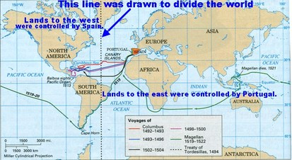
I. SPANISH CONTACT W/ NATIVE PEOPLES IN NORTH AMERICA
OBJ: EVALUATE THE CONSEQUENCES OF EUROPEAN CONTACT WITH NORTH AMERICAN INDIGENOUS GROUPS

Slide 5
Excerpt from “Inter Caetera,” a Papal Bull (decree) sent from Pope Alexander VI, to the king and queen of Spain on May 4, 1493 – “DOCTRINE OF DISCOVERY”
Alexander, bishop, servant of the servants of God, to the illustrious sovereigns, our very dear son in Christ, Ferdinand, king, and our very dear daughter in Christ, Isabella, queen…. Among other works well pleasing to the Divine Majesty and cherished of our heart, this assuredly ranks highest, that in our times especially the Catholic faith and the Christian religion be exalted and be everywhere increased and spread.
We have indeed learned that you, who for a long time had intended to seek out and discover certain islands and mainlands remote and unknown … chose our beloved son, Christopher Columbus … whom you furnished with ships and men equipped for like designs, not without the greatest hardships, dangers, and expenses, to make diligent quest … and they at length, with divine aid and with the utmost diligence … discovered certain very remote islands and even mainlands that hitherto had not been discovered by others; wherein dwell very many peoples living in peace, and, as reported, going unclothed, and not eating flesh. Moreover … these very peoples … seem sufficiently disposed to embrace the Catholic faith and be trained in good morals.
And, in order that you may enter upon so great an undertaking with greater readiness and heartiness endowed with the benefit of our apostolic favor, we … give, grant, and assign to you and your heirs and successors … all their [Native peoples’] dominions, cities, camps, places, and villages, and all rights, jurisdictions, and appurtenances, all islands and mainlands found and to be found, discovered and to be discovered.
We trust in Him from whom empires and governments and all good things proceed, that, should you, with the Lord's guidance, pursue this holy and praiseworthy undertaking, in a short while your hardships and endeavors will attain the most felicitous result, to the happiness and glory of all Christendom…. Given at Rome, at St. Peter's, in the year of the incarnation of our Lord one thousand four hundred and ninety-three, the fourth of May, and the first year of our pontificate.
Gratis by order of our most holy lord, the pope. Alexander VI
“we” and “our” refers to the Pope and Catholic Church, while “you” refers to the king and queen and rest of the monarchy.

Slide 6
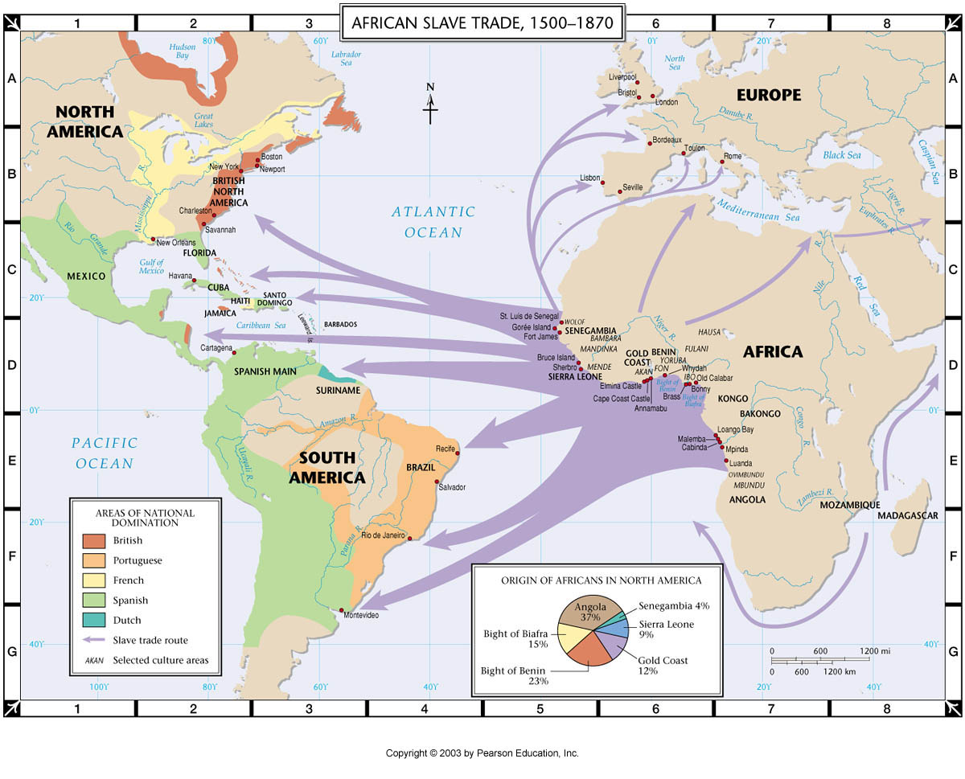

Slide 7
A. 16TH C. SPANISH INCURSIONS: C. & S. AMERICA
GOLD, GLORY, GOD
TRIBUTE COLONIES/ENCOMIENDA
EXPLOITATION OF LABOR
1st NATIVES THEN SLAVES
B. DE LAS CASAS
INITIALLY SPANISH MEN & LIVED IN CITIES
MOVED TO RURAL AREAS
PLANTATION AGRICULTURE
WOMEN CAME LATER

Slide 8
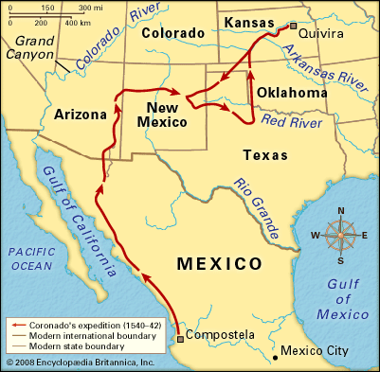
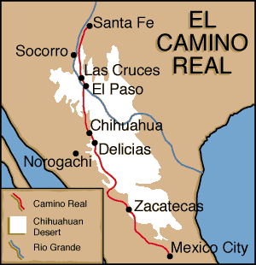
B. SPAIN IN NORTH AMERICA
1. *ST. AUGUSTINE 1565 –de AVILES
OLDEST CONTINUOUS SETTLEMENT U.S.
NO FURTHER EXPANSION NORTH
CONFLICT W/ FRANCE & NATIVES
2. *CORONADO 1540 7 CITIES OF GOLD
DEBACLE, DEATH & DEBT
3. *JUAN DE ONATE 1580’S
ACOMA MASSACRE 1599
*1610’S “NO GOLD & LEFT”
BUT……GOD:
ESTABLISHED MISSIONS

Slide 9
4. FRANCISCAN ARRIVAL & SANTA FE
1675 60 MISSIONS BUILT
FORCED CONVERSION
RISE OF PO’PAY: PROTECT TRADITION
PUEBLO REVOLT 1680
SPANISH RETALIATED VIOLENTLY
PUEBLO’S RULED 12 YRS.
SPANISH RETURNED 1693
ABOLISHED ENCOMIENDA & REPLACED W/ HACIENDA SYSTEM
DISADVANTAGEOUS TO NATIVES
SYNCRETISM OF RELIGION
HALTED SPANISH NORTHERN PUSH

Slide 10
Check for Understanding
1. The image best serves as evidence that many Native American Groups had developed farming techniques that
A. spread tobacco cultivation throughout the continent
B. supported permanent villages
C. allowed for continuous warfare
D. differed dramatically from English agricultural practices
2. By the early 1600’s, which of the following had most changed the circumstances of villages such as Secotan in eastern N. Am.?
A. the establishment of permanent settlements by English colonists
B. the impact of epidemic diseases introduced by Europeans
C. the decline of the fur & beaver trades
D. In introduction of new foods into the Native American diet.

Slide 11
3. Which of the following best explains the presence of the Spanish in the areas depicted in the map?
A. The emergence of competition between European powers in the Americas
B. The outbreak of rebellion by the Pueblo Indians
C. The spread of maize culture from American Indians to the Spanish colonists
D. The introduction of African slavery to Spanish Florida
4. Which of the following was a major difference between the Spanish colonies in the Americas in the 1500s & the English colonies in the Americas in the early 1600s?
A. The Spanish adopted African slavery in their colonies, while the English relied more on Native labor
B. The Spanish actively sought to convert American Indians to Christianity than did the English
C. The Spanish tried to change American Indian worldviews, while the English generally accommodated them
D. The Spanish rejected assimilating American Indians into their culture, while the English favored assimilation

Slide 12
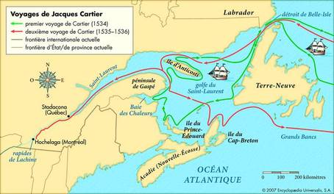
II. NEW FRANCE: #EXPLORATIONGOALS
CARTIER, LA SALLE, CHAMPLAIN, MARQUETTE
1ST TO SEEK NORTHWEST PASSAGE
FUR, COD
SOME RELIGIOUS CONVERSION
UNSUCCESSFUL AG SETTLEMENT
LOUIS XIV 1662: ROYAL COLONY
FEW SETTLERS: WEATHER 1700 ≈ 19K POP
EVENTUALLY, LARGE N.AM. LAND HOLDINGS
FR & NATIVE RELATIONS
MIL, COMM & DIPLO CONNECTIONS
INTERMARRIAGE, ‘MORE HUMANE’ TREATMENT, NOT SEEN AS INFERIOR, SOME CONVERSION
MOURNING WARS – ALGONGUIN, IROQUOIS ETC. EXPEDITIONS TO REPLACE LOST MEMBERS (DISEASE, WARFARE) WITH FRENCH

Slide 13
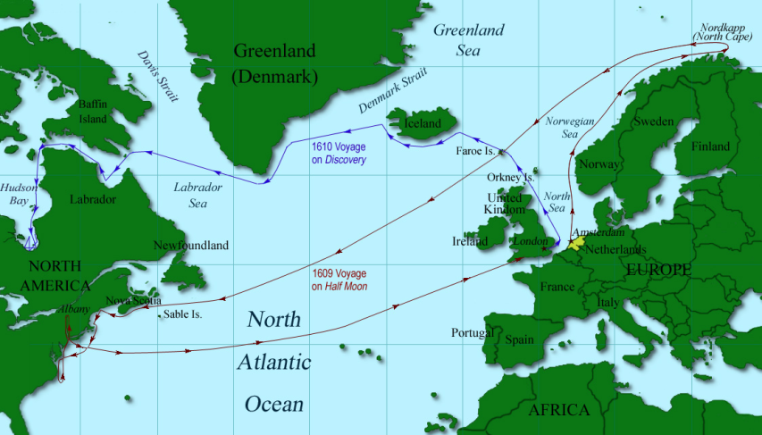
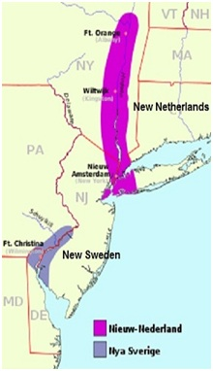
III. DUTCH PRESENCE IN N. AMERICA
DUTCH DOMINATED EURO $$$, SLAVE & SUGAR TRADE
1609 HENRY HUDSON - FUR
1621 DUTCH W. INDIA CO. ESTABLISHED COLONY
NW PASSAGE – FAIL, FARMERS, ARTISANS TO NO AVAIL
GENEROUS LAND GRANTS, PATROONS
NATIVE RELATIONS SOURED QUICKLY
1643 ALGONQUIN ATTACKS – DEADLY & VICIOUS FOR ALL
DUTCH LOST INTEREST
TENSION B/W DUTCH & NATIVES & DUTCH & FRENCH → 70 YR. WAR

Slide 14
SAQ Practice
Answer the following:
A) Briefly explain ONE example of how contact between Native Americans & Europeans brought changes to Native American societies in the period 1492 to 1700
B) Briefly explain a SECOND example of how contact between Native Americans & Europeans brought changes to Native American societies in the period 1492 to 1700
C) Briefly explain ONE example of how Native American societies resisted change brought by contact with Europeans in the same period

Slide 15
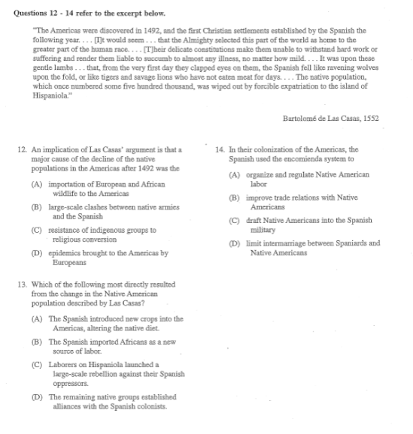
In your notebooks write down the answers to the following questions

