Slide 1

RE-THINKING & RE-WORKING THE NATIONAL GOVERNMENT 1781-1788
Obj: What events led some American leaders to determine a stronger central government was necessary and how did they succeed?

Slide 2
I. TRADE (OR LACK THEREOF)
TWO MAJOR SOURCES OF COLONIAL ERA COMMERCE ELIMINATED – NO INCOME
  Exports to Britain restricted.
  British law prohibited trade with Britain's remaining sugar colonies in the Caribbean.
BRITAIN FLOODED U.S. W/ CHEAPER MFG IMPORTS
WESTERNERS TROUBLE WITH NATIVE AMERICANS

Slide 3
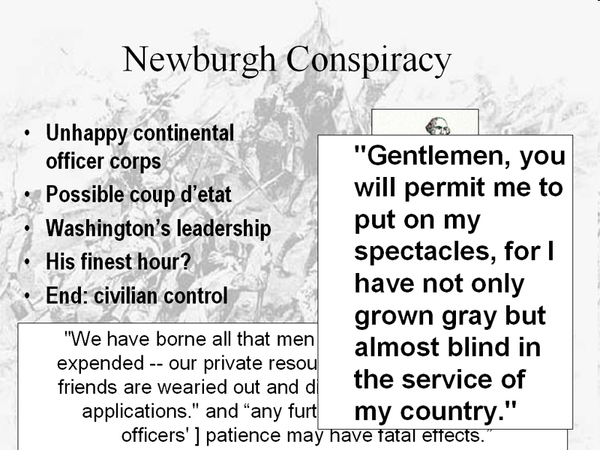
II. INFLATION, DEBT, NO INCOME
HIGH LEVEL OF STATE DEBT FUELED INFLATION
NATION MUST BE ON SOUND FINANCIAL FOOTING
R. MORRIS & 5% IMPORT DUTY 1782 – REJECTED
TREATY SIGNED SEPT/82 & ARRIVED NOV/83
NEWBERGH CONSPIRACY 3/83
IMPOST 1783 REJECTED APRIL
CONGRESS ADJOURNED W/O PROVISIONS FOR PAY

Slide 4
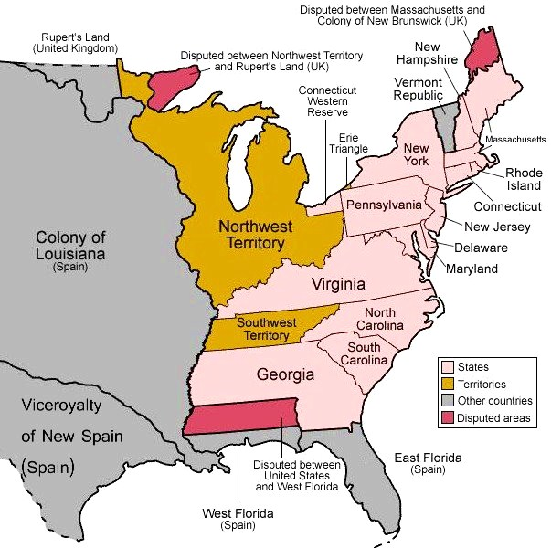
III. FOREIGN AFFAIRS
A. JAY-GARDOQUI TREATY 1784
FLORIDA BORDER DISPUTE
SPAIN DIDN’T SIGN TREATY
SPAIN DIDN’T RECOGNIZE U.S. RIGHTS TO SHIP GOODS DOWN THE MISSISSIPPI
SECTIONS SUSPICIOUS OF EACH OTHER’S INTENTIONS
TREATY NOT RATIFIED

Slide 5
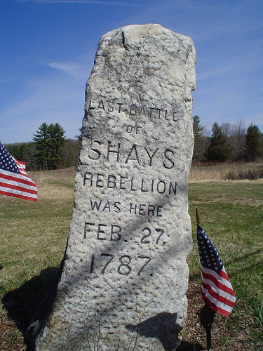
IV. DOMESTIC AFFAIRS
A. SHAYS’ S REBELLION 8/1786
AOFC LIMITED GOVERNMENT WAS INEFFICIENT
“I saw 1 head turning into 13” GW
Culmination of signs for many: federal gov’t needed teeth
Catalyst to stabilize the country: threat to property
Daniel Shays’ & others stormed courthouse in Springfield
No aid for MA from central gov’t

Slide 6
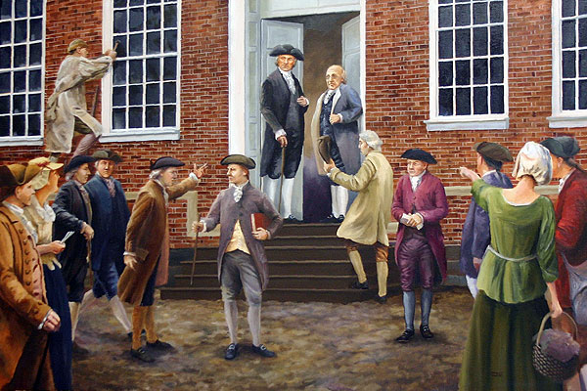
B. STRENGTHENING FEDERAL AUTHORITY
1. ANNAPOLIS CONVENTION 9/17/86
Focus on common commerce issues
Reps from 5 states
2. PHILADELPHIA CONVENTION 5/87
55 delegates from 12 states
Democracy = Anarchy
ISSUES: amend or scrap Articles & Representation

Slide 7
C. DEBATE OVER REPRESENTATION
REPUBLICANISM – THE IDEA THAT REPRESENTATION WAS CENTRAL TO GOOD GOVERNMENT

Slide 8
1. THE COMPROMISE
VIRGINIA PLAN – E. RANDOLPH (JAMES MADISON)
BICAMERAL LEGISLATURE, REPRESENTATION PROPORTIONATE TO POPULATION
NEW JERSEY PLAN – WM. PATTERSON
UNICAMERAL LEGISLATURE, EACH STATE EQUAL VOTE
CONNECTICUT COMPROMISE (GREAT COMPROMISE) R. SHERMAN – BICAMERAL LEGISLATURE
EQUAL VOTE/EACH STATE UPPER HOUSE, PROPORTIONALLOWER HOUSE
REVENUE BILLS INTRODUCED IN THE HOUSE
OPPOSED BY SOME BUT PASSED
DESIRE FOR STRONG CENTRAL GOVERNMENT OUTWEIGHED FEAR OF ABSOLUTE GOVERNMENT & REDUCTION OF STATES’ RIGHTS

Slide 9
2. SEPARATION OF POWERS
CHECKS AND BALANCES
FEDERALIST #51 – CONSTITUTION SUPREME, OUTLINE GOVERNMENT POWER & LIMITS

Slide 10
3. FEDERALISM
FEDERALIST #51 – SHARED POWER, CONSTITUTION SUPREME

Slide 11
4. MORE COMPROMISE
3/5THS COMPROMISE
COMMERCE COMPROMISE
CONSTITUTION PERPETUATED SLAVERY
NO INTERFERENCE WITH SLAVE TRADE UNTIL 1808
FED REGULATES INTER & INT’L TRADE
STATES REGULATE INTRASTATE
NO EXPORT DUTIES 20 YEARS
RETURN FUGITIVE SLAVES
PRESIDENCY: FEDERALIST #70
4 YR TERM, ELECTORAL COLLEGE, NO LIMITS ON # OF TERMS (UNTIL 22ND 1951) PAID TO STOP INFLUENCE OF BRIBES
STRONG QUICK ACTION BY PRESIDENT TO BALANCE DELIBERATIVE NATURE OF LEG.
DO SLAVES COUNT AS POPULATION?
PROPERTY RIGHTS
SLAVES 3/5THS OF A PERSON TOWARDS POPULATION BUT ALSO TAXED AS PROPERTY AT SAME RATE

Slide 12
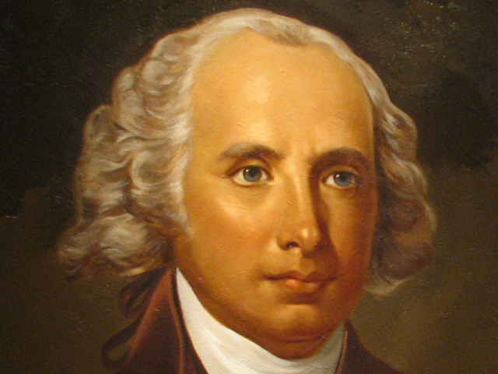
D. RATIFICATION – JAMES MADISON FATHER OF THE CONSTITUTION
KNEW STATE LEGISLATURES WOULDN’T RATIFY (SUBORD-INATION TO FED AUTHORITY)
CONSTITUTION REPUDIATED IDEA THAT STATES WERE FOUNDATION OF THE NEW GOVERNMENT
“WE THE PEOPLE” NOT “WE THE STATES”
SPECIAL STATE CONVENTIONS
9 OUT OF 13 NEEDED FOR RATIFICATION

Slide 13
E. FEDERALIST PAPERS
Madison, Jay, Hamilton
FEDERALISTS (AH): NEED STRONGER CENTRAL GOVERNMENT
ANTI-FEDERALISTS (ADAMS): STATES SUBORDINATE TO NATIONAL GOVERNMENT UNACCEPTABLE
FEDERALIST #10 – STRONG & UNIFIED GOV’T MORE EFFICIENT THAN INDIVIDUAL STATES AT CONTROLLING FACTIONS
MASSACHUSETTS: CONTENTIOUS RATIFICATION 2/1788– 4 STATES FOLLOW
NH 9TH STATE 6/21/88 BUT NOT YET FOR NEW YORK & VIRGINIA
VA 6/26/88 & FINALLY NY RATIFY JULY 26 (30 TO 27)

Slide 14
How did the definition of citizenship in the new republic exclude Native Americans & African Americans
Support an argument about the assertion that the Constitution was a “Bundle of Compromises” that shaped the direction of the new nation. Which compromise were most significant & why?

Slide 15
Briefly explain how 1 specific historical development represents an accomplish-ment of the national government under the Articles of Confederation
Briefly explain 1 specific argument critics used in the 1780’s to support revising the Articles of Confederation
Briefly explain 1 specific way in which the U.S. Constitution addresses a criticism of the Articles of Confederation

