Slide 1
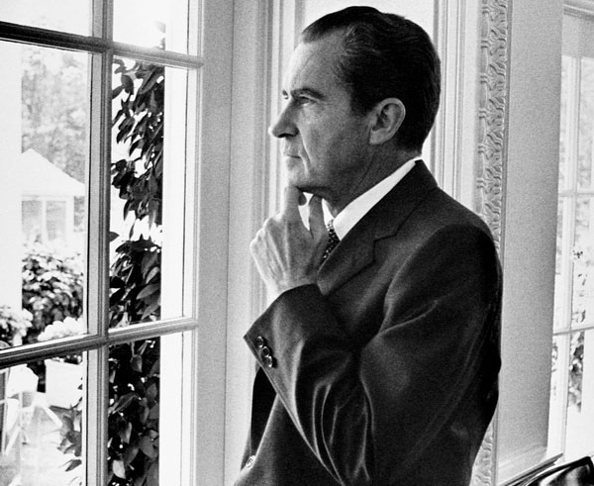
THE FALL OF RICHARD MILHOUS NIXON

Slide 2

NIXON’S STRENGTHS
APOLLO 11: 7/21/69
INCREASE SOCIAL SECURITY BENEFITS
BUILD SUBSIDIZED HOUSING
EXPANED JOB CORPS
LOWERED VOTING AGE TO 18
OSHA, EPA, EARTH DAY (4/22/14)

Slide 3
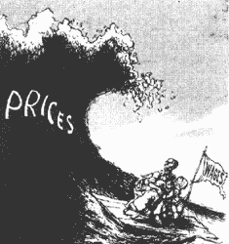
A TROUBLED ECONOMY
INFLATION – WAR COSTS, OIL PRICES, BUDGET DEFICITS
90 PRICE & WAGE FREEZE
OIL EMBARGO
NIXONOMICS

Slide 4
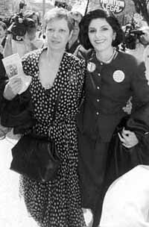
NIXON’S SOCIETY
ESTABLISH NEW REPUBLICAN BASE
“THE PLUMBERS” & The Pentagon Papers ‘70
SOUTHERN STRATEGY
SUPREME COURT
60’s SERIES OF CASES SHIFTED TO FAVOR POOR & DISPOSSESSED UNDER EARL WARREN. DECISIONS SEEN AS UPSETTING SOCIAL MORES & RESPONSIBLE FOR INCREASE IN CRIME, DISORDER & MORAL DECAY: Engel v Vitale, Gideon, Escobedo, Miranda & Baker v. Carr - redistricting
Blackmun, Powell, Rehnquist – not as conservative as many wanted
Swann v. Ch.-Mecklenberg Bd. -busing
Roe v. Wade-abortion
Bakke v UCLA – upheld affirmative action

Slide 5
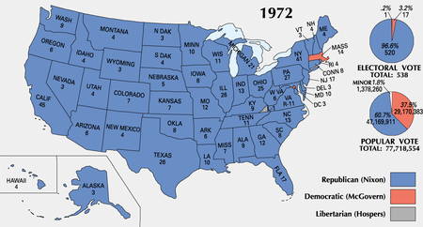
ELECTION 1972
CREEP
WATERGATE CONTAINED
NIXON 520 VS MCGOVERN 17
56% VOTED (64% IN 1960)

Slide 6
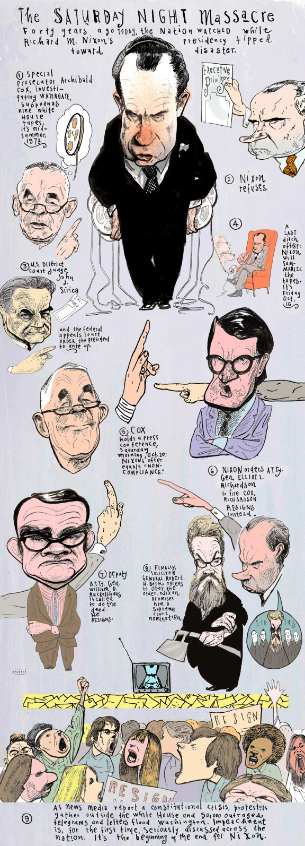
IMMEDIATE PROBLEMS PLAGUE NIXON
*BOLD ATTACK ON INFLATION – PRICE & WAGE FREEZES HELPED W/ ELECTION BUT THEN CHANGED COURSE
*WATERGATE INVESTIGATION BEGINS TO LEAD TO THE WHITE HOUSE- WOODWARD & BERNSTEIN’S ‘DEEP THROAT’
*5/73 ERVIN COMMITTEE TELEVISES HEARINGS, LOTS OF REVELATIONS NO ‘SMOKING GUN’
*10/73 COURT ORDER TO PRODUCE TAPES & SATURDAY NIGHT MASSACRE
*10/73 AGNEW RESIGNS & FORD SWORN IN – ONLY VP & PRES NEVER ELECTED

Slide 7

INVESTIGATION LEADS TO ARTICLES OF IMPEACHMENT
NEW PROSECUTOR JAWORSKI
U.S. V. NIXON 1974 – NO EXECUTIVE PRIVILEGE – TAPES TURNED OVER
3 ARTICLES OF IMPEACHMENT LATE JULY
AUGUST 9, 1974 RESIGNS BEFORE VOTE ON IMPEACHMENT

Slide 8
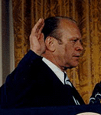
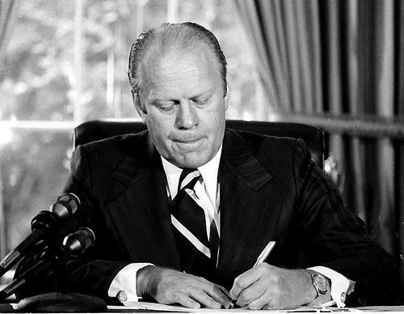
RE-ESTABLISHING THE PRESIDENCY

Slide 9

THE FORD ADMINISTRATION 1974-1976
DOMESTIC POLICY
PARDON – deal beforehand?
CIA + G. H.W. BUSH – 8 attempts on Castro – bring honesty & truth back
WHIP INFLATION NOW (WIN) unemployment, gas restrictions, Japanese imports eventually cause of unfavorable balance of trade
ENERGY PROGRAM – no coherent policy & we’re still trying to figure it out

Slide 10
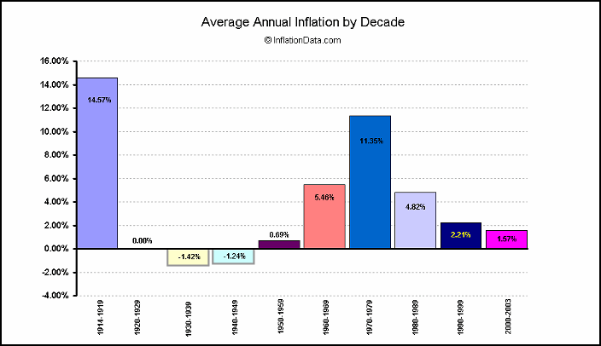
ECONOMY & ENERGY
JAPANESE IMPORTS 2 TO 4 MILL. 70-89
FED RAISES INT. RATES
UNEMPLOYMENT 11% 1975
BIG 3 FAIL TO REINVENT THEMSELVES
SERVICE SECTOR JOBS INCREASE BUT LITTLE COMFORT FOR FACTORY WORKERS
1976 DEFICIT, INFLATION & UNEMPLOY. CONTINUE

Slide 11
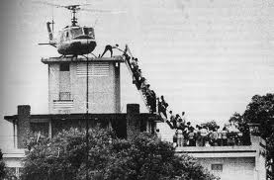
FOREIGN POLICY
VIETNAM & SAIGON – WE LOST THE WAR
MAYAGUEZ & CAMBODIA – SHOW OF FORCE
RESCUE CREW BUT 41 MARINES DEAD

Slide 12
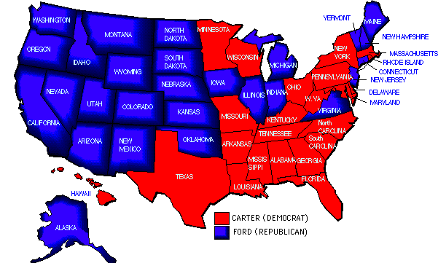
ELECTION OF 1976
NATIONAL MORALE LOW
BICENTENNIAL
FORD GETS NOMINATION
CARTER – DC OUTSIDER
VOTING ALONG CLASS LINES
REPUBLICANS STILL DIS-GUSTED W/ NIXON
FORD 240 V CARTER 297
REJECTION OF IMPERIAL PRESIDENCY
SELF PROCLAIMED POPULIST PRESIDENT

Slide 13
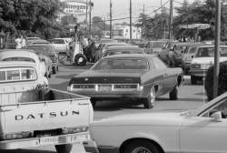
DOMESTIC POLICY
NO COHERENCY, VISION OR UNITY
INFLATION & OIL AGAIN
ENERGY POLICY PASSED BUT INEFFECTIVE, NOT TOUGH ENOUGH
OIL SHOCKS DUE TO VIETNAM & SPENDING, FOOD SUPPLY SHORTAGE, 6 FOLD INCREASE IN PETROLEUM PRICES
REAL WAGES DECLINE 5.5% BY 1980

Slide 14
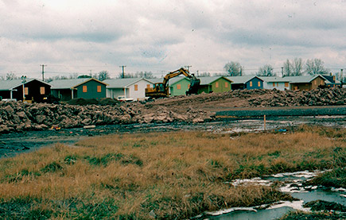
ENVIRONMENTAL POLICY
RACHEL CARSON & “SILENT SPRING”
ALASKA LANDS ACT
LOVE CANAL, NY
SUPERFUND – MONIES FOR CLEANUP 1980

Slide 15
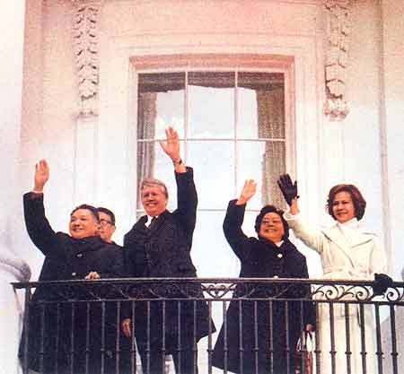
FOREIGN POLICY COLD WAR
CHINA FOLLOWS DÉTENTE WITH DENG XIAOPING & FULL DIPLO RELATIONS 79
USSR SALT II TALKS DIES WITH INVASION OF AF-GHANISTAN- SEEN AS USSR DESIRE FOR EXPANSION
BAN SALES OF HIGH TECH
BOYCOTT 1980 OLYMPICS
BOYCOTT OF GRAIN
NSA BRZEZINSKI “1ST POLE IN 300 YEARS TO STICK IT TO THE RUSSIANS”

Slide 16
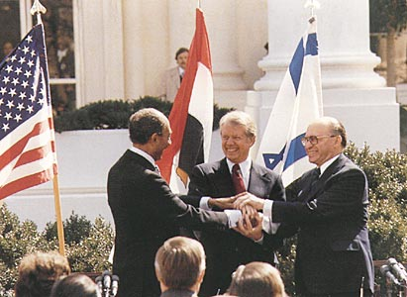
FOREIGN POLICY LATIN AMERICA & MIDDLE EAST
RIGHTS TO PANAMA CANAL REVERT TO PANAMA IN 1999
CAMP DAVID ACCORDS 1978: MOST SUCCESSFUL ACT DURING ADMIN.
FRAMEWORK FOR ARAB-ISRAELI NEGOTIATIONS
ASSASSINATION OF SADAT IN 1981 REVERSES ANY GAINS

Slide 17
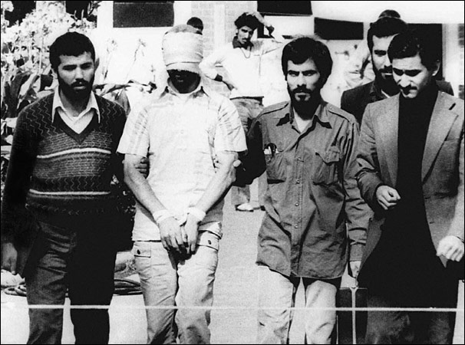
IRANIAN CRISIS 1979 & CARTER DOCTRINE 1980
IRAN UNDER SHAH PAHLAVI SINCE 53 W/ CIA AID – REPRESSIVE BUT PRO-AMERICAN
SHIITES HATE SHAH & US MISREAD LEVEL OF TENSION
1/79 SHAH FLED DUE TO UPRISINGS
KHOMEINI RETURNS, STRICT ISLAMIC RULE
SHAH TO US FOR TREAT-MENT
53 HOSTAGES TAKEN FOR 444 DAYS
CD:US FIGHT TO PROTET VITAL OIL INTERESTS OF PERSIAN GULF BUT NO ENFORCEMENT

Slide 18
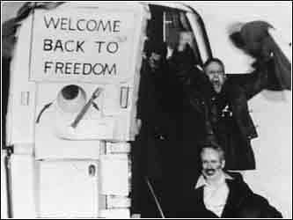
FAILED RESCUE & RELEASE
APRIL 1980 ATTEMPTED RESCUE – FAILURE – 8 MARINES DEAD
SECRETARY OF STATE VANCE RESIGNS
RESCUE SEEN AS DECLINING US POWER THROUGHOUT THE WORLD
1/20/81 RELEASE ON DAY OF REAGAN INAUGURATION- HE GETS THE CREDIT

