Slide 1
REPUBLICAN ASCENDANCY & A RETURN TO NORMALCY OBJ: TO CONSIDER THE IMPACT OF WWI ON POLITICS IN THE 1920’S

Slide 2
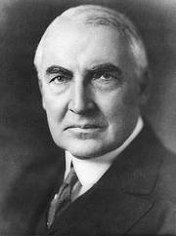
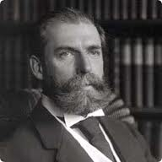
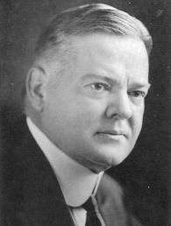
I. POLITICS IN THE ROARING 20’S
A. WARREN G. HARDING 1921-1923
1. RETURN TO STABILITY & NORMALCY
POWERFUL CABINET BECAUSE HE WASN’T
STATE – C.E. HUGHES
TREASURY – A.MELLON
COMMERCE – H. HOOVER
OHIO GANG – LESSER POSITIONS
2. POLICIES
LAISSEZ FAIRE
PRO-BUSINESS
REDUCED TAXES
PARDONED DEBS
3. DIED 1923

Slide 3
4. DOMESTIC AFFAIRS – MELLON AT THE HELM
a. ECONOMIC NATIONALISM
4 WAYS GOVERNMENT SUPPORTED BIG BUSINESS:
1) FORDNEY-McCUMBER TARIFF 1922 HIGHEST IN HISTORY
2) DEBT REDUCTION: TAX CUTS, ↓ GOV’T SPENDING
3) CUTBACKS AT FTC & PRO-BUSINESS APPOINTMENTS
4) HERBERT HOOVER @ COMMERCE

Slide 4
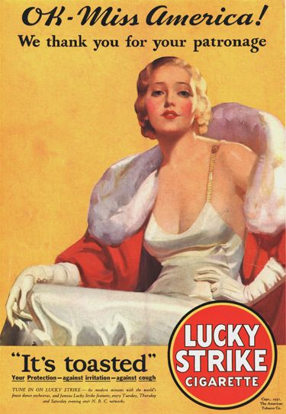
B. INDUSTRIAL GROWTH
SOARED BY 1922
60% BUSINESS & HOUSEHOLDS RUN ON ELECTRICITY
3R’S REPLACED W/ BUY, BUY, BUY
CONSPICUOUS CONSUMPTION “YOU’LL LOVE IT AT LEVITZ”
CORPORATE CONSOLIDATION & MASS MARKETING – RISE OF ADVERTISING

Slide 5
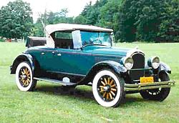
C. A – U – T - O
1. 2nd INDUSTRIAL REVOLUTION
1913 H. FORD - ASSEMBLY LINE
1925 75% BOUGHT ON CREDIT
CHRYSLER INTRODUCED COLOR & COMPETITION BEGAN
1929 9% OF ALL MFG. WAGES
1930 60% OF AMERICANS OWNED CARS
2. IMPACT
DRIVE IN MOVIES, CAR DATES, TRIPS TO THE SHORE, HOTELS, MOTELS, HOLIDAY INN’S, RESTAURANTS, SERVICE STATIONS
TOWNS EXPAND
FULL EMPLOYMENT
AND THEN……………..

Slide 6
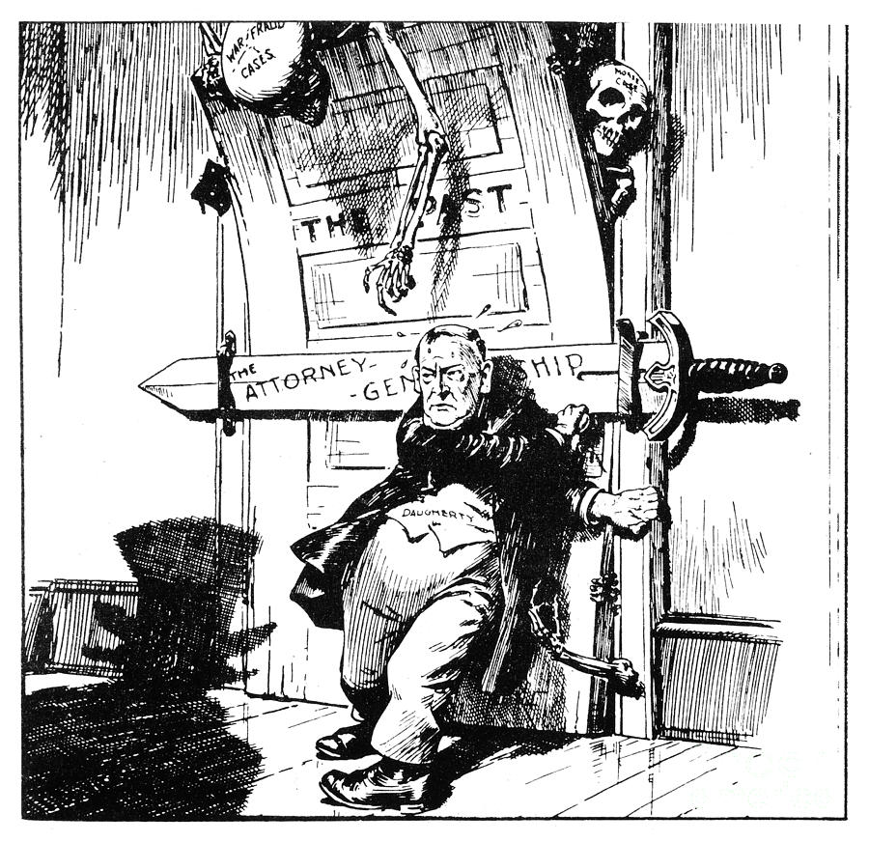
D. DEATH & SCANDALS “I HAVE NO TROUBLE WITH MY ENEMIES, IT’S MY DAMN FRIENDS THAT KEEP ME UP AT NIGHT”
*JULY 1923 VACATION & HEART ATTACK
*COOLIDGE TOOK OVER
*1924 INVESTIGATIONS
*TEAPOT DOME – LEASING OIL RESERVES $$$ - A. FALL JAILED
*FORBES CONVICTED OF STEALING FUNDS & FLED TO EUROPE
*DAUGHERTY ESCAPED CONVICTION IN 2 CRIMINAL TRIALS
N-nothin to it, I tell you!

Slide 7
E. FOREIGN AFFAIRS – INDEPENDENT INTERNATIONALISM RETURN TO ISOLATION ?
WASHINGTON NAVAL CONFERENCE 1921-1922
1ST EVER DISARMAMENT CONF.
3 PARTS:
5 POWER TREATY: SPECIFIC RATIO OF BATTLESHIPS – 1ST ATTEMPT AT NAVAL REDUCTION
4 POWER TREATY: CONSULT W/ EA. OTHER BEFORE TAKING ACTION IN E. ASIA – JAPAN #1 THREAT TO U.S. INTERESTS
9 POWER TREATY: INTERNATION-ALIZATION OF OPEN DOOR; RESPECT TERRITORIAL RIGHTS IN CHINA
PEACE THROUGHOUT 20’S BUT ALLOWED FOR JAPANESE EXPANSION

Slide 8
II. COOLIDGE AS PRESIDENT – CONSERVATISM CONTINUES “THE BUSINESS OF AMERICA IS BUSINESS”
PRESIDE BENIGNLY NOT GOVERN
RAISED ETHICAL TONE IN D.C.
EPITOMIZED MYTH OF AMERICAN SELF MADE MAN
KEATING-OWEN OVERTURNED
HIGH TARIFFS
PROMOTED BUSINESS INTERESTS

Slide 9
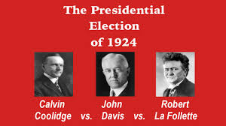
A.1924 ELECTION
GROWING ECONOMY, NO THREATS, NO CONTEST
DAVIS COMPROMISE CANDIDATE
LA FOLLETTE 16.6%
DAVIS LOWEST SHARE OF POP VOTE FOR DEMS IN HISTORY

Slide 10
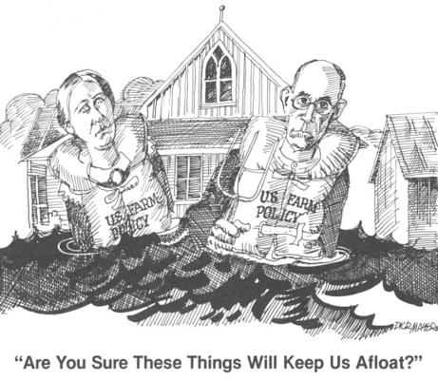
B. DOMESTIC AFFAIRS
1. MELLON REMAINED
TAX CUTS → HUGE PERSONAL FORTUNES
BIG BUSINESS & GOVERNMENT PARTNERS
ECONOMY CONTINUED TO RISE
2. FARMERS
PER CAPITA $273 (INDUSTRIAL $681)
MCNARY HAUGEN ACT 1924
2X VETOED ’27 & 28
PURCHASE SURPLUS WHEAT AT AVG. PRICE 1909-14 & RESELL ABROAD @ MARKET PRICE
VETO LED MANY TO VOTE DEMOCRATIC IN NEXT ELECTION

Slide 11
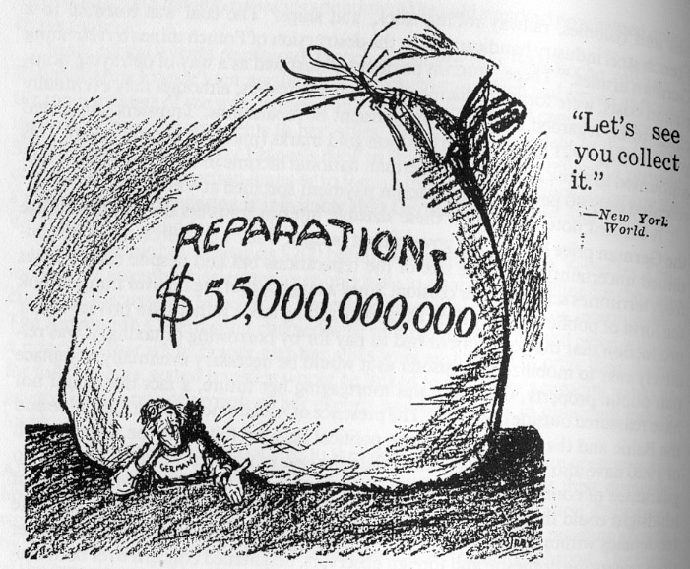
C. FOREIGN AFFAIRS WAR DEBT & REPARATIONS
CONNECTION B/W HIGH TARIFF & REPARATIONS
1. DAWES PLAN 1924: $200M LOAN TO STABILIZE GERMAN CURRENCY
2. YOUNG PLAN 1929: FURTHER REDUCTIONS
3. 3LOANS CEASED, PAYMENTS STOPPED, GERMANY DEFAULTED
4. KELLOGG-BRIAND PACT 1928: 62 NATIONS OUTLAW WAR
5. U.S. PEACE MOVEMENT GROWING

Slide 12
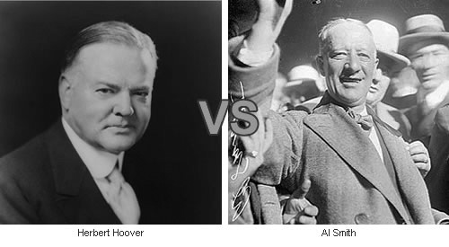
III. RISE OF HOOVER
A. 1928 ELECTION
HOOVER REP. DRY, PROTESTANT, RURAL UPBRINGING
AL SMITH DEM. WET, CATHOLIC, URBAN
HOOVER 58%
ARE DEMS DONE FOR?
BUT…………………
DEM GAINS IN CITIES: 12 LGST IN ‘24 WENT DEMOCRATIC IN ‘28
IMMIGRANTS, WE GET THE JOB DONE!
PROSPERITY MORE WIDELY SHARED BUT, MORE THAN ½ POPULATION SAW NO REAL BENEFITS

Slide 13
B. HE’S NOT YOUR FATHER’S REPUBLICAN
OPPOSED CUT-THROAT COMPETITION
CORPORATE COOPERATION
WELFARE CAPITALISM
ADVOCATED VOLUNTARISM
WASHINGTON BUSINESS CONFERENCES
TRADE ASSOCIATIONS
8 HOUR WORK DAY
DIVISION OF CO. RIVER H2O

Slide 14
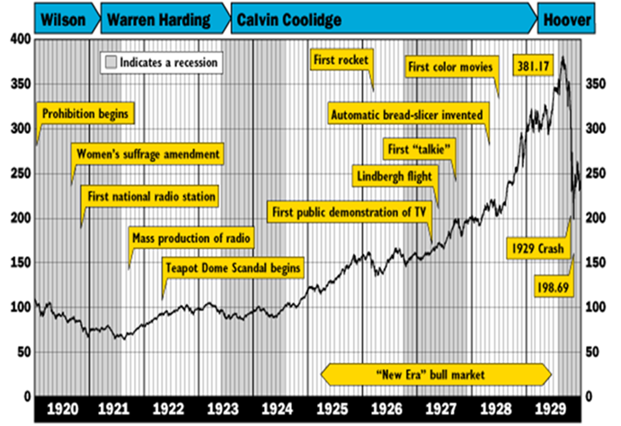
c. WHAT GOES UP MUST COME DOWN
1. 5 YR ARTIFICIAL RISE
2. TAX POLICIES
3. RAMPANT CONSUMER SPENDING
4. SPECULATION/BUYING ON MARGIN
5. CAUSES:
UNDERCONSUMPTION/OVER-PRODUCTION; INFLATION; MERGERS; TRADITIONAL INDUSTRY REPLACED BY NEW TECH
6. 10/24/29 BLACK THURSDAY
CLOSED MARKET LONG WEEKEND “BUSINESS OF U.S. IS ON A SOUND & PROSPEROUS BASIS”
29 MIL SHARES SOLD 10/24&29 COMBINED

Slide 15
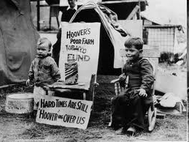
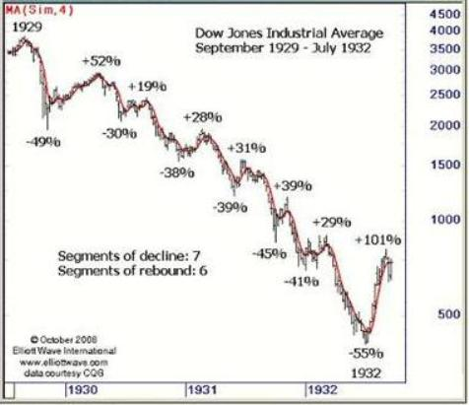
D. HOOVER’S RESPONSE
RUGGED INDIVIDUALISM
*LOCAL GOV’T & CHARITIES RESPONSIBLE
*PUBLIC WORKS: HOOVER DAM
*WASHINGTON BUSINESS CONFERENCES
*9K BANKS GONE
*SMOOT HAWLEY TARIFF: PROTECTIONIST 49%
*FEDERAL FARM BOARD – RAISE FARM PRICES BUT TOO LATE
*FINALLY REJECTED LAISSEZ FAIRE *RECONSTRUCTION FINANCE CORP – AID TO BIG BUSINESSES NOT YET BANKRUPT

