Slide 1


SOME THOUGHTS ON AP LIVE REVIEW SESSIONS 1 & 2

Slide 2
I. SKILLS
A. DOCUMENT ANALYSIS: USEFUL FOR SAQ & DBQ
1. WHEN FACED WITH AN IMAGE REMEMBER:
  POINT OF VIEW – WHAT IS MESSAGE?
  PURPOSE – REASON FOR IMAGE
  AUDIENCE
  AUTHOR

Slide 3
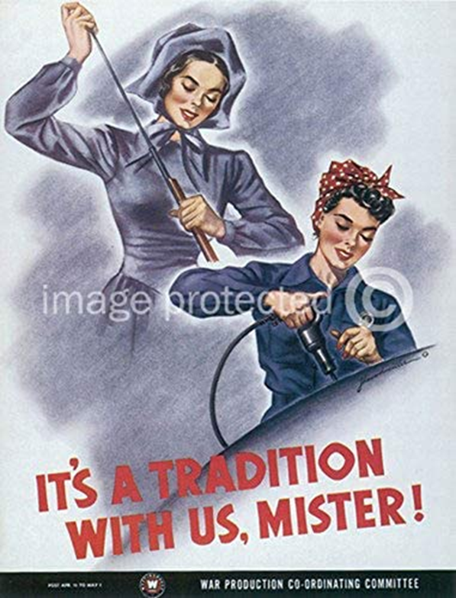
POINT OF VIEW?
Everyone needs to help during wartime – total war
Women have always stepped up to do their part from Revolutionary War to WWII
PURPOSE?
Get able bodied women into factories
Need for tremendous materials for war
Most men off to war
AUDIENCE?
Women
AUTHOR?
Government most likely, need to keep pace with demands for war

Slide 4

2. FACTS & INFO FOR ANALYSIS
What are similarities between women during Revolutionary War & WWII in terms of their roles in the war effort?
Republican Motherhood ideal Rev War
Increased eco independence WWII
Traditional role continued post Rev War
Women realized freedom, opportunity, pride they felt in assisting war effort but also, faced societies traditional views that forced many back into the home after the war

Slide 5
B. COMPARE & CONTRAST
This can apply to similar issues, political, economic, foreign policy, social (women, Native Americans, African Americans, religion, etc.) in the same or different time periods
It can be used in an LEQ or SAQ (historical interpretation)
When asked for ‘difference’ in interpretation you CANNOT just quote from the passage. Any info. given to you by the AP (quotes from historians or historical figures) can’t be used by you for credit.
When asked to BRIEFLY DESCRIBE you must describe/explain you can’t just say one was a red stripe and the other was a white stripe on the American Flag. The description is White signifies purity and innocence, Red, hardiness & valour.
Let’s look at an SAQ – perhaps read the questions first before you read the quotes, look at the people and the dates to help place quotes in context

Slide 6
“As to the history of the revolution, my ideas may be peculiar, perhaps singular. What do we mean by the revolution? The war? That was no part of the revolution; it was only an effect and consequence of it. The revolution was in the minds of the people, and this was effected from 1760 to 1775, in the course of fifteen years, before a drop of blood was shed at Lexington.”
Former president John Adams to former president Thomas Jefferson, August 1815
“There is nothing more common than to confound the terms of the American Revolution with those of the late American war. The American war is over: but this is far from being the case with the American Revolution. On the contrary, nothing but the first act of the great drama is closed. It remains yet to establish and perfect our new forms of government; and to prepare the principles, morals, and manners of our citizens, for these forms of government, after they are established and brought to perfection.” Benjamin Rush, signer of the Declaration of Independence and delegate to the Continental Congress, January 1787
Using the excerpts, answer (a), (b), and (c).
Briefly describe ONE significant difference between Adams’ understanding and Rush’s understanding of the American Revolution.
Briefly explain how ONE specific historical event or development from the period between 1760 and 1800 could be used to support Adams’ interpretation.
Briefly explain how ONE specific historical event or development from the period between 1760 and 1800 could be used to support Rush’s interpretation
So, take a few minutes to list 2 significant differences, & come up with 2 events/developments each for b & c then compare them to the rubric.

Slide 7
A. Possible options:
Adams thought the revolutionary spirit that led to fighting was the revolution; out of a growing resistance to British regulation, the emergence of an American identity completed the revolution
Rush argued the revolution was changing political systems & seeing if this new form of government could work, the revolution came after the fighting ended
B. Growing separateness from Britain: “American Mind”, end of Salutary Neglect
Stamp Act, Stamp Act Congress, & public demonstrations, including Sons of Liberty
Movement to boycott British goods
Boston Tea Party & Intolerable Acts
Common Sense by T. Paine
Declaration of Independence, list of grievances 1760-1775

Slide 8
C. republican form of gov’t, American Identity, nationalism developed during & after the war
Declaration of Independence; statement of principles, morals as basis of government
Articles of Confederation – State power over federal power
Slavery issue, 3/5ths, NW Ordinance
Constitutional Convention & US Constitution ratification
Bill of Rights
Election of George Washington, cabinet formation, Jay’s Treaty
Election 1800 – we are all Federalists we are all Republicans
Development of the 2 party system

