Slide 1
THE RISE OF RICHARD M. NIXON
CONSERVATIVE RESURGENCE

Slide 2
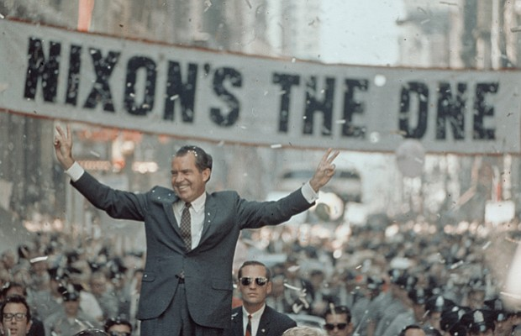
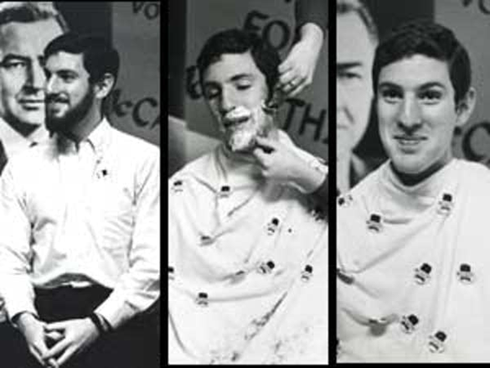
THE ELECTION OF 1968
DEMOCRATS DIVIDED
McCarthy, Humphrey, RFK
NEW REPUBLICANS: Sunbelt, SW, S. Cal.,
FL & Silent Majority
Richard Nixon & Spiro Agnew(R)
WAR MAJOR ISSUE “End the war win the peace”
Law & Order Campaign: pushback against liberal S.C. decisions
RIGHTS OF INDIVIDUAL VS. FEDERAL GOV’T
ENGEL, BAKER, ESCOBEDO, MIRANDA - ‘WARREN COURT’
GEORGE WALLACE-INDEPENDENT
GOING CLEAN FOR GENE

Slide 3
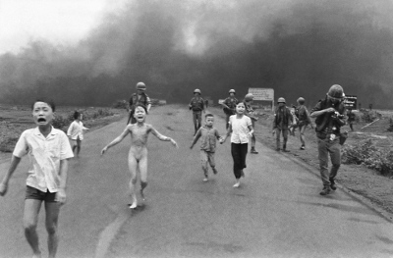
NIXON’S FOREIGN POLICY 1. REALPOLITIK
VIETNAMIZATION
*REPLACE US W/ SV TROOPS
*DIRECT NEGOTIATION WITH N. V.
*INCREASE AIR STRIKES
NEWS OF MY LAI MASSACRE
APRIL 1970 CAMBODIAN INCURSION
KENT STATE – MAY
JANUARY 1973 PARIS PEACE ACCORDS

Slide 4
2. DÉTENTE: a. RELAXATION OF TENSIONS WITH CHINA & RUSSIA
HENRY KISSINGER
COLD WAR: RIVALRY TO BE MANAGED NOT WON
IMPROVED RELATIONS W/ CHINA: 2/72 BEIJING, PING PONG DIPLOMACY
1979: FULL DIPLOMATIC RECOGNITION

Slide 5
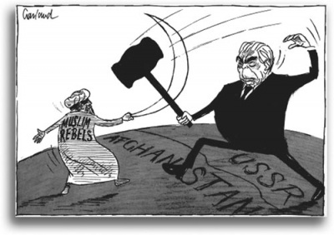
b. THAW IN THE COLD WAR
5/72 MOSCOW TRIP; DIDN’T END ARMS RACE
SALT I: NUCLEAR EQUALITY NOT SUPERIORITY: REDUCTION OF US & USSR BALLISTIC MISSILES
ABM TREATY: RESTRICT DEPLOYMENT OF OUR NATIONWIDE MISSLE DEFENSE SYSTEM
THAW ENDED W/ INVASION OF AFGHANISTAN 1980’S

Slide 6
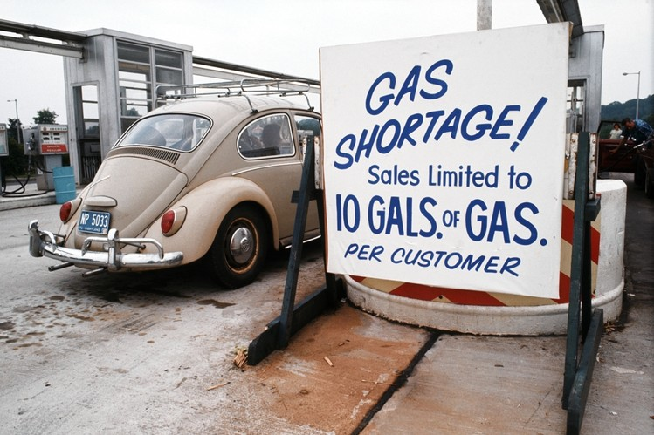
3. SHUTTLE DIPLOMACY ‘74 - MIDDLE EAST
6 DAYS WAR 1967
YOM KIPPUR WAR 1973
OIL EMBARGO
KISSINGER BROKERED TRUCE & ENDED EMBARGO
PALESTINIAN ISSUE UNRESOLVED

Slide 7
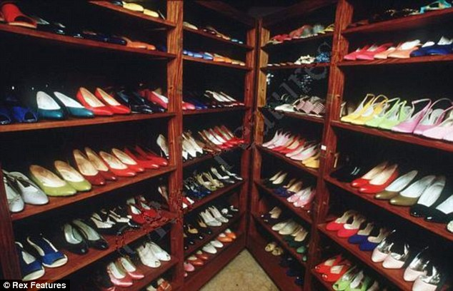
4. NIXON DOCTRINE: COUNTRIES RESPONSIBLE FOR OWN DEFENSE TO COMBAT DOMESTIC DISTURBANCES
IRAN: COUNTER SOVIET INFLUENCE
SOUTH AFRICA: SUPPORTED APARTHEID
PHILIPPINES: SUPPORT FOR MARCOS BUT FILIPINO’S DIDN’T
CHILE: FEARED ANOTHER CUBA, COVERT OPS TO GET ALLENDE TO RESIGN

