Slide 1
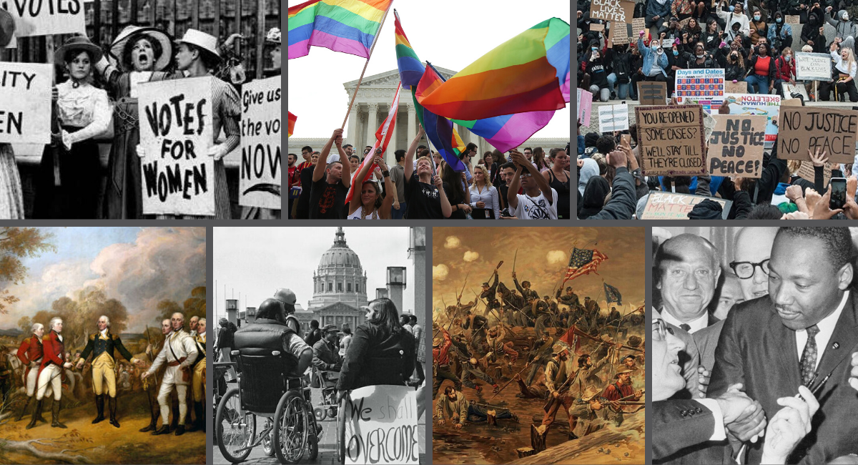
WELCOME TO APUSH Dr. Hosmer, Ms. Stuart & Mr. Ancharski https://uhsapush2015.weebly.com/

Slide 2
COVERSHEETS & UNIT OVERVIEW TO BE HANDED IN BEFORE EVERY UNIT EXAM
THEMES: USE THE ONES ON THE UNIT OVERVIEW
CCOT – MUST BE DIFFERENT INFO FROM THEMES, SPECIFIC EXAMPLES REQUIRED
TIMELINE: IN CHRONO ORDER – ALL #1’S RELATE, ALL #2’S ETC.
USE OVERVIEW FOR TERMS/EVENTS – THERE IS ALSO A TIMELINE ON COURSE WEBSITE AND ON THE OVERVIEW
QUESTIONS?

Slide 3
I. TRANSFORMATION OF THE ATLANTIC WORLD
2 CENTRAL DEVELOPMENTS 1450-1700
NATIVE AMERICAN DIVERSITY & COMPLEXITY
POL, ECO, SOC & REL PRACTICES DIFFERED BASED ON GEOGRAPHY, POPULATION SIZE
COLONIAL SETTLEMENT & COLUMBIAN EXCHANGE
DOMESTICATED ANIMALS/PLANTS ALTERED LANDSCAPE, INTRODUCED DISEASE & DECIMATED NATIVE POPS

Slide 4
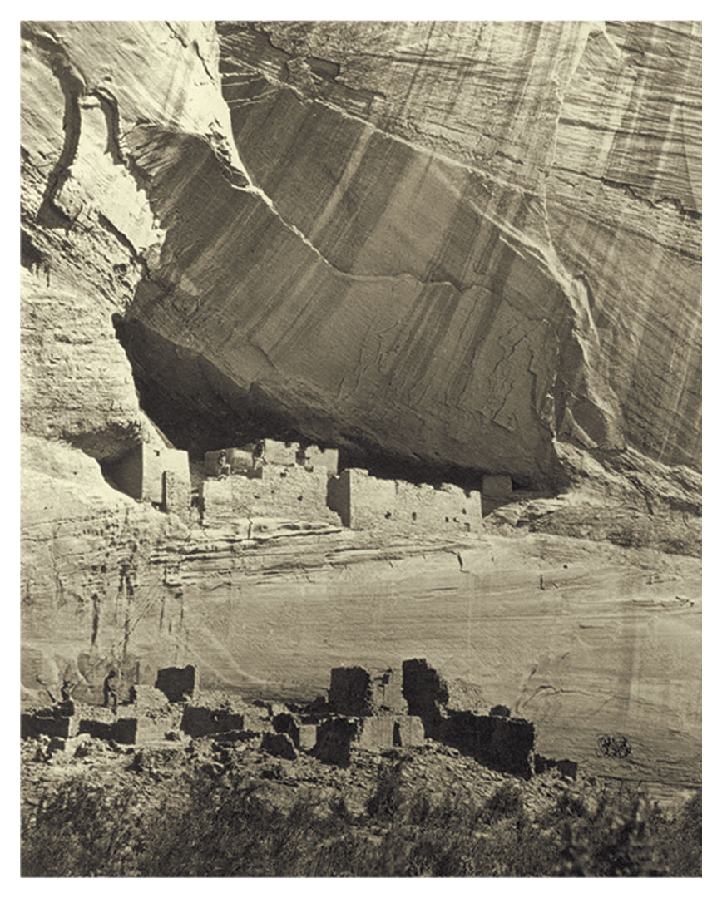
OBJ: TO COMPARE & CONTRAST DIFFERENT NATIVE COMMUITIES IN NORTH AMERICA PRIOR TO EUROPEAN CONTACT

Slide 5
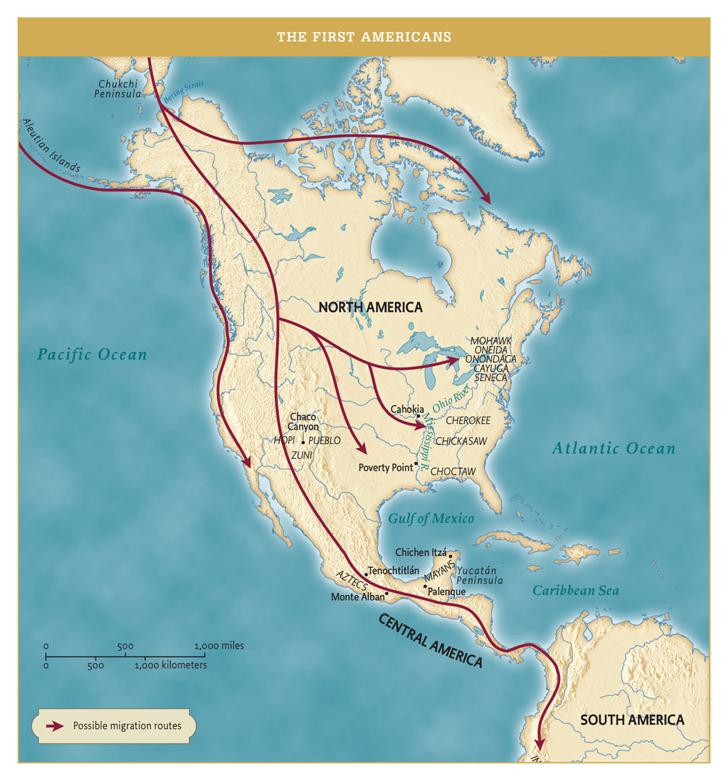
A. EARLY MIGRATION TO AMERICAS
3 WAVES: 13,000-3,000 BCE
MIGRATION USUALLY SOUTH (MEX/PERU) BUT ALSO, EAST TO MISS VALLEY & SE N. AM.
DOMESTICATED CROPS ABOUT 6K YRS AGO
POTATO, MAIZE, LED TO POP GROWTH
SW CROPS 3 SISTERS: SQUASH, MAIZE, BEANS

Slide 6
1.The trend in the map was MOST likely caused by which of the following?
a. | Native populations sought to live in similar natural environments.
b. | Native societies were able to adapt to diverse environments as they settled throughout the Americas.
c. | Settlement patterns were shifted as native groups tried to avoid mountainous regions.
d. | Native American populations were not able to live together peacefully, so widespread migration developed.

Slide 7
2. According to the map, which of the following was true about all of the native populations in the Americas?
a. | These populations were highly dependent on the cultivation of maize.
b. | These populations supported themselves through the vast resources of the ocean.
c. | Geographic factors were of little concern to these populations.
d. | All shared some similar characteristics because they came from related origins.

Slide 8
3. According to the map, which of the following was true about native populations in the Great Basin and Great Plains?
a. | They settled in permanent villages due to their use of large-scale agriculture.
b. | These populations engaged in mixed economies that favored a reliance on water.
c. | They developed largely mobile lifestyles in response to the aridity of their climate.
d. | These populations were similar to the populations of the Northeast and Mississippi River valley.

Slide 9
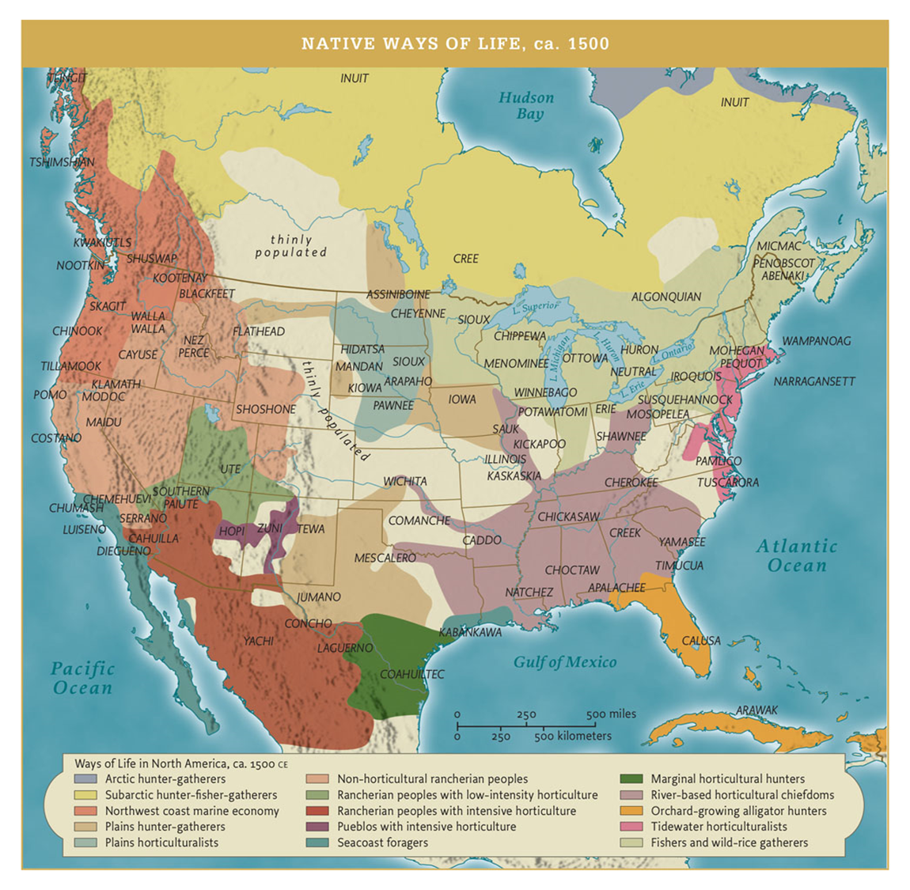
PAGE 11 B. NORTH AMERICAN NATIVE SOCIETIES DISTINCT & COMPLEX MISSISSIPPI WEST & SOUTHWEST EAST

Slide 10
What were the major patterns of Native American life in N. AM before Europeans arrived? Discuss & record in notes at least 2 patterns Perfected techniques of farming, hunting, fishing; structures of governance & political power, religious practices, extensive trade, irrigation, architecture
Where did mound-building tribes flourish?
A. In the Ohio River Valley B. near the Atlantic Ocean
C. in present day New Mexico D. in Florida’s peninsula
What was the significance of Native American cultivation of maize?
A. the ability to cultivate it led to extensive & permanent settlements
B. maize was a crop that provided complete nutrition for Native American cultures
C. Maize wasn’t consumed by people but used for animal fodder
D. The cultivation of maize was learned from the Spanish in the 15th century

Slide 11
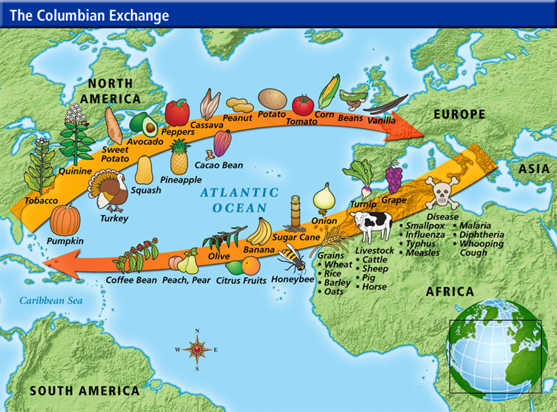
B. COLUMBIAN EXCHANGE

Slide 12
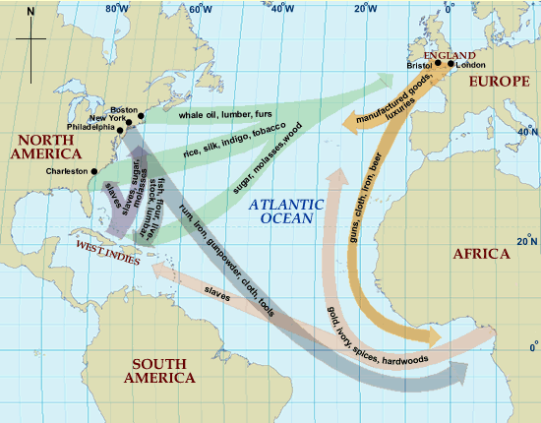
C. Atlantic Trade, Triangular Trade 16th – early 19th centuries

