Slide 1
THE TIMES THEY ARE A-CHANGIN’
OBJ: To understand the effects of WWI on America in the 1920’s by discussing tensions within society

Slide 2
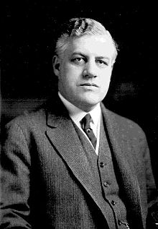
I. SEEING RED! RETURN TO ISOLATION & NATIVISM
A. THE RED SCARE 1919-1920
WWI PROPAGANDA CREATED CLIMATE OF INTOLERANCE
ANTI RADICALISM & ANTI IMMIGRATION
POST RUSSIAN REVOLUTION
B. THE FIGHTING QUAKER – A. MITCHELL PALMER
1919 BOMBS, PALMER RAIDS (UNION TARGETS), & MORE BOMBS WALL STREET 1920 & DEPORTATIONS
FOCUS ON UNIONS – SOCIALISTS & IMMIGRANTS

Slide 3
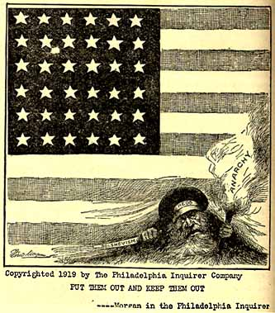
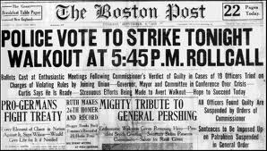
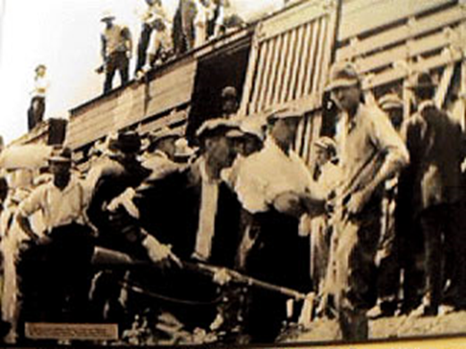
C. XENOPHOBIA
1. UNIONS: THE BASTIONS OF COMMUNISM
DEMANDS FOR RAISES
5MILL MEMBERS IN 1920
ANY BENEFITS MARGINAL
GOV’T USE OF INJUNCTIONS
CORPS USE OF YELLOW DOG CONTRACTS & WELFARE CAPITALISM
2. STRIKES
4MIL STRIKERS, 3600 STRIKES, $2BIL IN DAMAGES 1919 ALONE
TIMBER & BISBEE ‘17, BOSTON POLICE, SEATTLE LONGSHOREMEN & US STEEL ‘19
UNION “VICTORY” WAS FEDERAL IMMIGRATION RESTRICTIONS

Slide 4
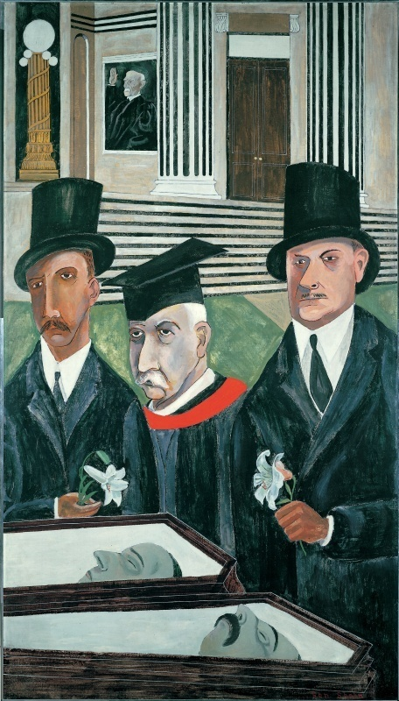
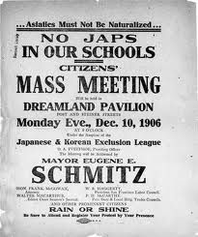
D. IMMIGRATION
1. RACISM
KKK: BLACKS, CATHOLICS, JEWS, IMMIGRANTS
RACE RIOTS 1917, 1919, 1921
ULTRACONSERVATIVE UPRISING AGAINST MODERNITY
2. PROHIBITION 18TH AMEND. 1919
CAN’T LEGISLATE MORALITY
3. ‘AMERICA’
SACCO & VANZETTI 1920
EMERGENCY QUOTA ACT 1921
IMMIGRATION ACT 1924
UNRESTRICTED IMM. W. HEMISPHERE
CA, HI, WA: JAPANESE DENIED CITIZENSHIP & LAND OWNERSHIP
BEN SHAHN – The Passion of Sacco & Vanzetti

Slide 5
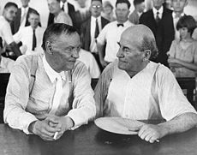
II. RELIGIOUS FUNDAMENTALISM SURGE IN FUNDAMENTALISM – THE RURAL COUNTERATTACK
A. SCOPES TRIAL 1925
CONFLICT B/W FUNDAMENTAL CHRISTIANITY & SCIENCE
TECHNOLOGICAL INNOVATION SPURRED SOCIAL TENSION
POST WAR PROTESTANTS FACED EXPANDING CATHOLIC & JEWISH POPULATIONS
TENNESSEE LAW CHALLENGED
ACLU SOUGHT CHALLENGE
DARROW-DEFENSE & BRYAN-PROSECUTION
HOLLOW VICTORY

Slide 6
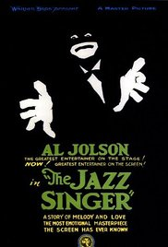
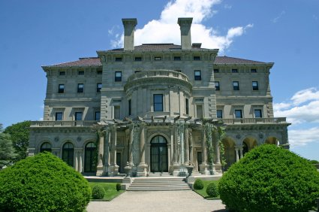
III. ART & ARCHITECTURE
Return to morality
The Sheik blatant sexuality & changing norms
Joseph Stella Brooklyn Bridge, Variation on an old Theme 1939
The Breakers – C. Vanderbilt II
1st movie synchronous sound

Slide 7
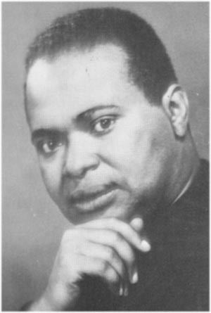
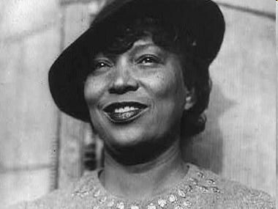
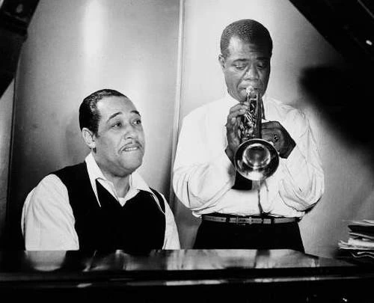
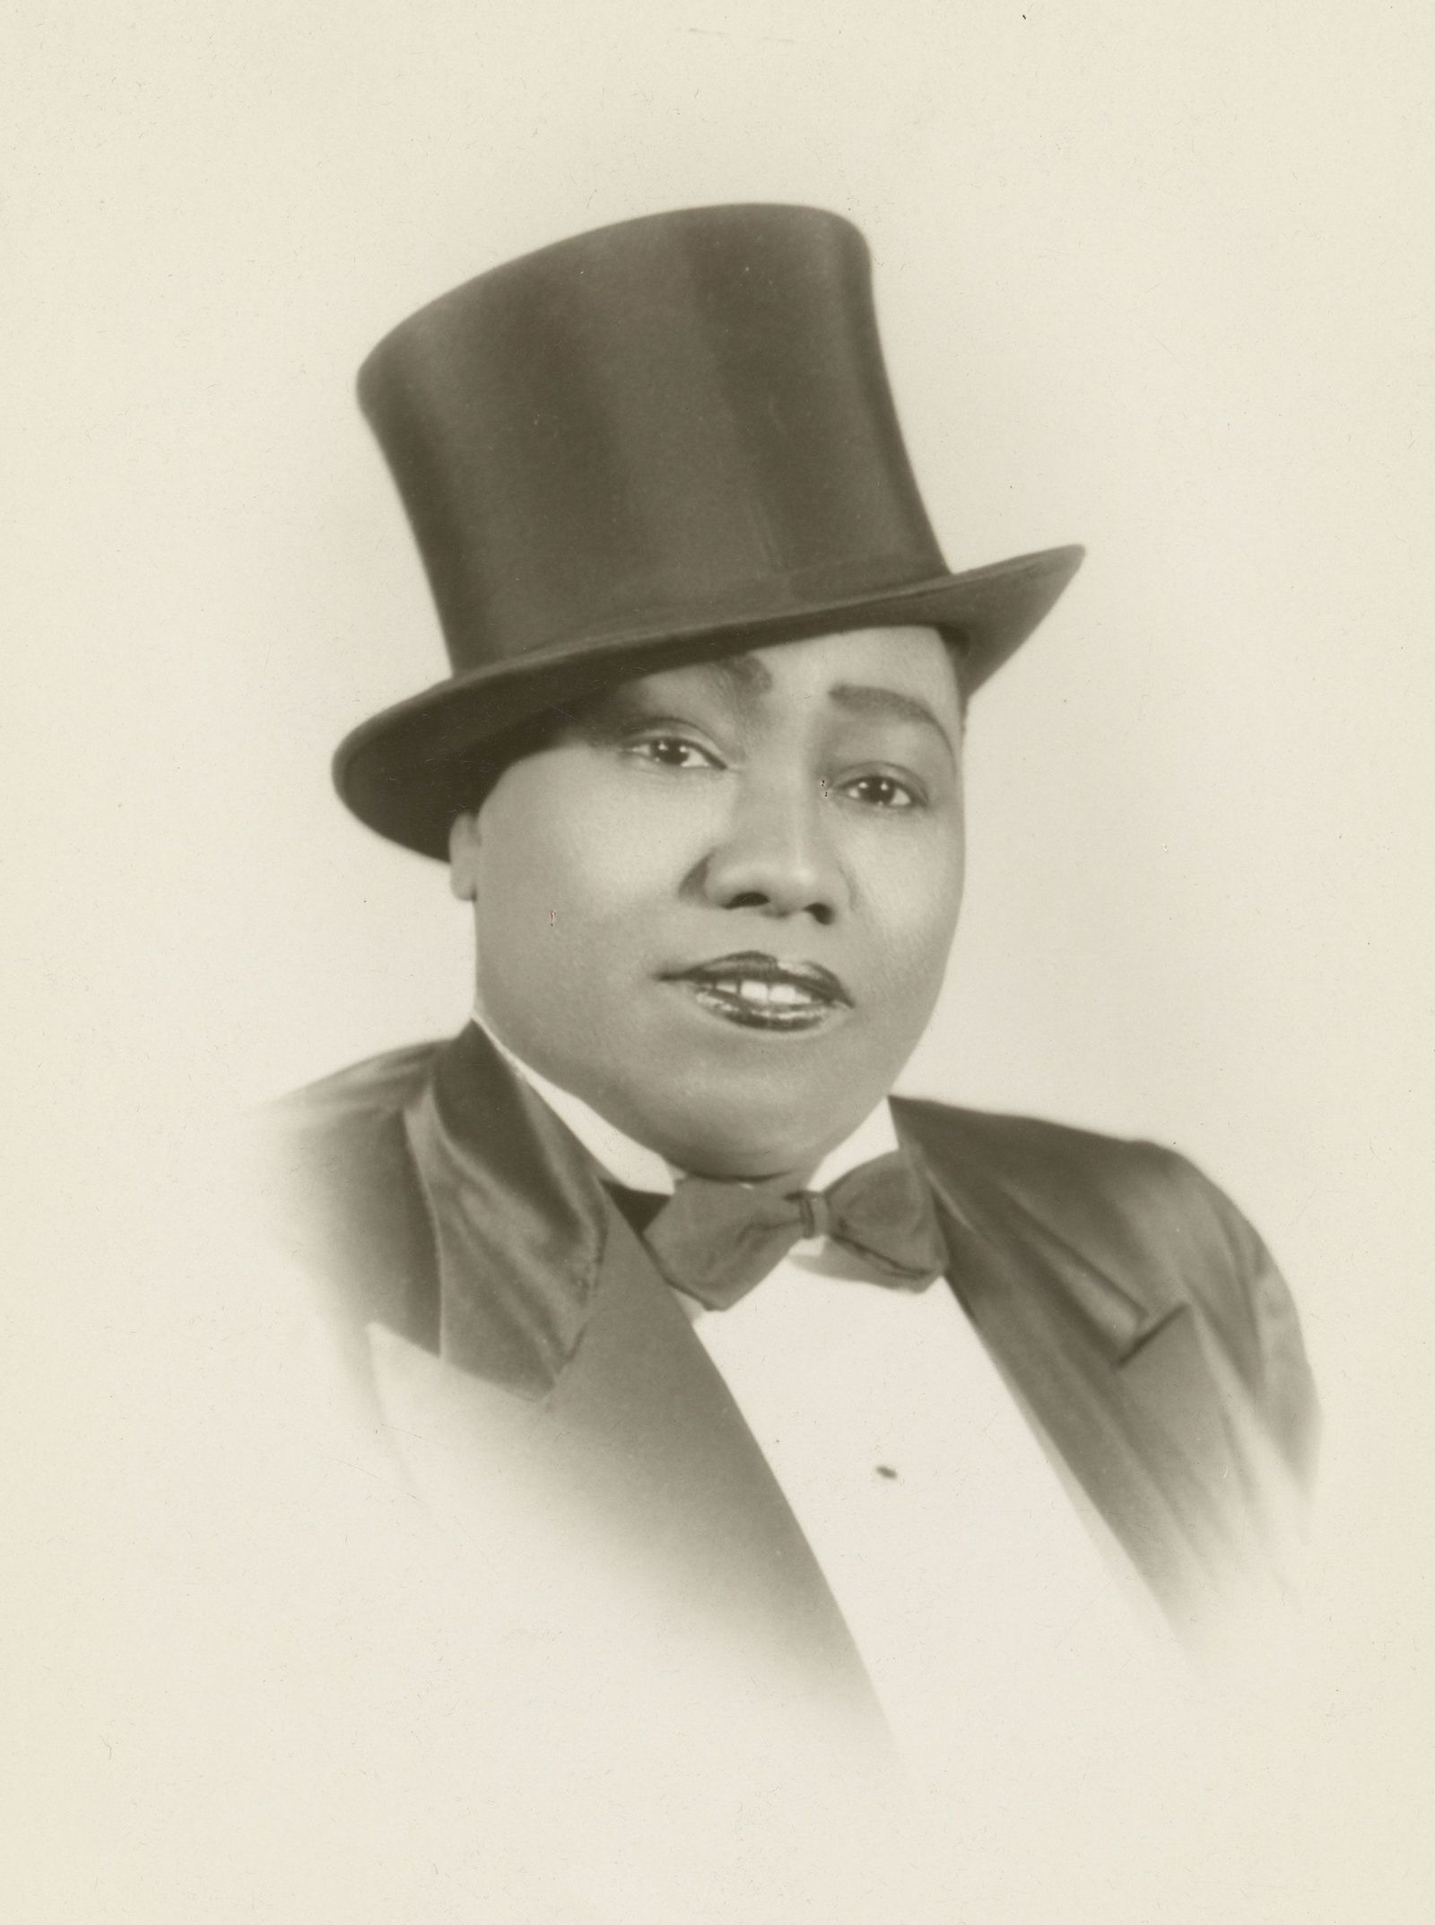
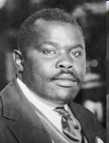
A. THE HARLEM RENAISSANCE “IT WAS AS SURELY AS GAY AS IT WAS BLACK” Henry Louis Gates, Jr. The Black Man’s Burden
1. PRIDE IN CULTURE, HERITAGE
2. LITERATURE, MUSIC, DANCE, THEATER; “THE JAZZ AGE”
3. “BACK TO AFRICA”
BLACK ECONOMIC INDEPENDENCE
REVITALIZED BLACK CONSCIOUSNESS
COUNTEE CULLEN
ZORA NEAL HURSTON
DUKE & LOUIE
GLADYS BENTLEY
LANGSTON HUGHES
MARCUS GARVEY

Slide 8
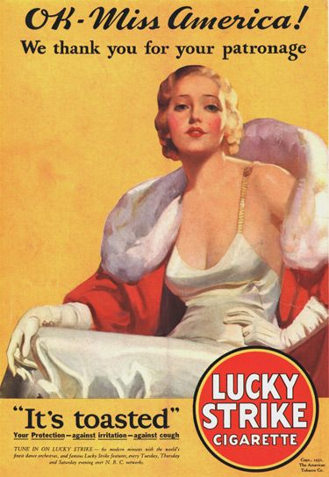
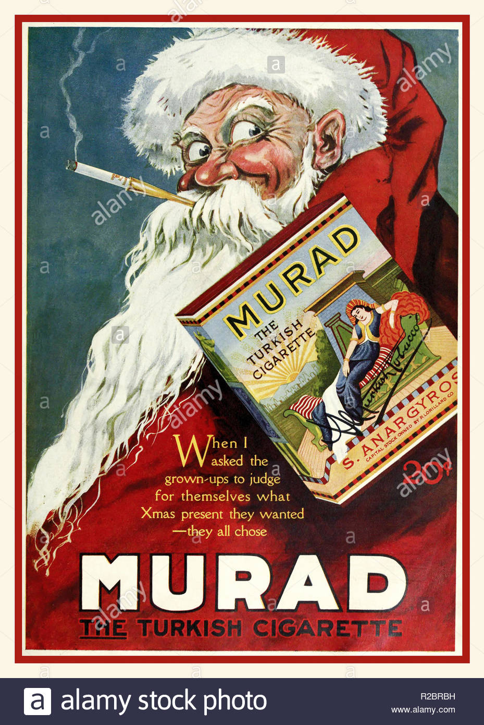
IV.WHAT GOES UP
A. INDUSTRIAL GROWTH
SOARED BY 1922
60% BUSINESS & HOUSEHOLDS RUN ON ELECTRICITY
3R’S REPLACED W/ BUY, BUY, BUY
CONSPICUOUS CONSUMPTION “YOU’LL LOVE IT AT LEVITZ”
CORPORATE CONSOLIDATION & MASS MARKETING – RISE OF ADVERTISING

Slide 9
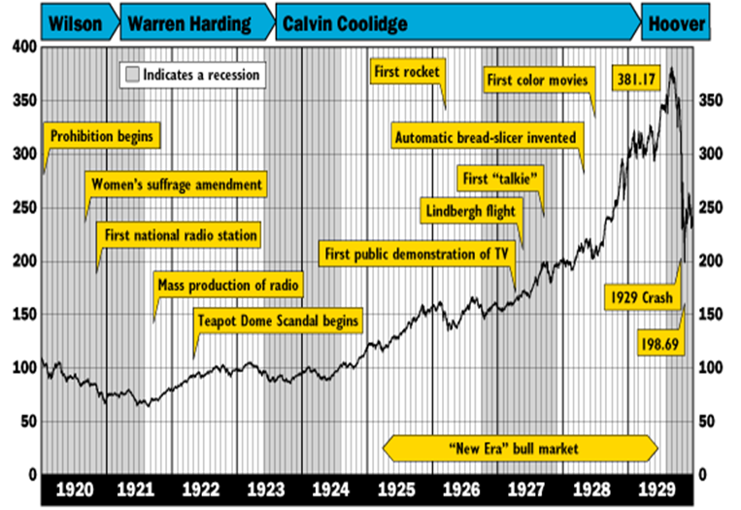
B. THE STOCK MARKET
1. CHARACTERIZED BY SPECULATION & BUYING ON MARGIN
ECONOMY UNSTABLE
MERGERS → JOB LOSS MONOPOLISTIC PRACTICES
2. FARMER’S $273 PER CAPITA
WORKERS $681 PER CAPITA
WAGE DISPARITY
3. TRUCKING → RR
NATURAL GAS & PETROLEUM → COAL
SYNTHETICS → COTTON
ELECTRICITY → STEAM
SOUTH EXPANDING MFG AS NORTH LOSING MFG STATUS

Slide 10
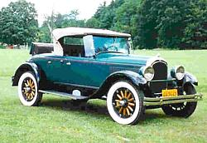
C. A – U – T - O
1. 2nd INDUSTRIAL REVOLUTION
1913 H. FORD - ASSEMBLY LINE
1925 75% BOUGHT ON CREDIT
CHRYSLER, COLOR & COMPETITION
1929 AUTO MFG = 9% OF ALL MFG. WAGES
1930 60% OF AMERICANS OWNED CARS
2. IMPACT
DRIVE IN MOVIES, CAR DATES, TRIPS TO THE SHORE, HOTELS, MOTELS, HOLIDAY INN’S, RESTAURANTS, SERVICE STATIONS
TOWNS EXPAND
FULL EMPLOYMENT
AND THEN……………..

