Slide 1
THE WAR TO END ALL WARS OBJ: To identify challenges in Paris that led to U.S. rejection of the Treaty of Versailles

Slide 2
I. PREPARING FOR PEACE
A. HIGH EXPECTATIONS
PEACE WITHOUT VICTORY

Slide 3
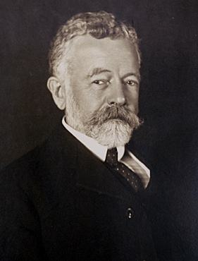
B. ISSUES SURFACE BEFORE DEPARTURE
1. WILSON 1ST PRES TO NEGOTIATE TREATY
2. REPUBLICANS IRATE
3. 1916 ELECTION – REPUBLICAN GAINS IN HOUSE & SENATE
4. 1918 ELECTION – DEMS LOST THE SENATE
HENRY CABOT LODGE

Slide 4
C. PEACE WITHOUT VICTORY?????
1. WILSON DIDN’T UNDERSTAND DESIRES OF EUROPEAN LEADERS
2. BRITAIN & FRANCE DEVASTATED
3. REVEN

Slide 5
D. THE BIG FOUR
1. CLEMENCEAU
2. LLOYD GEORGE
3. ORLANDO
4. WILSON

Slide 6
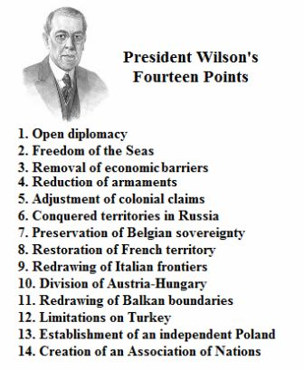
II. DELIBERATIONS - URGENCY
A. 14 POINTS
B. LEAGUE MOST IMPORTANT
C. COMPROMISED

Slide 7
III. RESULTS SHOCKED MANY
A. SECRET TREATY
B. NO SELF-DET., NO FREE SEAS
C. NO RUSSIA
D. ONLY GERMANY DISARMED
E. REPARATIONS EXHORBITANT
F. 4 POINTS HONORED FULLY
G. GERMANY BITTER

Slide 8
H. SOME POSITIVE OUTCOMES 1. NEW NATIONS 2. LEAGUE OF NATIONS
EUROPE 1914
EUROPE 1919

Slide 9
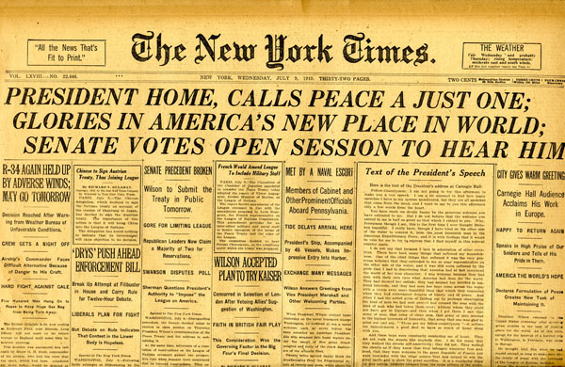
III. RATIFICATION
A. RESISTANCE
1. REPUBLICANS
ROUND ROBIN

Slide 10
“THEY MUST TAKE THEIR MEDICINCE…”

Slide 11
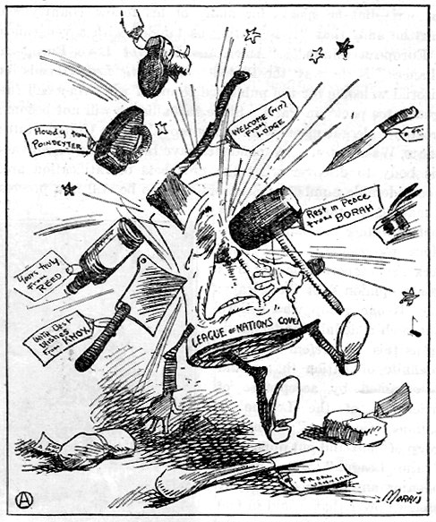
B. 2ND TRY
1. REPUBLICANS DIVIDED
IRRECONCILABLES – BORAH
MILD RESERVATIONISTS
STRONG RESERVATIONISTS – LODGE
14 RESERVATIONS
CONGRESS POWER TO DECLARE WAR
PROTECT MONROE DOCTRINE

Slide 12
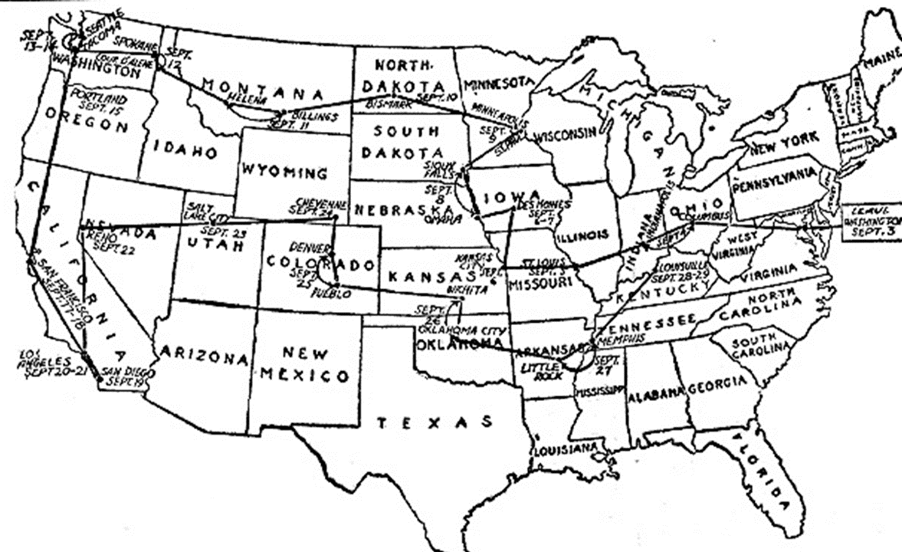
2. WILSON WORRIED – NEEDS PUBLIC SUPPORT

Slide 13
3. STROKE & DEBATE

Slide 14
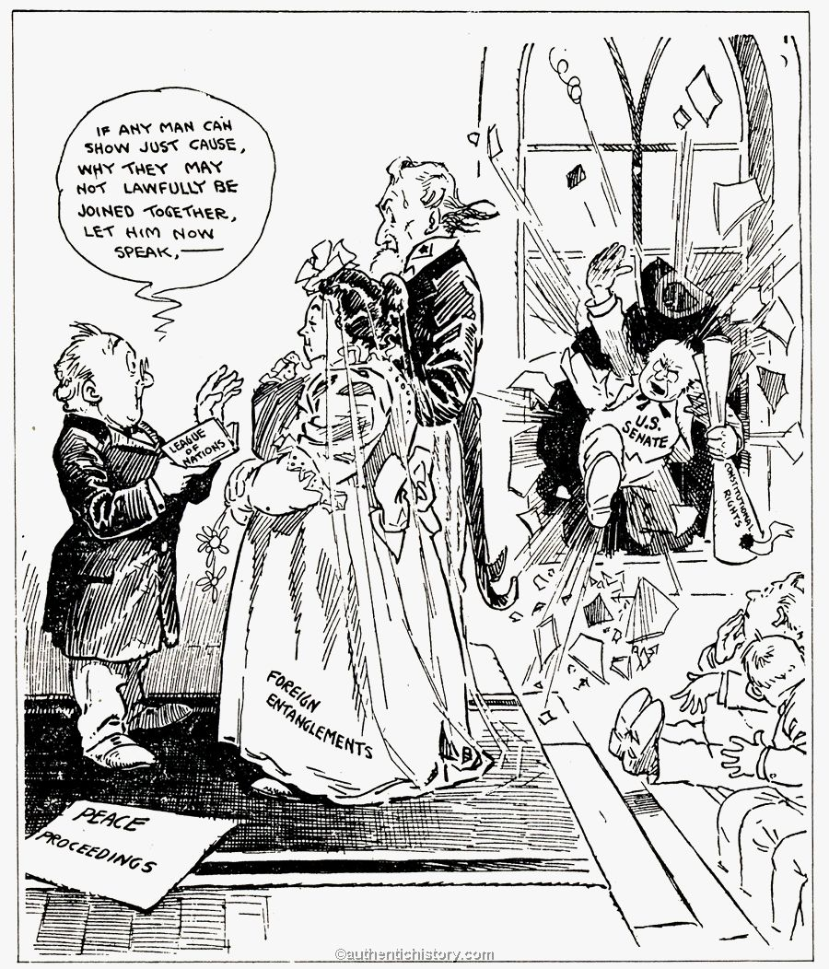
4. THE VOTE 1. 1ST VOTE – DON’T YOU DARE VOTE FOR TREATY W/ ANY RESERVATIONS 2. 2ND VOTE – VOTE ON TREATY AS IS – REPS REJECT

Slide 15
IV. ELECTION OF 1920
REPS: TR FRONT RUNNER BUT…
DEMS: WW HOPED FOR 3RD BUT…
REPS: WARREN HARDING
DEMS: JAMES COX
ISSUES: WOMEN, FOREIGN POLICY, ECONOMY
“RETURN TO NORMALCY”

