Slide 1
HOW THE OTHER HALF LIVES URBANIZATION & CITY LIFE IN THE LATE 19TH CENTURY

Slide 2
RICH VS. POOR - INSIDE
APARTMENT LIVING
TENEMENT LIFE

Slide 3
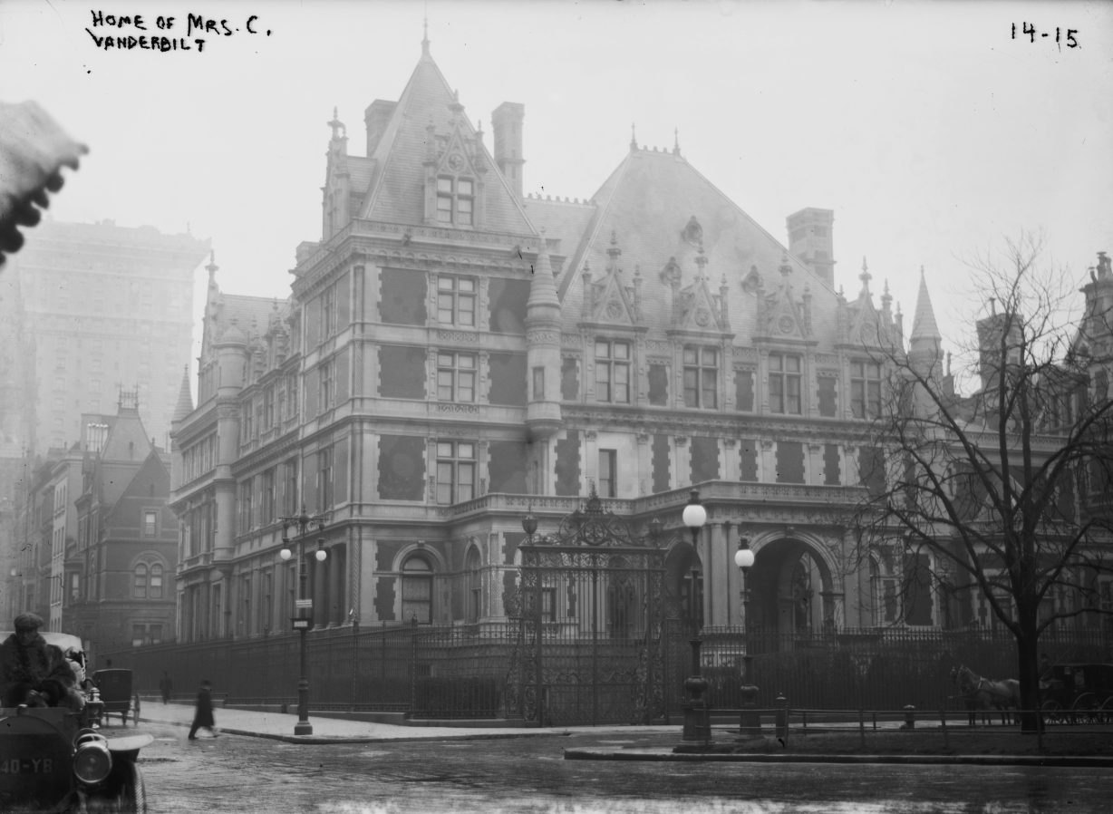
AND OUT
VANDERBILT MANSION 1884
LOWER EAST SIDE TENEMENT

Slide 4
LIFE OF A WAGE EARNER
INCREASE IN INCOME 31% UNSKILLED & 74% SKILLED B/W 1860-90
10 HOURS DAY/6 DAYS TYPICAL; 25% OVER 10 HRS./DAY
885,000 1860 FACTORY WORKERS 1890 3.2 MILLION
AVERAGE URBAN WORKER HAD IMMENSE SOCIAL MOBILITY
CHILD LABOR UNDER 14 YEARS WAS TYPICAL
SOME AS EARLY AS 8 OR 9 IN FACTORIES, MINES
WOMEN 17% OF WORKFORCE 1900 – GENDER SPECIFIC JOBS; TEACHERS, NURSES, DEPT. STORE CLERKS, TYPISTS
1ST FEMALE LAWYER 1869 – FEW FEMALE PROFESSIONALS
MOST LIVED IN CITIES –CITIES UNPREPARED; 1.4 MILLION NYC 1890
FUNDAMENTAL RESTRUCTURING OF WORK HABITS & A NEW EMPAHSIS ON WORKPLACE DISCIPLINE

Slide 5
URBAN LIVING
IMMIGRANTS STAY IN CITY- NO OPTIONS
NEW IMMIGRANTS: 1880 – 1910, EASTERN & SOUTHERN EUROPEAN, PEASANTS, UNSKILLED, SINGLE – PUSH & PULL SAME
1.2 MILL 1882 ALONE; 25 MILL 1860-1920
ELLIS ISLAND 1892
METRO BOARD OF HEALTH 1866
1879 MIN. STD PLUMBING & VENTILATION
BROOKLYN BRIDGE 1883
1850 15% POPULATION 1920 50% LIVE CITIES
AVERAGE # PEOPLE/DWELLING 5.5 FOR TENEMENTS 18.5
CRIME MAJOR PROBLEM
POLITICAL MACHINES, BOSS TWEED

Slide 6
IMMIGRATION RESTRICTION
CHINESE EXCLUSION ACT 1882
AMERICAN PROTECTIVE ASSOCIATION 1887 – ANTI-CATHOLIC
RISE OF NATIVISM
IMMIGRATION RESTRICTION LEAGUE 1894 LITERACY TEST
PHYSICALS, INTELLIGENCE TESTS AT ELLIS ISLAND

Slide 7
REFORMERS & RELIGIOUS RESPONSE
YMCA 1851 + SALVATION ARMY 1880 – LOCAL RESPONSIBILITY
POPE LEO XIII RERUM NOVARUM 1891 – CRITICIZES EXCESS OF RICH & CALLS ON GOV’T TO ACT
SOCIAL GOSPEL – PROTES-TANT RESPONSE TO TAKE CARE OF INDIVIDUAL & WORRY ABOUT SAVING SOULS LATER
SETTLEMENT HOUSES: HULL HOUSE 1889 CHICAGO, JANE ADDAMS & 1893 HENRY STREET SETTLEMENT HOUSE BY L. WALD, NYC

