Slide 1
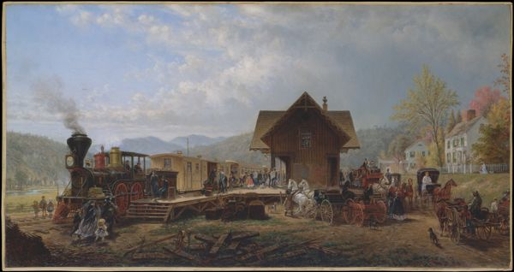
THE GATHERING TEMPEST 1853-1860
OBJ: HOW DID ECONOMIC DEVELOPMENTS IN THE 1840’S & 50’S WIDEN THE BREACH BETWEEN NORTH & SOUTH?

Slide 2
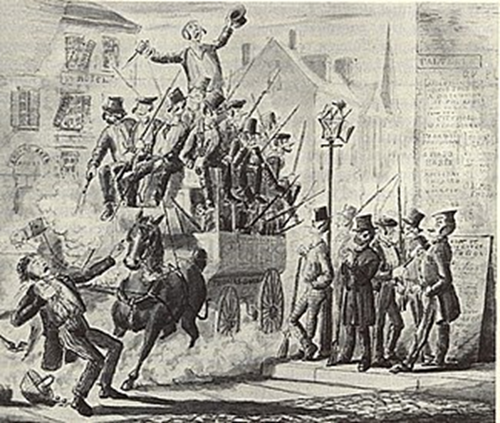
I. THE CONJUNCTION
A. RISE OF NATIONALISM
ECONOMY: RR, COTTON, INDUSTRY
PANIC 1857: INCREASED SECTIONAL TENSIONS – SOUTH SPARED THE BRUNT: IMPENDING CRISIS: H.R. HELPER
SOCIAL: TRANSCENDENTALISTS – INHERENT GOODNESS
BUT MELVILLE: DARK SIDE OF HUMANITY
MANIFEST DESTINY
B. KANSAS – NEBRASKA ACT 1854
S.A.D. – NO MORAL CONVICTION ON SLAVERY – SLAVERY NOT GOING ANYWHERE ALA RAMSDELL
LINCOLN – “AN UNQUALIFIED EVIL TO THE NEGRO, THE WHITE MAN & THE STATE….” – NOT AN ABOLITIONIST
C. BLEEDING KANSAS 1854
KNOW NOTHINGS ON ELECTION DAY
1854 ELECTION DAY RIOT

Slide 3
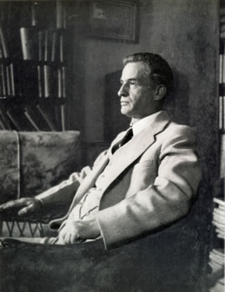
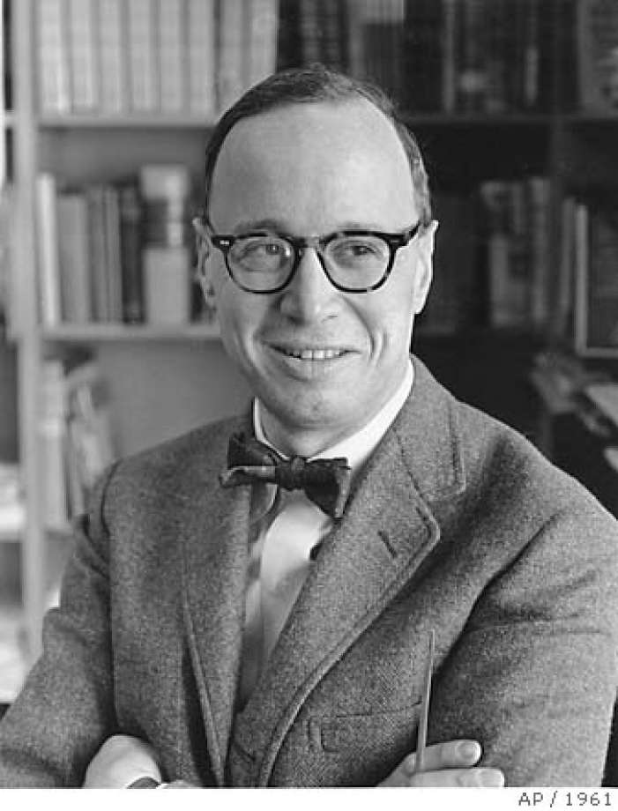
CIVIL WAR CAUSATION
ARTHUR SCHELSINGER, JR.
J.G RANDALL
MORAL WAR
REVISIONISTS DON’T OFFER HOW TO AVOID WAR
REVISIONISTS IGNORED MORAL URGENCY
WAR HAD TO HAPPEN BUT CAN’T GET IT STARTED
NEEDSLESS WAR
EMOTION
SECTIONAL DIVISION
FANATICISM
SLAVERY WOULD END BY 1900
SIMILAR TO?
REVISIONIST OR IRRECONCILABLE

Slide 4
II. THE LINCOLN-DOUGLAS DEBATES - 7
REGARDING KANSAS AND DRED SCOTT
DOUGLAS DISAPPOINTED
LINCOLN CALLED TO ACTION
THE ELECTION OF 1858 – ILLINOIS SENATE SEAT
LINCOLN BECAME NATIONAL FIGURE
SAD – SLAVERY NOT MORAL ISSUE – MADE ABE LOOK LIKE AN ABOLITIONIST, NEGROPHILE
ABE – SLAVERY IMMORAL – SAD PART OF PLOT TO EXPAND SLAVERY – CAN’T COUNT ON SAD – “HOUSE DIVIDED AGAINST ITSELF CANNOT STAND”
PLAYED TO AUDIENCE – SPOKE OF NON-EXTENSION IN NORTHERN ILL., SPOKE OF NOT HATING SLAVEOWNERS IN SOUTHERN ILL.

Slide 5
B. FREEPORT DOCTRINE
1. ASKED SAD, “HOW DO YOU RECONCILE DRED SCOTT WITH POPULAR SOVEREIGNTY?”
SAD WANTS TO WIN, NEEDS N. SUPPORT
ANSWER: ENFORCEMENT OF DECISION UP TO LOCAL LAWS
LOST SOUTHERN DEMOCRATIC SUPPORT
2. SAD WON
SOUTHERN DEMS TRY FOR FEDERAL SLAVE CODE BUT DEFEATED BY REPS & N. DEMS, INCLUDING SAD

Slide 6
III. CLOSER TO WAR?
“WITHOUT SHEDDING OF BLOOD THERE IS NO REMISSION OF SIN” HEBREWS 9:22
22 MEN – RAID ARSENAL HARPER’S FERRY
½ DOZEN ABOLITIONIST SUPPORTERS
DISASTER, NOT 1 FREED SLAVE
TRIED & HUNG
REPERCUSSIONS
SOUTH ON HIGH ALERT, FEARED SLAVE INSURRECTION
NORTHERN CONSPIRACY
MANY NORTHERNERS MOURNED DEATH
“DEFEND YOURSELVES! THE ENEMY IS AT YOUR DOOR” Sen. R. Toombs
The Last Moments of John Brown, 1884, by Thomas Hovenden

Slide 7
C. THE ELECTION OF 1860
CRISIS OF FEAR IN SOUTH
JOHN BROWN
ELECTION OF SPEAKER OF THE HOUSE
ALLEGIANCE OF NON-SLAVEHOLDERS
REPS: SEWARD? TOO RADICAL SO LINCOLN
NON-EXTENSION, HIGH TARIFF (PA), FREE HOMESTEADS (WEST) ETC. BROADER APPEAL
DOUGLAS DEMS: SAD A FRONTRUNNER BUT INTRANSIGENT SOUTHERNERS HOLD OUT – POPULAR SOVEREIGNTY
SOUTHERN RIGHTS’ DEMS: BRECKINRIDGE – KY – PROTECT SLAVERY
CONSTUTIONAL UNION: JOHN BELL TN – SPIRIT OF SECTIONAL ACCOMMODATION

