Slide 1
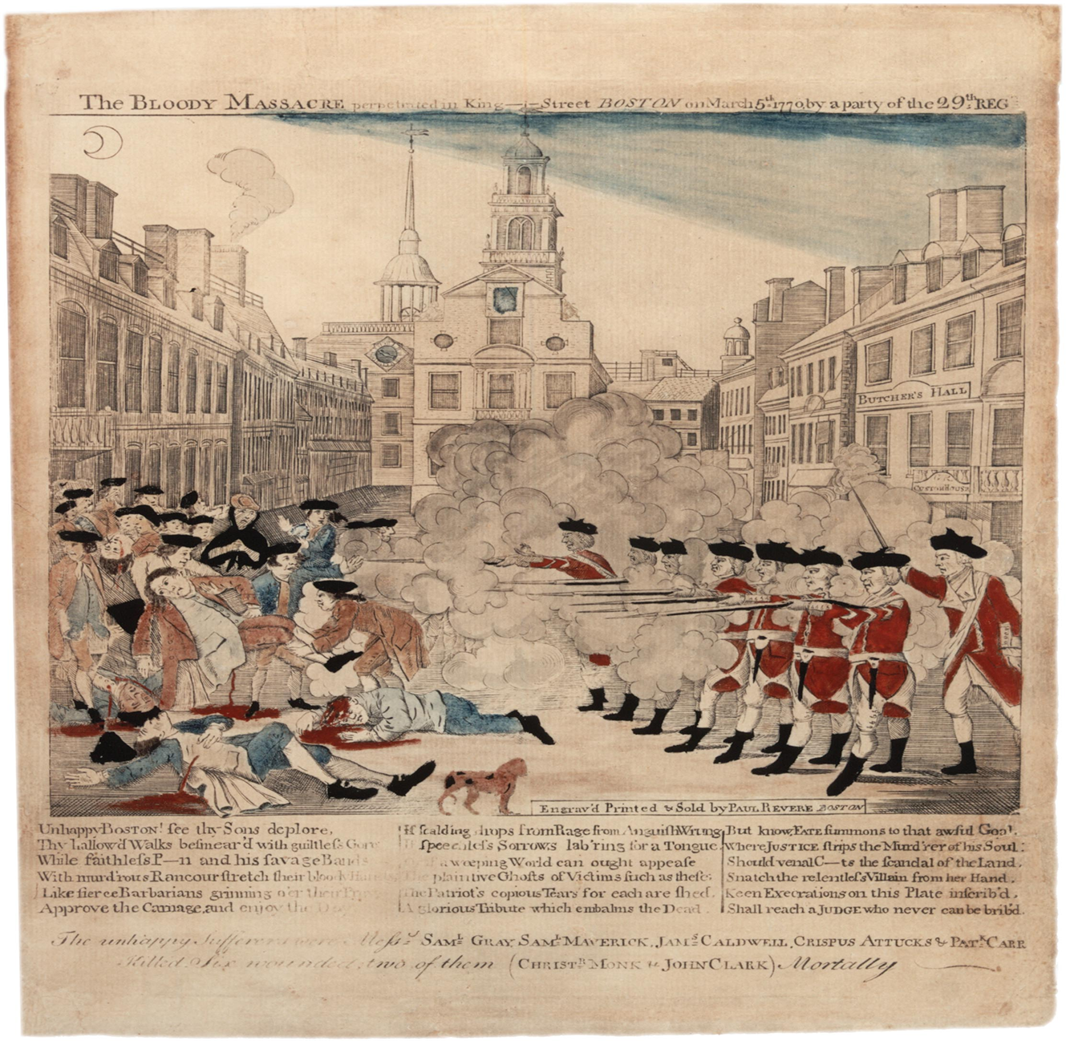
BEGINNINGS OF UNITY Obj: To follow the actions of the Second Continental Congress that led to independence 1775-1781
PAUL REVERE
THE BLOODY MASSACRE ON KING STREET
MARCH 1770
What are causes of massacre?
What was purpose of cartoon?

Slide 2
I.THE BREAK UP
LORD NORTH: REBUILD TRUST
CUSTOMS OFFICIALS: AGGRAVATED COLONISTS
J. HANCOCK’S RUN IN W/ CUSTOMS
GASPEE 1772
ADAMS SET UP COMMITTEE OF CORRESPONDENCE & ADOPTED BY OTHER COLONIES: 1772-74
TEA ACT & PARTY 12/1773

Slide 3
II.SWIFT & SEVERE REACTION
SPRING 1774 COERCIVE ACTS
INTOLERABLE ACTS
APPLIED INITIALLY IN MASS
CLOSE HARBOR UNTIL TEA PAID FOR
CHANGE MASS CHARTER BR PUNISHING COMMUNITY FOR ACTS OF A FEW
QUEBEC ACT 1774: PERMANENT CANADIAN ADMIN, COMPLETE RELIGIOUS FREEDOM & FRENCH FORM OF CIVIL LAW

Slide 4
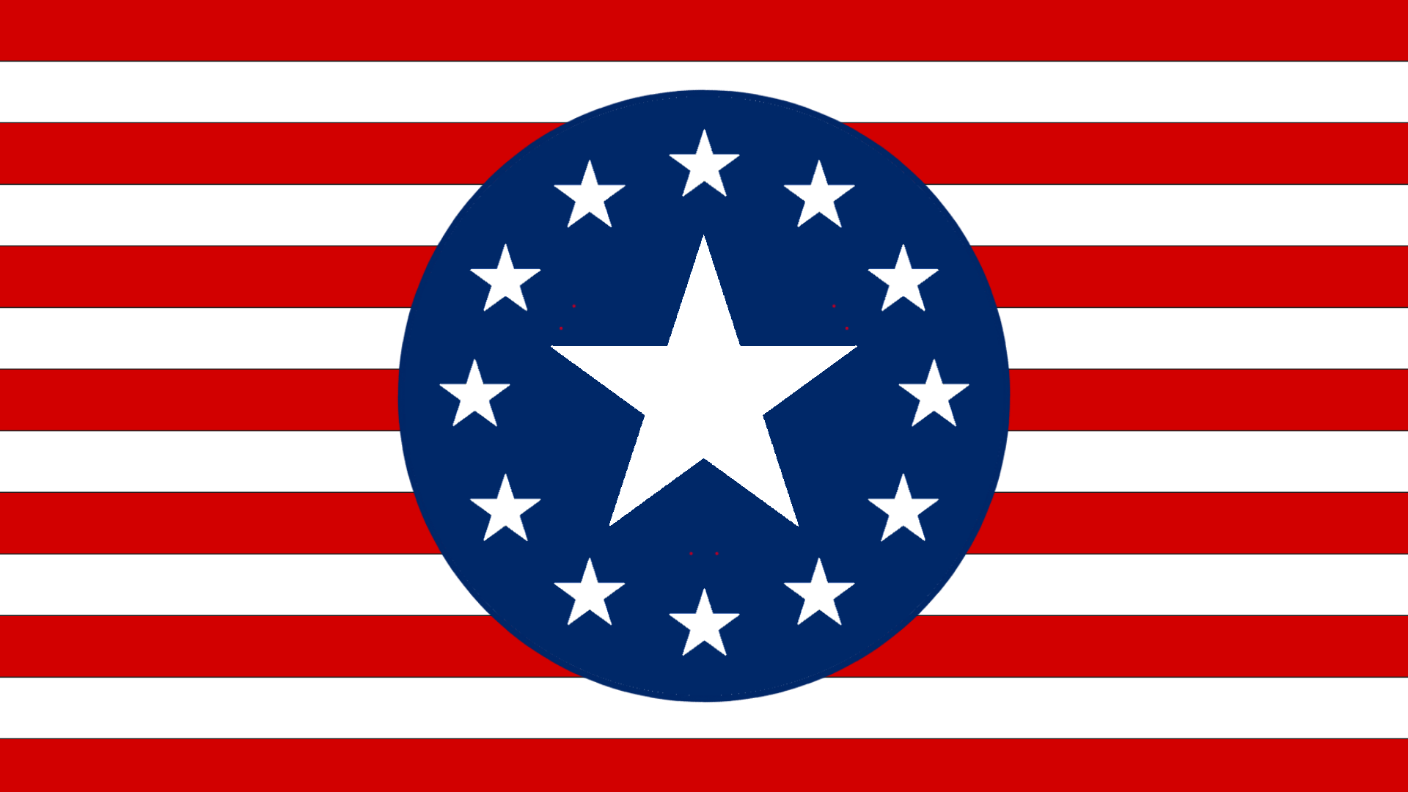
III. SWIFT & SEVERE RESPONSE
1ST CONTINENTAL CONGRESS – SEPT-OCT 1774
55 ELECTED DELEGATES, 12 COLONIES, TOTAL STRANGERS
STAMP ACT CONGRESS, LETTERS FROM A PA FARMER
CREATED “ASSOCIATIONS” – STOP COMMERCE WITH GB UNTIL INTOLERABLE ACTS REPEALLED
LOCAL COMMITTEES FORMED TO ENFORCE
NON-IMPORTATION
GEORGE III NOT PLEASED

Slide 5
A. THE SHOT HEARD AROUND THE WORLD 1775
COLONIAL RESISTANCE: MILITIA’S, BOYCOTT & AMERICAN MFG
FORMED SEPARATE GOV-ERNMENTS & IGNORED ROYAL GOVERNORS
COLONIST LOYALTIES DIVIDED
REDCOATS VS. MINUTE-MEN
LEXINGTON & CONCORD APRIL
FORT TICONDEROGA - MAY
BUNKER (BREED’S) HILL JUNE

Slide 6
B. THE SECOND CONTINENTAL CONGRESS MAY 1775
OLIVE BRANCH PETITION: ATTEMPT TO CURTAIL WARFARE JULY
LOYALIST SENTIMENTS
EXTRALEGAL AUTHORITY – MASSACHUSETTS STANDS ALONE

Slide 7
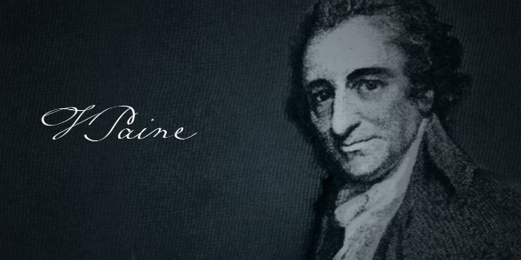
1. CONTINENTAL CONGRESS COMES AROUND
THOMAS PAINE “COMMON SENSE” 1/76: MASSES FELT EMOTIONAL IMPACT
HESSIAN MERCENARIES
RESOLVED: “THAT THESE UNITED COLONIES ARE, AND OF RIGHT OUGHT TO BE, FREE & INDEPENDENT STATES- JUNE
DECLARATION OF INDEPENDENCE –JULY
IMPERFECT GOV’T DOESN’T MEAN RIGHT TO DESTROY
DESTROY WHEN SEEKING TO TYRANNIZE PEOPLE
BALANCE B/W GOV POWER & INDIVIDUAL RIGHTS. HALLMARK OF AMERICAN POLITICAL DEVELOPMENT

Slide 8
Every quiet method for peace hath been ineffectual. Our prayers have been rejected with disdain; and only tended to convince us, that nothing flatters vanity, or confirms obstinacy in kings more than repeated petitioning. . . . Wherefore, since nothing but blows will do, for God’s sake, let us come to a final separation, and not leave the next generation to be cutting throats, under the violated unmeaning names of parent and child.
To say, they will never attempt it again is idle and visionary; we thought so at the repeal of the stamp act, yet a year or two undeceived us; as well may we suppose that nations, which have been once defeated, will never renew the quarrel.
Thomas Paine, Common Sense, 1776
1. At the time that Paine wrote Common Sense, the prevailing sentiment of colonial leaders was that
a. a good working relationship between the colonies and Great Britain was possible under certain circumstances.
b. the actions of the British government had led to a situation that was beyond repair.
c. declaring independence was necessary because a majority of the colonies supported the patriot cause.
d. alliances with other countries would need to be made to successfully separate from England.

Slide 9
2. A Loyalist would tend to see Paine’s statements as a. A persuasive argument for seeing independence b. a foregone conclusion due to the deteriorating relationship with England c. contrary to political obligations to the British government d. irrelevant due to significant cultural & economic ties to England
3. The values expressed Common Sense reflect
A. the general position taken by colonial leaders from the time of the French & Indian War
B. the sentiments of colonial leaders who felt notions of virtual representation left their interests unrepresented
C. opposition to authority that had been manifested in the attempt to establish a colonial government under the Albany Plan
D. ideas that emerged spontaneously once Great Britain fired shots.

Slide 10
4. Why did Paine believe that reconciliation with Great Britain was impossible?
A. Great Britain had already declared war on the colonies
B. Great Britain had refused to engage in negotiations with the colonies
C. Great Britain had taken conciliatory actions in the past but always had gone back on them
D. Great Britain had made allies with other colonial powers & Native American tribes.

Slide 11
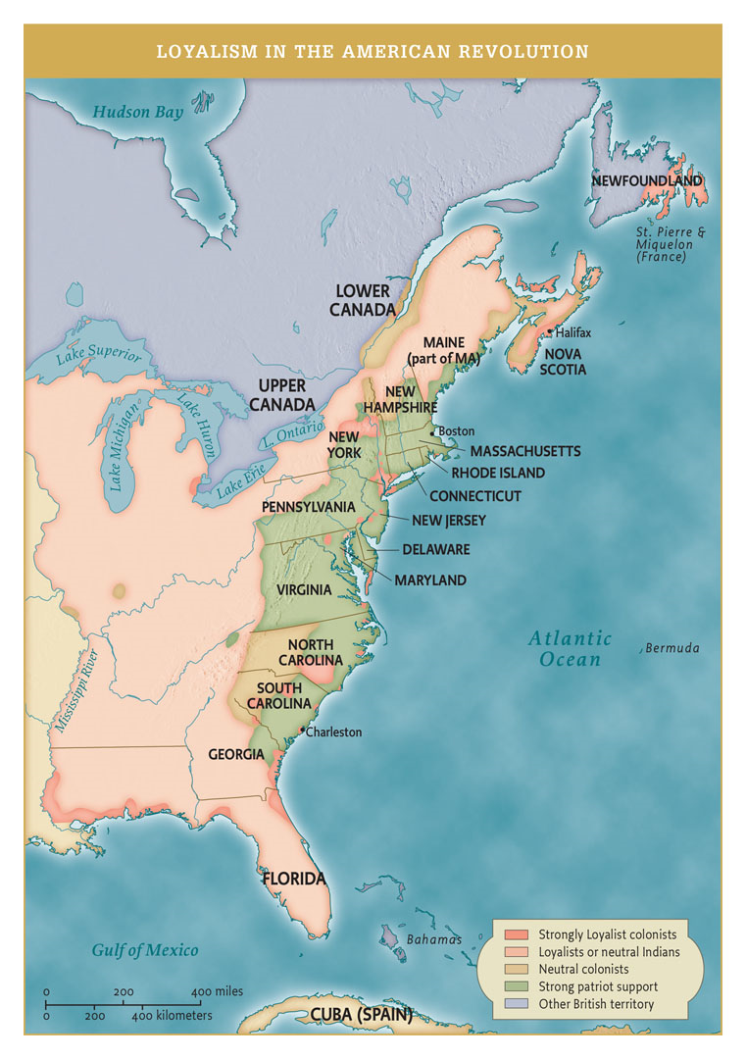
2. WAR & PEACE
FROM LEXINGTON & CONCORD, MA, TO YORKTOWN, VA
LOYALISTS FROM ALL SOCIO-ECO GROUPS
BRITISH ADVANTAGES: 1) EXPERIENCE, 2) POPULATION 3) NAVY & ARMY, 4) LOYALISTS
AMERICAN ADVANTAGES: 1) HOME FIELD 2) WASHINGTON 3) BR. WAR FATIGUE 4) FR&SP
(p. 224)

Slide 12
3. BATTLES INITIALLY CENTERED IN NEW ENGLAND BUT THROUGHOUT COLONIES
“THESE ARE THE TIMES THAT TRY MENS SOULS” T. PAINE POST NY & NJ LOSSES
NY & NJ CAMPAIGNS: TRENTON & LAFAYETTE
SARATOGA OCT. 1777 TURNING POINT → FRANCO-AMERICAN ALLIANCE 1778
VALLEY FORGE & VON STEUBEN
GW OPERATING ON SHOESTRING BUDGET…”We are outgunned, outmanned, outnumbered, outplanned..”

Slide 13
4. WAR IN THE WEST – SET STAGE FOR FUTURE TREATMENT OF NATIVE AMERICANS
PROCLAMATION 1763
SUBSEQUENT TREATIES W/O NATIVE OK
INITIALLY, BOTH SIDES WANTED NATIVES OUT OF WAR
AS WAR ESCALATED MORE BLOODY CONFLICT
VICTORY DECIDED IN SOUTH

Slide 14
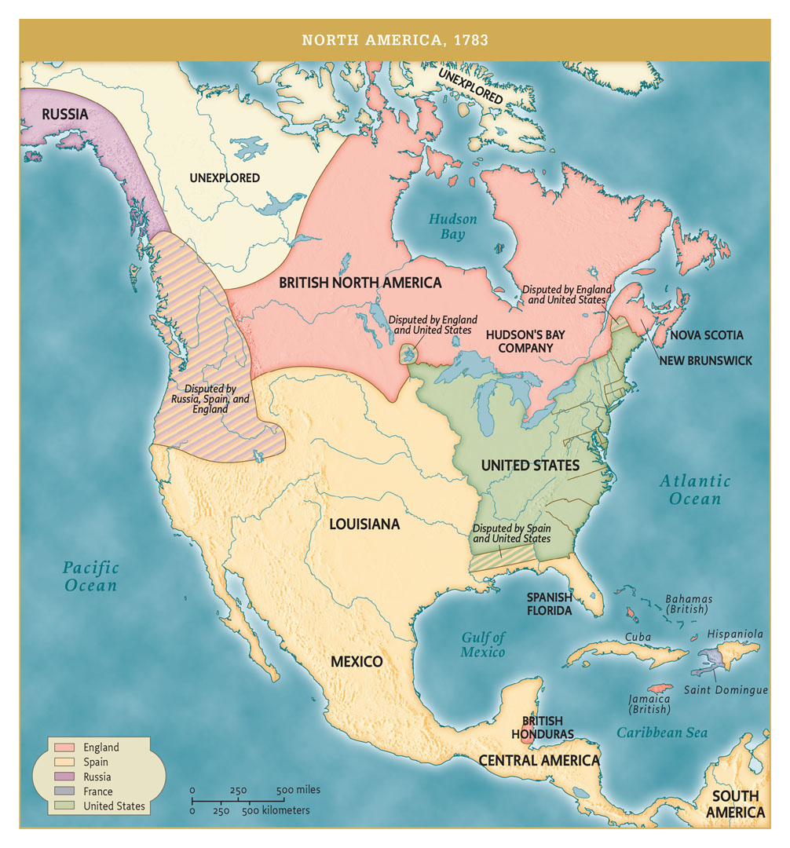
5. TREATY OF PARIS 1783
(P 205)
JAY, FRANKLIN & ADAMS
AMERICAN INDEP. RECOGNIZED
BR EVACUATE ALL TROOPS
AMERICA MUST REIMBURSE LOYALISTS
MISSISSIPPI RIVER WESTERN BOUNDARY
AMBIGUOUS FLORIDA BOUNDARY IN SOUTH
WHAT KIND OF SOCIETY? GOVERNMENT?

