Slide 1
LYNDON JOHNSON IN ACTION
“LET US RESOLVE THAT JFK DID NOT DIE IN VAIN”

Slide 2
LBJ’S BACKGROUND
NEW DEAL DEMOCRAT & OIL & GAS CONSERVATIVE
CONSUMATE POLITICIAN
30 YEARS OF EXPERIENCE
VAST KNOWLEDGE OF INS & OUTS OF DC
INSECURE IN ABILITIES TO FILL SHOES OF JFK

Slide 3
EARLY LEGISLATION
FINISH WHAT JFK BEGAN
TAX CUTS
1964 CIVIL RIGHTS ACT
EQUAL EMPLOYMENT OPPORTUNITY COMMISSION TITLE VII – GENDER IN WORKPLACE
TITLE IX ’72 AMENDS TO INCLUDE HS AND COLLEGE SPORTS
CIVIL RIGHTS CASES MOVED TO FEDERAL COURTS TO DECREASE DISCRIMINATION

Slide 4
THE WOMAN I REALLY LOVED War on Poverty

Slide 5
CONSERVATISM MORE IMPORTANT FOR REPUBLICANS

Slide 6
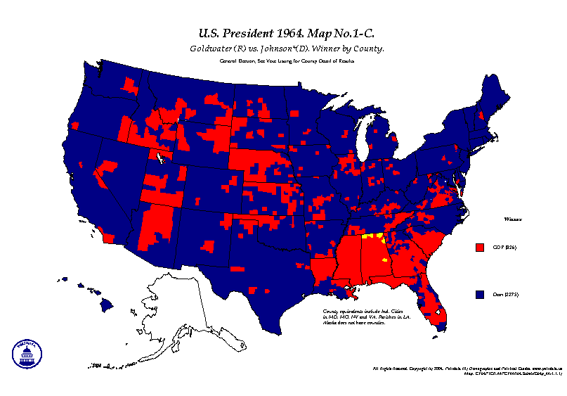
ELECTION OF 1964
LBJ & H. HUMPHREY GREAT SOCIETY
GOLDWATER & MILLER IDEOLOGY OVER EXPEDIENCY
GEORGE WALLACE “WHITE BACKLASH”
61%; 486 – 52; DEMS CONGRESS & EXEC

Slide 7
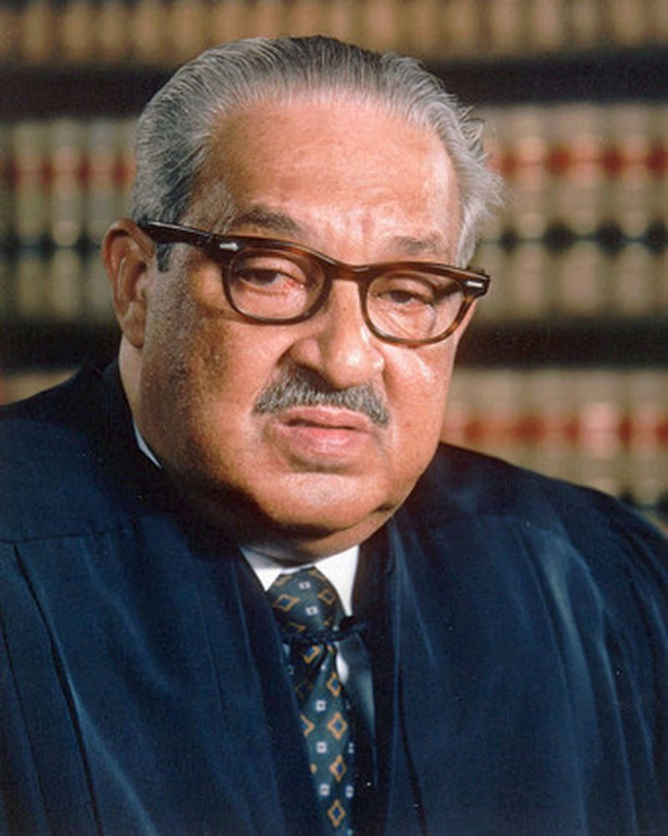
GREAT SOCIETY DOMESTIC POLICY
MEDICARE & MEDICAID
ELEMENTARY & SECONDARY EDUCATION ACT
CREATED HUD & TRANSPORTATION CABINET POSTS
1ST AFRICAN AMERICAN APPOINTED TO CABINET (HUD)
T.MARSHALL 1ST AA APPT. TO SUPREME COURT

Slide 8
MAJOR LEGISLATION
VOTING RIGHTS ACT 1965
IMMIGRATION ACT 1965

Slide 9
FOREIGN POLICY CONTINUATION OF POST WWII POLICIES

Slide 10
“I WON’T LET SOUTH ASIA GO THE WAY OF CHINA”
FRENCH RULE
HO CHI MINH ESTABLISHES DEMOCRATIC REPUBLIC
1946 LETTER TO TRUMAN – DID HE EVER SEE IT?
IKE “NOT OUR BUSINESS” BUT FINANCES FR. 1950-54
GENEVA TREATY 1954 – DIVIDES VIETNAM AT 17TH
DOMINO THEORY
DIEM KILLED 11/1; JFK KILLED 11/22/63
1960 700 MILITARY ADVISORS
END OF 1963 16K US MILITARY IN VIETNAM

Slide 11
AUGUST 1964 TO JANUARY1968

Slide 12
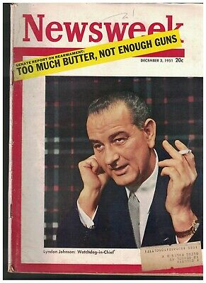
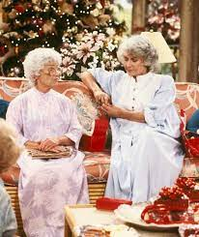
LBJ BEARS RESPONSIBILITY FOR VIETNAM
Gulf of Tonkin incident 8/64
Air Strikes: Operation Rolling Thunder
Blank Check, commits ground troops, attrition, no match for VC
Promises NOT to extend conflict but does
Guns & Butter

Slide 13
1968: A TUMULTUOUS YEAR

Slide 14
TET OFFENSIVE – JANUARY 68
SURPRISE ATTACKS ON US & SV FORCES FROM THE NORTH
TACTICAL VICTORY FOR US & SV BUT MORALE BOOST FOR VC & NORTH
26% APPROVAL RATING
COSTS RISING
C. CLIFFORD NEW SECRETARY OF DEFENSE. MCNAMARA OUT – LESS HAWKISH AS WAR DRAGGED ON

Slide 15
“WHAT THE HELL IS GOING ON”
“IF I‘VE LOST CRONKITE I’VE LOST THE AVERAGE AMERICAN” LBJ
INFO FROM WHITE HOUSE & INFO FROM FIELD DON’T MATCH
800 TONS OF BOMBS PER DAY – MORE THAN 3X AMOUNT DROPPED DURING WWII

Slide 16
BOMBSHELL – MARCH 68
TELEVISION ADDRESS
HALT BOMBING
BEGIN TALKS WITH NV
“I SHALL NOT SEEK NOR WILL I ACCEPT THE NOMINATION FOR PRESIDENT”

Slide 17
“A SHOT RANG OUT IN THE MEMPHIS SKY” APRIL 68
SOCIAL & CULTURAL UPHEAVALS BACK-DROP TO FRUSTRA-TION WITH WAR
MILITANCY RISES AMONG BLACKS
NON-VIOLENCE NOT POSSIBLE

Slide 18
JUNE 1968 LOS ANGELES
EUGENE McCARTHY 1ST TO THROW HAT IN THE ‘68 DEM. RACE
RFK FOLLOWS & ASSASINATED POST CA PRIMARY

