Slide 1
WELCOME TO APUSH DR. J. HOSMER MS. S. STUART MR. B. ANCHARSKI

Slide 2
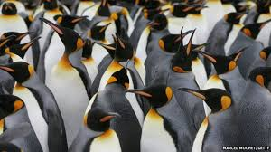
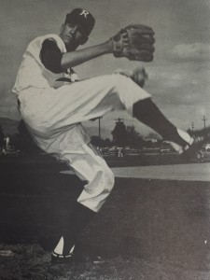
I. Getting to know us…..
Dr. John Hosmer (he, him)
NM & AZ
UHS – FROM THE EARLY DAYS
LOTS OF BOYS, GRANDFATHER
DOGS, DODGERS, DEBATE

Slide 3
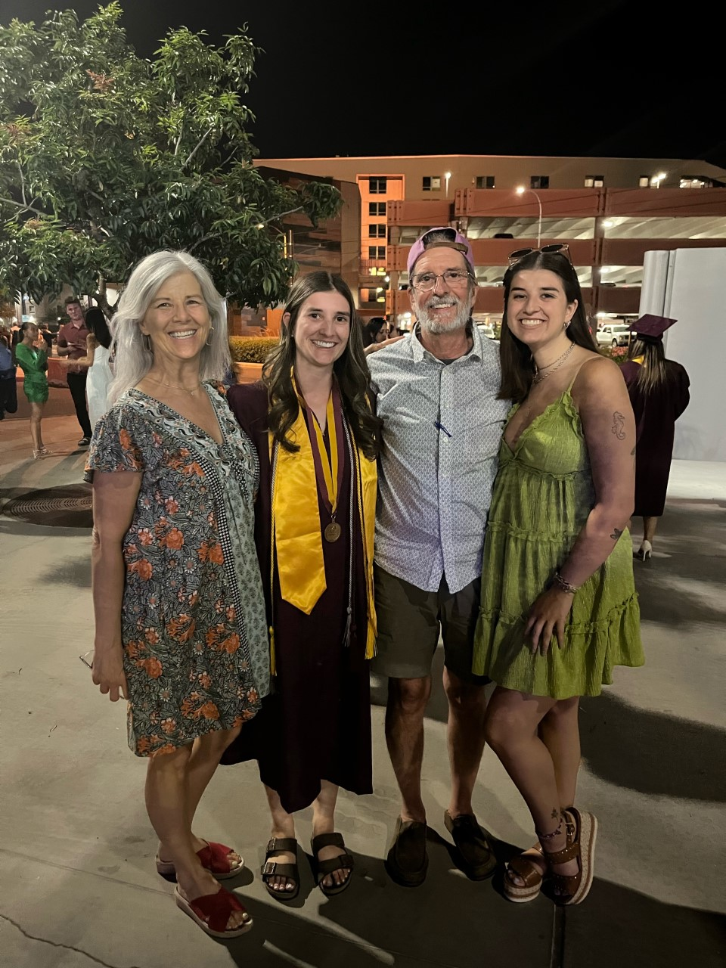
Ms. Sarah Stuart
NJ, NY, AZ – 2000
UHS 2001 – 29 YEARS TEACHING
SCUBA, F1, TRAVEL
2 DAUGHTERS - #ForksUp – 22 / 24
DOG NALA
PARTNER ERIC - BOV

Slide 4
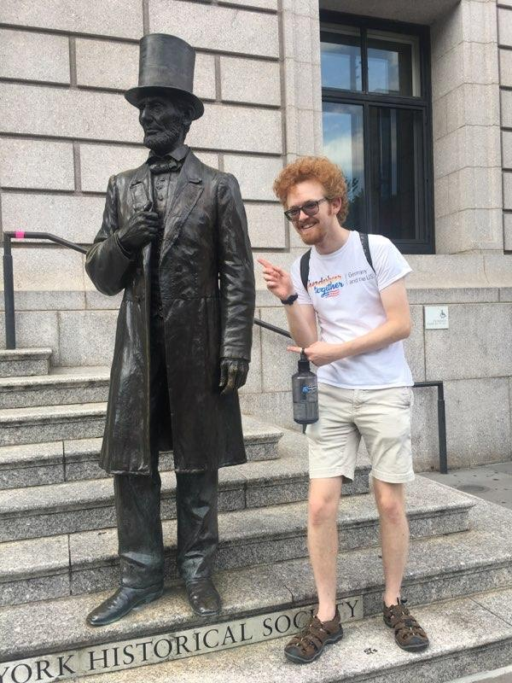
Mr. Ben Ancharski
Born and raised Tucson, AZ
UHS class of 2017 & UA Graduate 2021
Dog Luna & Cat Harold
Dream travel destination: Turkey
Favorite US Historical Period: Antebellum

Slide 5
II. Getting to know you…..
This is your first assignment ☺ please make sure your answers are clear & in full sentences.
Please tell us the name you want to be addressed by & your pronouns
Describe your favorite activity
If you work – where? How many hours & what days?
Do you drive yourself to school? Take the bus? Carpool with others?
Tell us something else you would like us to know about you!
Due 8/9/22 Tuesday
Copy your teacher’s Turnitin.com information for submission

Slide 6
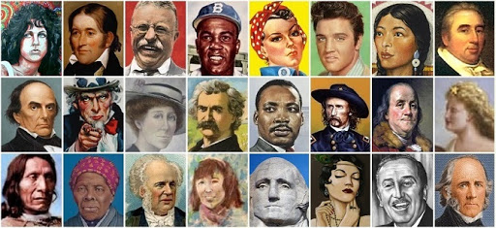
III. GETTING TO KNOW APUSH A. RULES, REGS, REQUIREMENTS
1. Participate – in class, discussion, homework, conference period
2. Prepare – refer to coversheet, stay on top of readings
3. Produce - questions, assignments
Advocate for yourself
Communicate your needs
Take responsibility for your education

Slide 7
Getting to know APUSH B. WEBSITES
https://uhsapush2015.weebly.com/
Main Page – course description AND College Board course description – MUST READ
Unit Overviews – where you locate terms for each unit, mini-time line, historians
PowerPoints/Outlines, Overviews, Coversheets, Historians etc.
We will provide you with class codes to join Turnitin.com
https://www.youtube.com/playlist?list=PL8dPuuaLjXtMwmepBjTSG593eG7ObzO7s this is the link to Crash Course U.S. History with John Green
https://www.khanacademy.org/humanities/ap-us-history
Make sure to bookmark AP Classroom as we will use that throughout the year – we will provide you with Class Codes.
PLEASE take some time before our next class and explore the APUSH website.

Slide 8
C. OVERVIEW & COVERSHEETS TO BE HANDED IN AT END OF UNIT – FLIPPED VIDEO MUST WATCH – ON WEBSITE
THEMES: ON UNIT OVERVIEW
CCOT
TIMELINE: IN CHRONO ORDER – ALL #1’S RELATE, ALL #2’S ETC.
USE OVERVIEW FOR TERMS/EVENTS – THERE IS ALSO A TIMELINE ON WEBSITE AND ON THE OVERVIEW
QUESTIONS?
TEXT READING MUST BE PART OF COVERSHEET MATERIA

Slide 9
TEXTBOOK READINGS – GIVE ME LIBERTY, By Eric Foner
Ch. 1
Ch. 1 PP 6-12 Begin at “1st Americans” & stop at “Native American Religion”
We will have readings listed at the start of every week on both sides of the classroom.

