Slide 1
DON’T JUDGE A BOOK BY ITS COVER OBJ: TO INVESTIGATE THE CULTURAL CHANGE OF THE 1920’S & ITS IMPACT ON SOCIETY

Slide 2
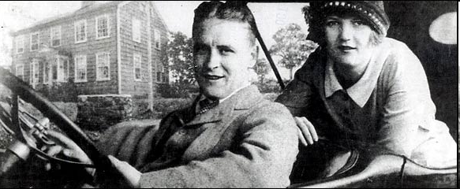
I. THE ROARING 20’S
A. LITERATURE
CULTURAL LIBERATION
LOST GENERATION
S. LEWIS BABBIT & MAIN STREET, AMERICANS SIMPLISTIC & SUPERFICIAL
T.S. ELLIOT: THE WASTELAND DISAFFECTED VIEW OF MANY POST WII & VERSAILLES DEBACLE
WM. FAULKNER THE SOUND & THE FURY; REJECT TRADITION
e.e.cummings

Slide 3
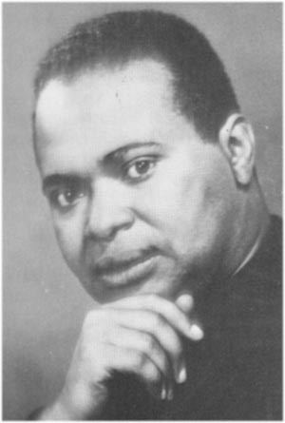
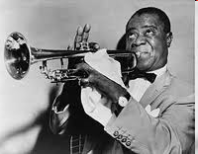
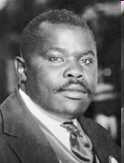
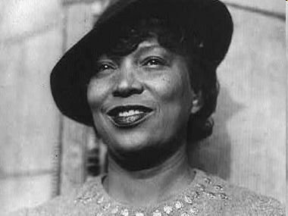
B. THE HARLEM RENAISSANCE
1. PRIDE IN CULTURE, HERITAGE
LANGSTON HUGHES, ZORA NEAL HURSTON, COUNTEE CULLEN
2. MUSICAL GENIUS – LOUIE ARMSTRONG & OTHERS
JAZZ MUSIC –IMPROVISATION, BREAK W/ TRADITIONAL MUSIC
3. MARCUS GARVEY: “BACK TO AFRICA”
BLACK ECONOMIC INDEPENDENCE
REVITALIZED BLACK CONSCIOUSNESS
MANY CONCERNED W/ ECONOMIC STABILITY BOTH BLACK & WHITE

Slide 4
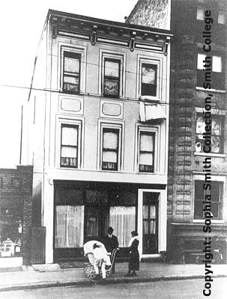
C. WOMEN
FLAPPER
MOST WORKING, WORRYING, WAITING
WAGE DISCRIMINATION
ERA FAILED 1923
EDUCATION INCREASED; MED SCHOOL QUOTAS
MARGARET SANGER
BIRTH CONTROL, SEXUAL MORES, FREUD
19TH AMENDMENT

Slide 5
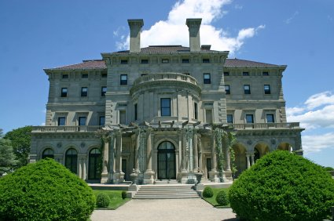
II. ART & ARCHITECTURE
Return to morality
The Sheik blatant sexuality & changing norms
Joseph Stella Brooklyn Bridge, Variation on an old Theme 1939
The Breakers – C. Vanderbilt II
1st movie synchronous sound

Slide 6
III.WHAT GOES UP
A. INDUSTRIAL GROWTH
SOARED BY 1922
INCREASED DEMAND FOR GOODS
60% BUSINESS & HOUSEHOLDS RUN ON ELECTRICITY
3R’S REPLACED W/ BUY, BUY, BUY
CORPORATE CONSOLIDATION & MASS MARKETING
CONSPICUOUS CONSUMPTION “YOU’LL LOVE IT AT LEVITZ”

Slide 7
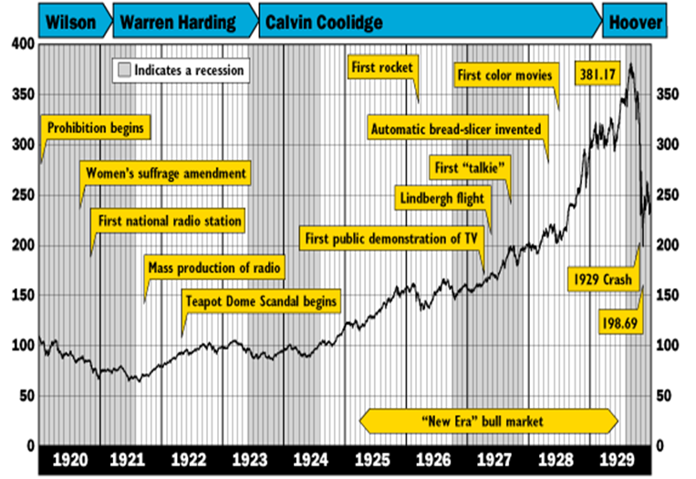
B. THE STOCK MARKET
1. MOST IMPORTANT CHARACTERISTIC SPECULATION & BUYING ON MARGIN
ECONOMY NOT STABLE
MERGERS → JOB LOSS MONOPOLISTIC PRACTICES
2. FARMER’S $273 PER CAPITA
WORKERS $681 PER CAPITA
WAGE DISPARITY
3. TRUCKING → RR
NATURAL GAS & PETROLEUM → COAL
SYNTHETICS → COTTON
ELECTRICITY → STEAM
SOUTH EXPANDING MFG AS NORTH LOSING MFG STATUS

Slide 8
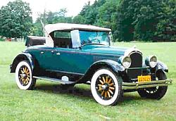
C. A – U – T - O
1. 2nd INDUSTRIAL REVOLUTION
1913 HENRY FORD - ASSEMBLY LINE
1925 75% BOUGHT ON CREDIT
1927 15 MILLIONTH MODEL T
CHRYSLER INTRODUCES COLOR & COMPETITION BEGINS
1929 AUTO MFG ACCOUNTED FOR 9% OF ALL MFG. WAGES
1930 60% OF AMERICANS OWNED CARS
2. IMPACT
DRIVE IN MOVIES, CAR DATES, TRIPS TO THE SHORE, HOTELS, MOTELS, HOLIDAY INN’S, RESTAURANTS, SERVICE STATIONS; JOBS GROWING EXPONENTIALLY BUT……….

